Slide 1

“When you pray, go to your inner room, close the door and pray to your Father in secret. And your Father, who sees in secret, will reward you.”
Jesus Christ, The Sermon on the Mount
Centering Prayer
Christian Contemplative Tradition

Slide 2
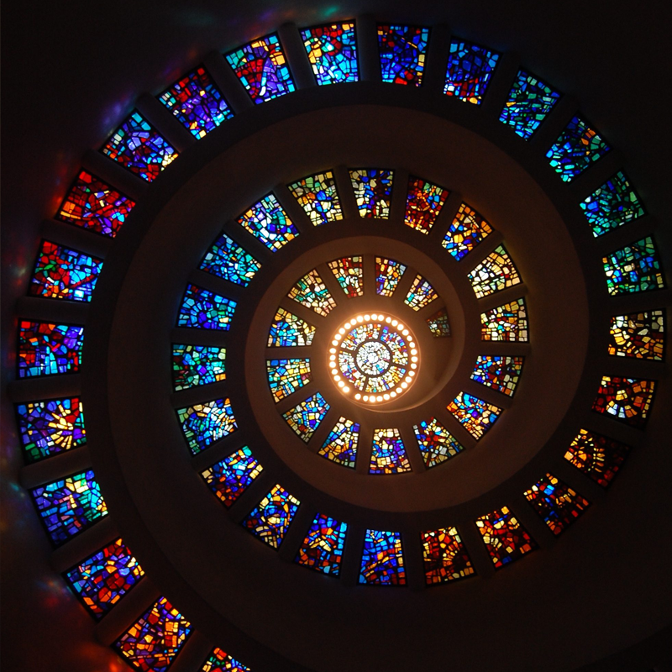
Meaning of Centering prayer
Centering prayer is the use of breath to focus inwards; to clear the mind of all thoughts and to rest in the Divine without words. It is the highest or purest form of prayer.
Centering prayer is a special method of contemplation in which the person simply attends to the presence of God within or at the centre of one’s being. A mantra or short phrase is sometimes repeated to keep one’s attention centred.
An example is the Jesus Prayer, which requests, ‘Jesus, son of God, have mercy on me, a sinner’ when repeated in a mantra.
In praying using centering prayer we are stilling the mind and body, calming the heart and opening ourselves to the presence of God.

Slide 3
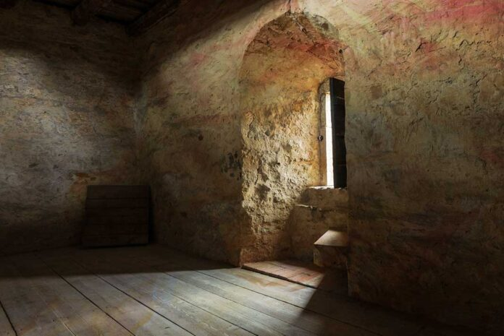
The origins of centering prayer
Centering Prayer is a simple Christian practice that helps us to locate and take refuge in our “inner room,” consent to the presence of God-in-2nd-person, and lead us into deep prayer, devotion, and contemplation of the divine. Largely popularized in recent decades by Father Thomas Keating, Centering Prayer traces its origin to the contemplative prayer of the Desert Fathers, the Lectio Divinia tradition of Benedectine monasticism, and to works like The Cloud of Unknowing and the writings of St. Teresa of Avila and St. John of the Cross. It endures to this day as one of the Christian tradition’s most powerful contemplative practices.

Slide 4
Goal is to quiet ourselves (thoughts, desires, imaginings) to cooperate more fully with the gift of God’s presence:
  Moves from more active styles of prayer (verbal, mental, affective) toward more receptive prayer of resting in God.
  Emphasizes prayer as personal relationship with God, fostered by regular practice of quiet peaceful contemplation. “Be still and know that I am God.” / “Be still and know that I am...” / “Be still and know…” / “Be still…” / “Be…” (Ps 46:10)
  Christian goal: deepen relationship to God through the grace of contemplation.
Why you might pray a centering prayer

Slide 5

How to practice praying a centering prayer
Take 20 minutes out of your day, and do the following:
  Choose a sacred word as the symbol of your intention to consent to God’s presence and action within (e.g. God, Christ, I AM, Love, Now, Faith, Amen, Father, Abba, Jesus, Lord, Saviour, Divine, Holy, Peace, Spirit, Hope etc.).
  Sitting comfortably and with eyes closed, settle briefly and silently introduce the sacred word as the symbol of your consent to God’s presence and action within.
  When you become aware of thoughts, return ever-so-gently to the sacred word.
  At the end of the prayer period, remain in silence with eyes closed for a couple of minutes, before returning to the rest of your day.

Slide 6
A Breathing Exercise to stillness
Close your eyes and let your body come to a quietness and stillness.
Listen to your breathing.
Breathe in slowly…
Breathe out slowly... (Repeat 3 or 4 times)
Practise breathing in through your nose and out through pursed lips. This is a special way of breathing when we meditate. Feel your breath as it comes in through your nose and as it passes over your lips.
Now, as you breathe in, count to four in your mind: In, two three four; and then blow out through your lips, out, two, three, four. You might pray as you breathe: Come Lord Je- sus.
Continue this pattern of breathing.
Now, discontinue your mantra. As you sit in stillness and silence, be prepared to wait as the Spirit of God surrounds you and rests with you and in you and by you, becoming part of you, even as you become part of the very pulse of the universe. Rest in God, even as God rests in you. There is nothing to do, but wait and rest in God….
When you are ready, come back to the present, take a deep cleansing breath and open your eyes.
You might wish to journal this experience, or to offer a prayer of thanks to God for the experience.

Slide 7

Explaining Centering Prayer

