Slide 1

But his delight is in the law of the Lord,
and on his law he meditates day and night.
Psalm 1:2
Christian Meditation
Stillness, Silence and Simplicity

Slide 2

Meaning of Christian Meditation
Christian Meditation is a way of becoming present to God and entering into a prayer of the heart. Christian meditation helps us enter into the actual experience of praying and enables us to fully attend to God while we pray. Christian Meditation is about being, rather than doing. When we pray through meditation, we move from mental prayer (prayer of the mind) to a deeper level, the heart (the prayer of the heart). It is an acknowledgement that the Spirit dwells within us and that we need to be quiet and still to listen to the Spirit. Christian Meditation requires Stillness, Silence and Simplicity (the 3 S’s) and invites the use and repetition of a prayer word or mantra. The word recommended to use is: ma-ra-na-tha, which means “Come Lord” or “Come Lord Jesus”. Repetition of the sacred word allows us to quiet our minds to make our hearts available to God. Above all, one can be assured that Christian Meditation is a meaningful and authentic way to pray.

Slide 3

The origins of
Christian Meditation
Christian Meditation is an ancient form of prayer that we are rediscovering in the western world. It dates back to the 3 rd and 4th centuries. At this time there were groups of Christian men and women who fled what they deemed an increasingly more distracting life and settled in the desert. They desired to live lives fully dedicated to God in prayer through solitude, simplicity and community. In the 4th century, St. John Cassian went into the desert of Egypt to sit at the feet of the Christian Hermits to learn about prayer and living an authentic Christian life. Eventually, he became a Desert Father and wrote instructions to his followers to repeat a mantra during prayer and throughout the day so that “one’s whole life becomes prayer”. Cassian stressed that this practice led to the silence of “pure” prayer, contemplative prayer where words and images are not used.

Slide 4
All people can meditate. Meditation deepens our personal relationship with God. It can initiate deep faith conversations that bring people closer to God.
• People have a natural capacity for contemplation and they are capable of experiencing the presence of God through prayer.
• Meditation leads to increased self-knowledge and self-acceptance.
• Meditation increases the desire to build community with others.
• People who engage in Christian Meditation often share it with others. For adults, this may mean sharing the practice with family, colleagues/classrooms and friends. Children who engage in
Christian Meditation at school often share their faith with their parents. They bring home their meditative practice and teach it to their parents and siblings. Thus, Christian Meditation can help bridge faith between home and school in a simple and experiential way.
• Christian Meditation offers an antidote to help balance the fast-paced digital world that we live in.
Why you might pray Christian Meditation

Slide 5

Explaining Christian Meditation

Slide 6
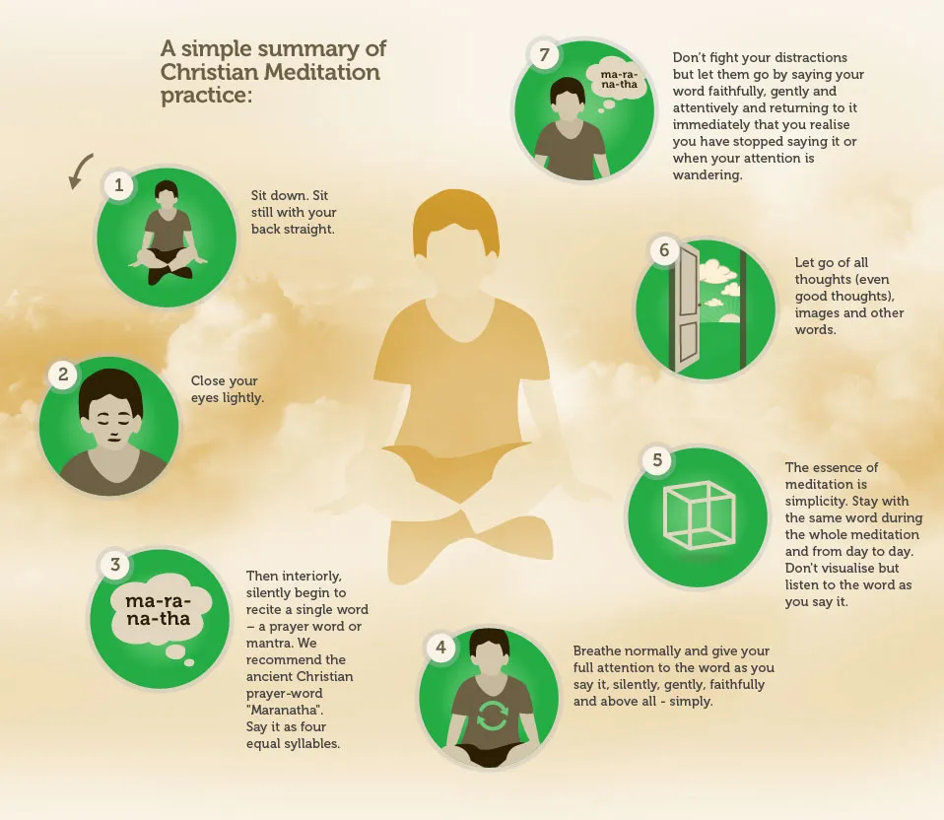
How to pray Christian Meditation

Slide 7
Leading a Christian Meditation Experience
Leader: Let us prepare to meditate
Sit on your chair. Sit with your back against the chair. Feel your feet on the floor. Gently close your eyes and come to stillness. Become aware of your breathing. Notice the pattern as you breathe in and out. Slow and listen to your breathing.
Breathe in... 1, 2, 3, 4.
Breathe out... 1, 2, 3, 4.
Continue until you have come to readiness to meditate.
Meditation
Sound a chime 3 times. Let us begin to meditate.
Let us say MA RA NA THA together 5 times.
Now slowly and carefully say the word MA RA NA THA in your mind. Listen to the word.
Breathe in on the MA RA breathe out on the NA THA.
When you think about other things come back to this word and say it again and again.
Silence (Decide on a time that you believe the participants are ready to meditate for. Begin with a few minutes and gradually increase the number of minutes across time.)
Sound the chimes to signal the end of meditation.

Slide 8
Be still and know I am God
Be still and know I am
Be still and know
Be still
Be

Slide 9
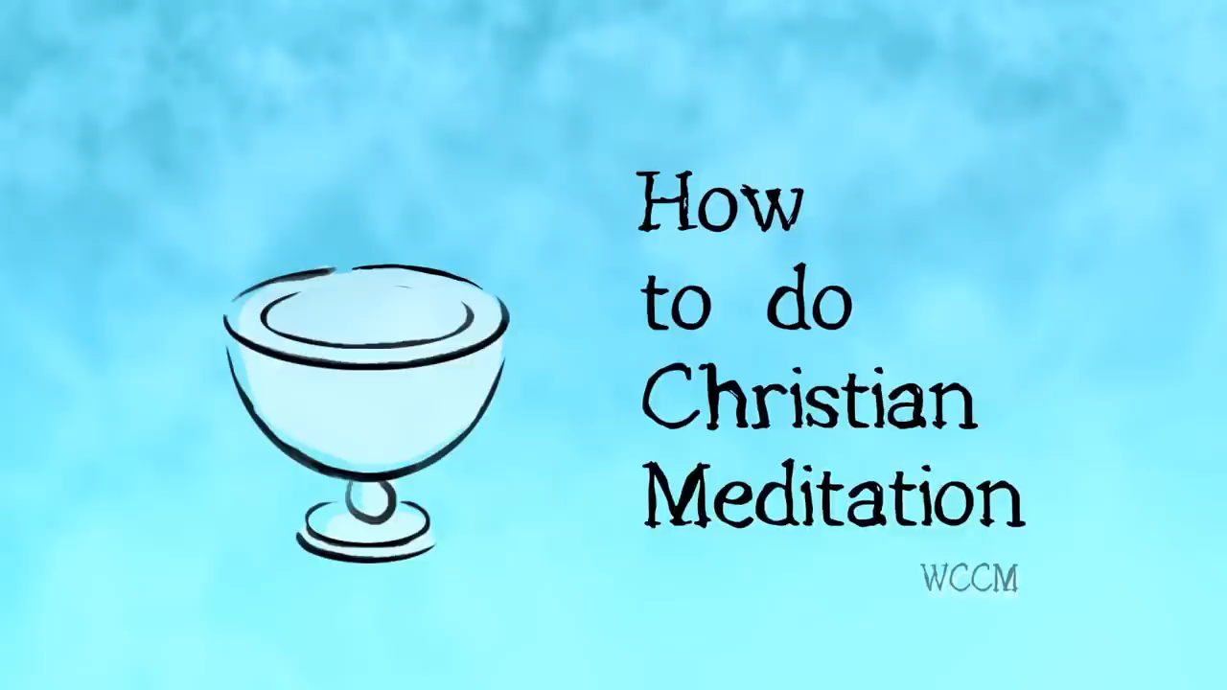
Video: How to do Christian Meditation

