Slide 1

‘Imagining Christ Our Lord before me on the cross… asking how it came about that the Creator made Himself man, and from eternal life came to temporal death, and thus to die for my sins. Then, turning to myself I shall ask, what have I done for Christ? What am I doing for Christ? What ought I do for Christ?’
St Ignatius of Loyola, Spiritual Exercises
Ignatian Contemplation
Imaginative Prayer

Slide 2
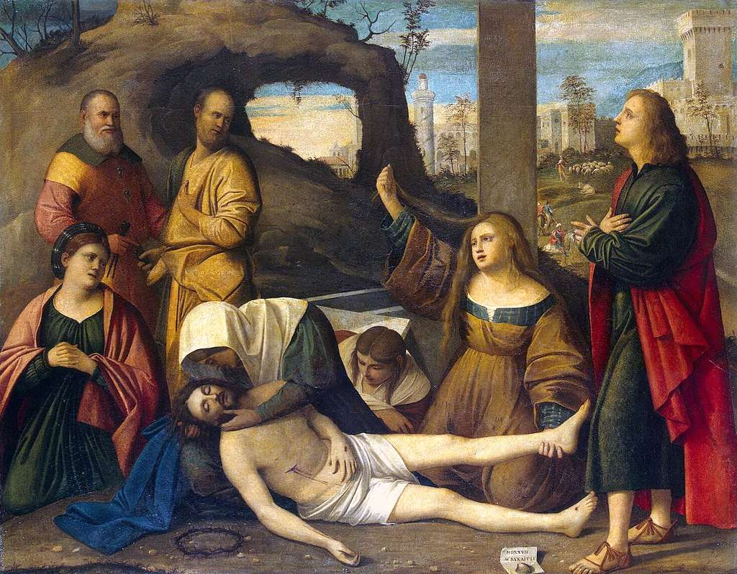
Meaning of imaginative contemplation
Imaginative contemplation is all about getting to know Jesus. It is a method of prayer in which you imagine yourself as present in a Gospel scene, stepping into the story and encountering Jesus there. It was St Ignatius' firm belief that God can speak to you just as clearly in your imagination as through your thoughts. This way of praying will help you to see more clearly, love more dearly, and follow more nearly the person of Jesus Christ.
The idea that God can speak to people through their imagination can seem a bit strange. Isn’t this just making things up in your head? On the contrary, the imagination is foremost a gift from God in the same way that a person’s intellect or memory is a gift from God. Christianity is clear that God speaks to people through the scriptures and the sacraments, through daily experiences and their emotions. If God can do all of these things, He can speak through the imagination too.

Slide 3
St. Ignatius believed that God intended for the human imagination to draw us closer to him. He was well aware that the imagination can just as easily separate us from God, of course. But imaginative prayer is different from idle daydreaming in two ways:
  It is powered not just by our imagination, but by the Holy Spirit working through our imagination.
  It is rooted in a sacred text, usually the Gospels.
In imaginative prayer, the same Holy Spirit who inspired the authors of the Gospels also “inspires” (literally “breathes into”) our imaginations in a way that draws us closer to Christ. Prayer is a conversation with God; imaginative prayer creates a space for that encounter.
The heart of imaginative prayer, then, is to “meet” God, usually in the person of Jesus, in a personal way.
Why you might pray with imaginative contemplation.

Slide 4
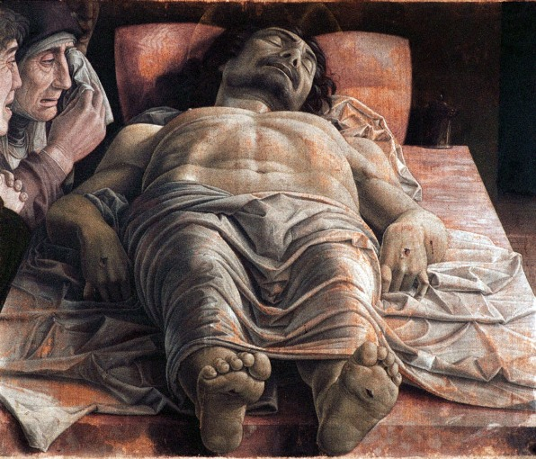
The origins of Imaginative contemplation
People have always used their imaginations in prayer, but the method of imaginative prayer outlined here was popularized five hundred years ago by a Spanish nobleman named Iñigo Lopez de Oñaz y Loyola, better known today as St. Ignatius of Loyola. St. Ignatius and some companions founded the Society of Jesus (the Jesuits) in 1540. A former soldier, he developed a spiritual “training manual” for the members of this new religious order. It was in this manual, the Spiritual Exercises, that St. Ignatius outlined his approach to imaginative prayer. He called this approach contemplative prayer, but because this term has a different meaning in the rest of the Christian tradition, here we will continue to call it imaginative prayer.

Slide 5
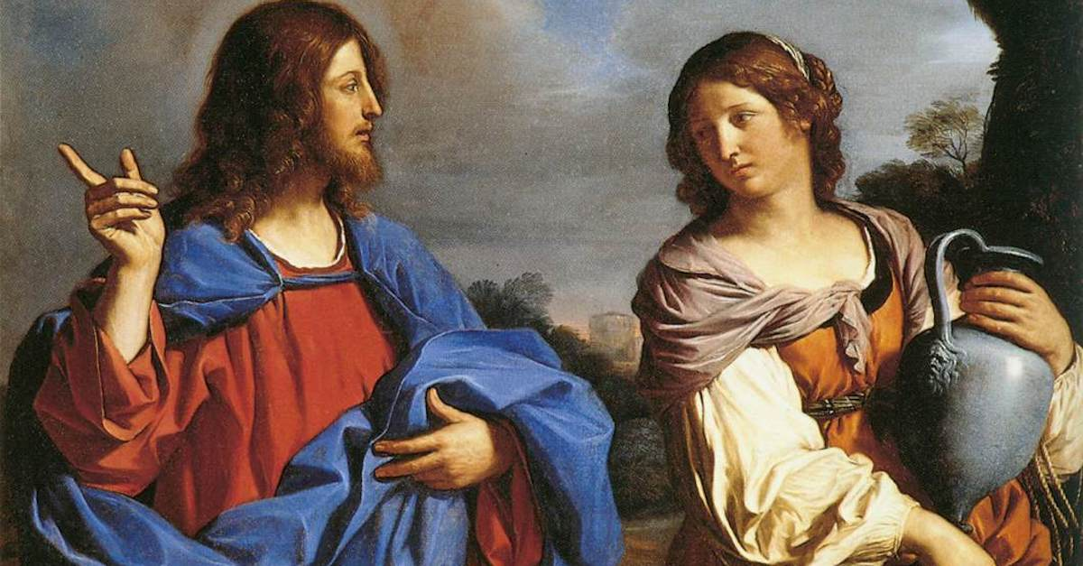
How to practice imaginative contemplation
1. Choose a Scripture passage
First, choose a suitable Scripture text.
While imaginative prayer can be used with any sacred text (including stories from the lives of the saints), St. Ignatius recommended contemplating scenes from the Gospels; they are the primary texts in which we encounter the Son of God “in the flesh.”
You can find a list of good readings for imaginative prayer in the book Imagine You Walked with Jesus, or at gracewatch.org/imagine.

Slide 6
2. Prepare with prayer
Rather than diving right into the Scripture or other sacred reading, St. Ignatius suggests we first prepare ourselves. Find a quiet and comfortable place to pray and take a few moments to settle in. Then, take a few moments to pray along these lines:
Begin by becoming aware that God is already here waiting for you. Rest in his loving presence.
Then, respond to God’s loving presence by giving yourself over to him. Pray that you might love and serve him in all your thoughts, words, and actions.
Prayer is fundamentally an expression of our relationship with God. When we begin by acknowledging God’s availability to us, and by making ourselves available to God in return, we situate everything that happens next within that relationship.
3. Read the scripture
Next, read the Scripture passage at least once.
You may wish to ask the Holy Spirit to help you to read the text prayerfully. Given the amount of reading most of us do online, you may be in the habit of skimming the text rather than ruminating on the words. Try to slow down; the Gospels were written slowly and intentionally. Each word and phrase, and each omission, was chosen for a reason. Stay with the words and see what they serve up.

Slide 7
4. Set the scene
After you have read the story at least once, use your imagination to set the scene. Be as specific about the details as possible, engaging all your senses: touch, smell, sound, sight…even taste, if the opportunity arises. Make the Gospel story come vividly to life, almost as if you were directing a movie. The Son of God chose to save us not merely with a word from heaven, but by becoming the Word-made-flesh at a specific time and place in human history. In imagining the Gospel in its physical setting, we honor the reality of Jesus’ incarnation, and set the stage for encountering him “in the flesh” ourselves.
Here are some things to consider as you set the stage for your imaginative prayer experience:
Who are you in this story?
What time of day is it? What is the weather like?
What do you see around you?
Who is present? What do they look like, and what are they doing?
What ambient sounds do you hear?
How do you feel? Hot? Hungry? Tired?
What do you smell?
Above all, be sure to pay attention to Jesus. What does he do? What does he look and sound like?

Slide 8
5. Walk with Jesus
Once you have “composed” the setting of the story, put aside the text and let yourself enter into it. This is the body of your imaginative prayer, so take as much time here as you need.
Before stepping into the Gospel, St. Ignatius advises that you pray for what you most desire from this encounter with Jesus.
Next, enter the Gospel, letting the action of the story unfold by itself under the direction of the Holy Spirit; do not actively direct or force the actions of the main characters. Your role is to participate in the action of the story in whatever way seems natural.
Finally, as you step out of the Gospel story, speak to God directly. St. Ignatius refers to this as a “colloquy,” or a spiritual conversation. He invites us to share our thoughts, feelings, and desires with God much as one friend would speak to another.
St. Ignatius advises that we close our time of prayer with the Lord’s Prayer; you might substitute another formal prayer that you like, such as the Glory Be or a simple Sign of the Cross. The point is to punctuate the end of this special time with Jesus.
6. Reflect on the Journey
After you are finished praying, spend some time reflecting on your encounter with Jesus. You can do this immediately after your prayer, or as you go about the rest of your day. You might record your reflection in a journal or notebook, or share and discuss your experience with your prayer group or a spiritual director.

Slide 9
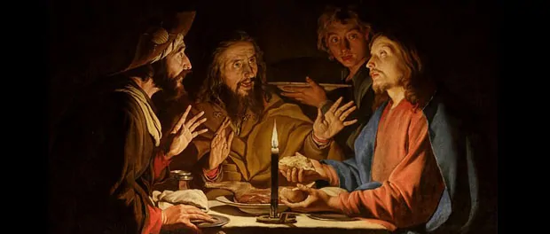
Example
This imaginative prayer exercise is based on Luke 24:13-35, the story of the disciples on the road to Emmaus.
It’s a long walk home from Jerusalem, but you’re glad for the exertion. The physical work of walking might ease, just slightly, the harder work that’s going on inside you today.
It is the work of grief. You lost a friend just a few days ago. Not only a friend, but your leader, your beloved teacher. And he didn’t simply die; he was executed in the most torturous, shameful way. You’ve seen a lot in your lifetime, but the memories of Jesus’ ordeal are forever branded into your memory. You close your eyes and see blood; you go to sleep but dream about someone suspended, gasping for air.
At least your friend is with you—both of you followed the teacher, with equal conviction and enthusiasm. So you bear your grief together now. As you walk and walk through the long, rainy afternoon, you encourage better memories—of all that the teacher said, of the people you know whom Jesus healed. You can’t seem to stop talking, although several times one or both of you must stop talking because you must cry for a while.
The stranger joins you while you are still several miles from home. Within moments, it’s clear that this person has no idea what has been going on in Jerusalem. With great heaviness and some annoyance, you fill in the barest details for him. All you have to say is “crucifixion” and anyone in Roman territories knows exactly what you’re talking about.
But the stranger engages in the conversation with great energy. He must be some kind of teacher, because he launches into an explanation of how Jesus’ fate is actually a good thing and the proper fulfillment of what was predicted long ago. This is fascinating—you and your friend are all ears. Before you know it, you’ve arrived at your home and it’s getting dark.
You invite the stranger to have supper with you and spend the night, rather than risk injury or other misfortune while on the road at night alone. Also you want to hear more of what he has to say. He graciously accepts your offer.
The first thing you do upon entering the house is prepare the evening meal. The three of you sit down to eat. Then the stranger takes the bread and blesses it. You feel a strange energy move through you and hover in the room.
Where have you heard this sort of blessing before?
The stranger hands each of you a piece of the bread. You take it, and memory washes over you—of a hillside with thousands of hungry people. Of a few loaves and fishes being transformed in an instant to miraculous abundance.
Suddenly, it is clear who this man is, eating at your table. You look into his face.
What do you see? What is his expression? What do you feel? What do you know in the truth of your heart?
Your friend has barely gotten the words out—“Why, it’s the Lord!”—when the stranger vanishes.
The room still feels strangely warm, and there are waves of that energy, like lightning sparking all over the room. You and your friend stare at one another, and finally you say, “Weren’t our hearts on fire when he explained the Scriptures? Didn’t we know something even then—we just couldn’t identify it?”
You finish your meal—what a healing pleasure to eat the bread blessed by those hands! But then you look at each other and know what you must do. You head back to Jerusalem. You have to tell Jesus’ other followers who are still there in the city.
What is your conversation like on the way back?
You are traveling at night—something you never do, for safety’s sake. What does it feel like to be on the road at such a strange hour?
What thoughts keep running through your mind on this journey?
How has your perspective changed, now that you have met the resurrected Jesus?

Slide 10
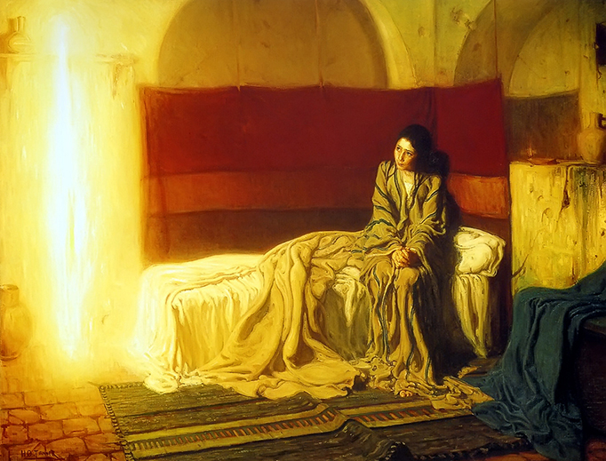
Example
Imaginative Contemplation: Luke 1:26-38
Picture, in your imagination, the town of Nazareth. It doesn’t need to be historically accurate – just whatever you think this town might look like in the story we just heard. Picture the buildings – how high are they? Picture the streets – are they wide or narrow? Are they dirt or are they paved with stones? What are the homes like in this town – what might the layout look like?
Now focus on one home – this is Mary’s home. Where is it in the town – on the outskirts or more in the center? What is this home like – what does it look like inside – is it spacious or more cozy? Is it partially open to the air or more closed in with full walls? Perhaps there’s a courtyard or some outdoor space somewhere. Spend a few moments really seeing and being in this home.
Who lives in this home besides Mary? Parents? Grandparents? Siblings? Aunts, Uncles, cousins? What does it sound like during the day – are there many voices or few? What are people doing – working, playing, relaxing, cooking?
Where is Mary? What does she look like when you see her? She is a young woman, in her teens, just past puberty. See her face, her eyes, her hair, her clothes. What is she like?
And what is she doing? Perhaps she’s playing a game with siblings and cousins, or maybe some chores around the house, or maybe she has been resting or sleeping, depending on the time of day. Whatever she is doing, she’s now paused and finds herself alone for a moment.
See the moment when the angel Gabriel appears to Mary. Watch her as she reacts to his greeting. The angel says, “Do not be afraid, Mary, for you have found favor with God.” Listen as he delivers the rest of his message – don’t worry if you don’t remember it verbatim. Notice Mary’s response, and notice your own.
Is there anything that the Angel or Mary has said that stands out for you in particular? Something that moves or troubles you? A message that resonates for you personally?
Have you ever felt something was impossible, and later discovered that nothing is impossible for God?
Before you close your prayer, spend a few moments in conversation. You might want to talk with Mary about your prayer, sharing your thoughts and feelings with her and listening to what she has to say in response. Or, you might consider talking with God about it all.
When you are ready, close with a favourite prayer.

Slide 11

Explaining Imaginative Contemplation

