Slide 1

““Meditation is above all a quest. The mind seeks to understand the why and how of the Christian life, in order to hear and respond to what the Lord is asking.”
Catechism of the Catholic Church, 2705
Walking Meditation
PRAYING WITH A LABYRINTH
mcgrath.nd.edu/resources

Slide 2
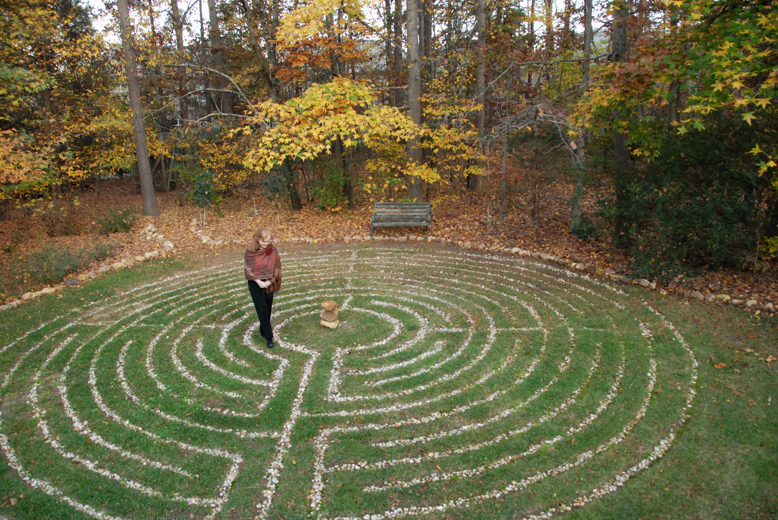
Meaning of labyrinth
Praying with a labyrinth is a form of walking meditation, a physical expression of the interior journey towards Christ that characterises all Christian meditation.
Like a pilgrimage, forms of walking meditation evoke our earthly journey towards heaven while simultaneously giving us time and space to listen and respond to the Lord.

Slide 3
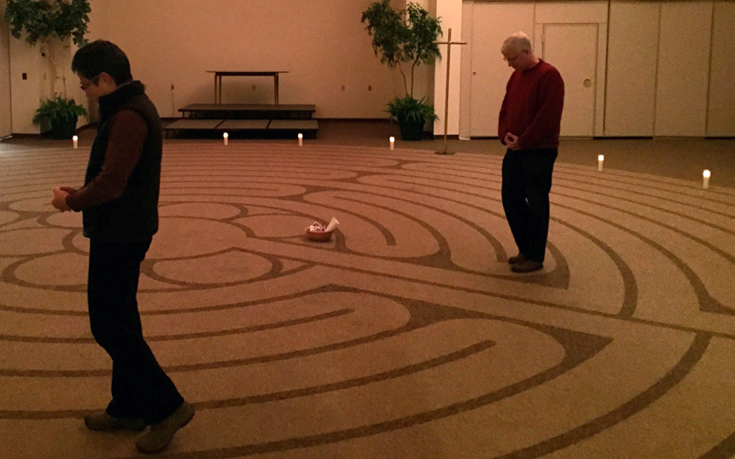
The origins of labyrinths
The earliest examples of labyrinths go back nearly 5,000 years, but the use of labyrinths in Christian prayer emerged during the Middle Ages. The most famous example of a Christian labyrinth intended for prayer is the stone labyrinth inlaid on the floor of the Chartres Cathedral in France. However, you can find prayer labyrinths in most areas of the country, from abbeys and monasteries to the campuses of Catholic parishes and colleges.

Slide 4
Where we pray affects how we pray. Most of the time, we seek to pray in places of quiet and stillness. At other times, taking a walk or simply being outside helps us pray. Although we can embark on a walking meditation nearly anywhere, the predictable and concentrated route of a labyrinth frees us from the inevitable distractions that come with being out for a walk (like recalling directions or wondering when to turn back). If being outdoors makes you feel closer to God or if pilgrimage has been influential in your spiritual life, then praying with a labyrinth might be a helpful practice.
Why you might pray with a labyrinth

Slide 5
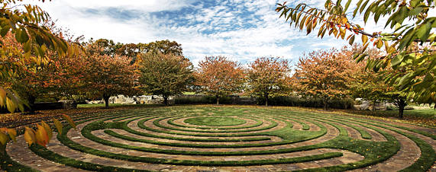

How to pray with a labyrinth
Find a labyrinth
Scriptural preparation
Look for a prayer labyrinth in your area. If you can’t find one nearby, you still have options. You can also use a finger labyrinth printed on an A4 or A3 piece of paper.
The key is finding a place where you will be relatively undisturbed either by other people or the need to make decisions about the direction you are heading.
Consider reading a passage from Scripture to set your mind on God’s accompaniment with you during this short pilgrimage of prayer. There are many possibilities, but here are a few to get you started: Deuteronomy 1: 31, Exodus 13: 21-22, Isaiah 42: 1-9, Luke 24: 13-35.

Slide 6

Steps of Praying with a Labyrinth
Name your intention
Since we embark on a walking meditation in order to hear and respond to the Lord, invite God to walk with you during this prayer period. Ask for the grace to hear and respond to him. If you have any particular intentions on your heart, name them to God at this time and tell him that you will carry these intentions with you during the walk. This can occur using your finger labyrinth as well.
Walk the path (with your feet or finger)
Enter and follow the path of the labyrinth, knowing that God is with you. Go at a pace that feels natural. As you move along the path, notice what is happening in your mind and heart. There is no agenda to this prayer. Rather, let your prayer unfold as you go and trust in God’s guidance. If your mind wanders to thoughts that seem like distractions, name the distraction, lift it up to God and ask God to guide your mind and heart back to him. If the distraction returns, explore it with God.
Give thanks
When you reach the center of the labyrinth, thank God for having walked with you along the way.
Reflect
Afterwards, take time to reflect on your walking meditation. Write down your thoughts, feelings or anything else that you experienced. If something from these recollections stands out to you, consider exploring it at another time in prayer or in spiritual direction.

Slide 7

Example
Praying with a Finger Labyrinth
• Find a comfortable place where you can sit and welcome peace.
Pray: Lord, here I sit inviting your presence.
• Slowly glide your finger through the labyrinth path using your non-dominant hand, allowing for free-flowing unedited thought. Open to the Holy Spirit’s gentle guidance, permitting the awareness that God is near, and trusting that Jesus will always care for you, enter into peace.
• While your finger is in the center of the labyrinth,
reflect on your thoughts…
• …remain in the center for a moment and pray your
heart.
• When you have laid bare your heart before God, return to the beginning of the labyrinth. Return gratefully…return prayerfully…return reinvigorated.
• As you exit the labyrinth, sing praises, speak words of thanks: Glory to God in the Highest (repeat), Jesus you are my Saviour and Redeemer (repeat), Holy Spirit my Comforter and Sustainer (repeat) from everlasting to everlasting (repeat).

Slide 8


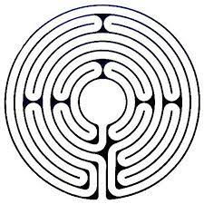
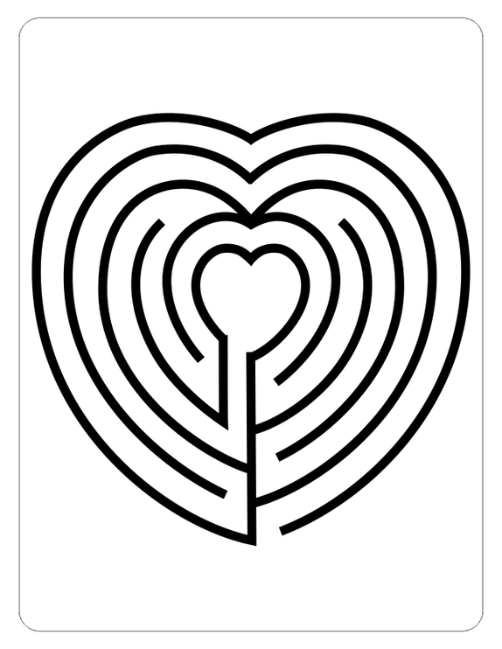



Slide 9

Explaining a labyrinth
Labyrinth Journey App

