Slide 1

“Christian iconography expresses in images the same Gospel message that Scripture communicates by words. Image and word illuminate each other”.
(CCC 1160)
Praying with Icons
Windows into heaven

Slide 2
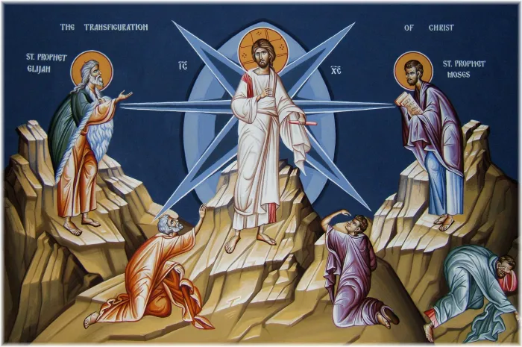
Meaning of praying with icons
The word icon simply means image. A religious icons is considered to be a soul window, an entrance into the presence of the Holy.
Icons serve as invitations to keep eyes open while one prays. It is prayer to just look attentively at an icon and let God speak.
The profound beauty of an icon is gentle. It does not force its way. It asks for time spent before it in stillness….gazing. More importantly it invites the one praying to be gazed upon by it.
One is invited to enter into the icon and come closer to the Holy One portrayed. Icons are a reminder of God’s unconditional love.

Slide 3
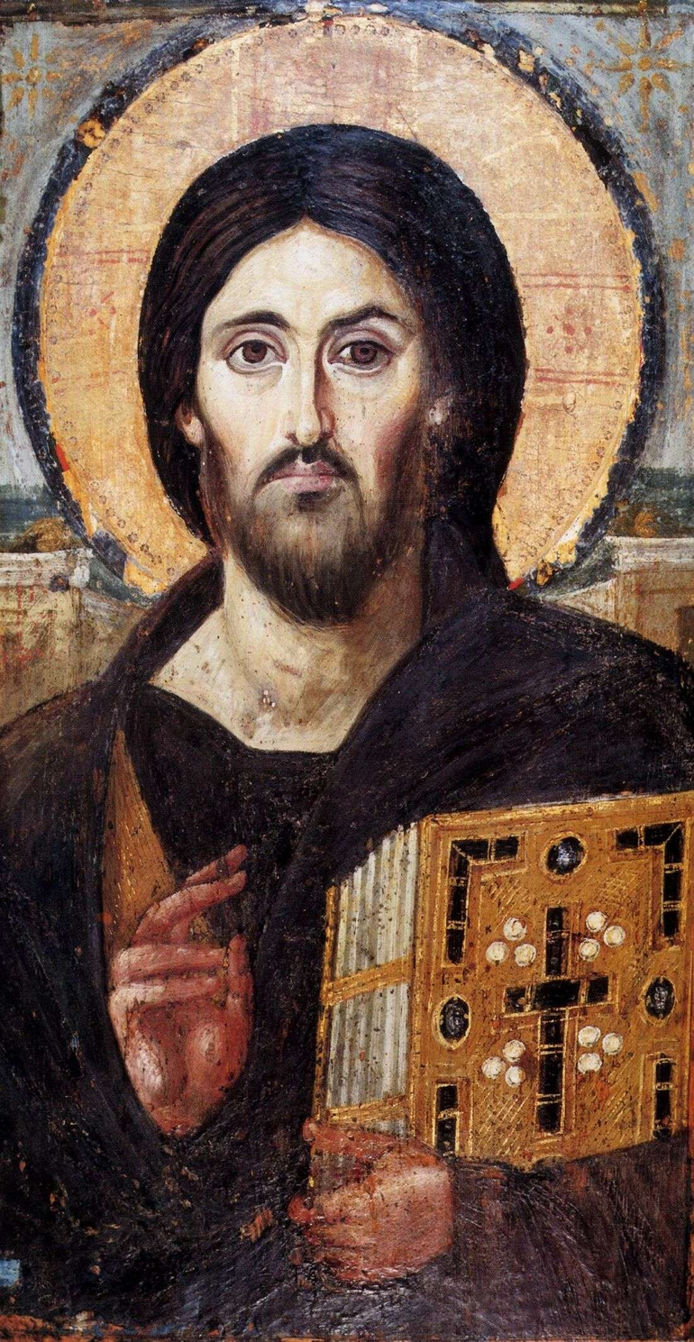
The origins of praying with icons
Iconography is the original tradition of Christian sacred art, and has been an integral part of the worship and mystical life of Christians since apostolic times.
Referred to in the Eastern Christian tradition as "windows into heaven," they have inspired and uplifted millions of the faithful, and have at times been the instruments for demonstrating God's miraculous intercession in the life of mankind.

Slide 4
We do not pray to icons, but we may pray through them. The icon functions as a tool for recollecting the mind and heart and settling into the nearness of God (whether felt or unfelt). On the most basic level, icons help us to remember who we are, and to whom we pray. The sense of meeting the iconic gaze, there is the deeper/more contemplative sense of actually meeting the divine presence through the material medium of the icon.
Someone once described contemplative prayer as “I look at God, and God looks at me.” When gazing into the eyes of Christ as presented in an icon, take advantage of a beautiful, material aid to prayer that invites you into that very I-thou experience.
Why you might pray with an icon

Slide 5
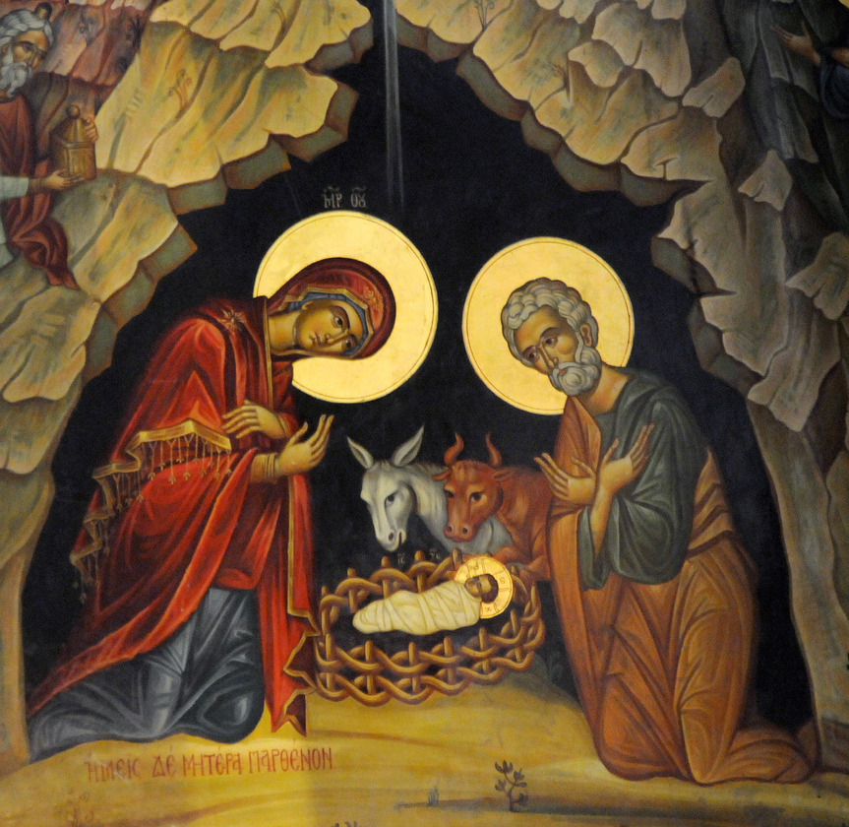
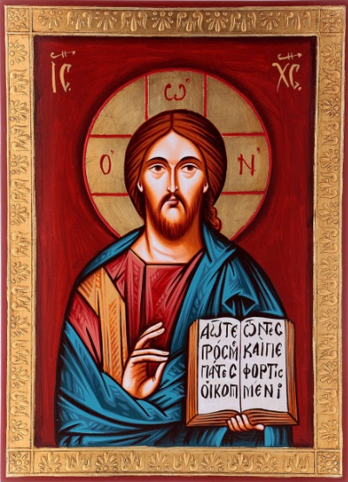
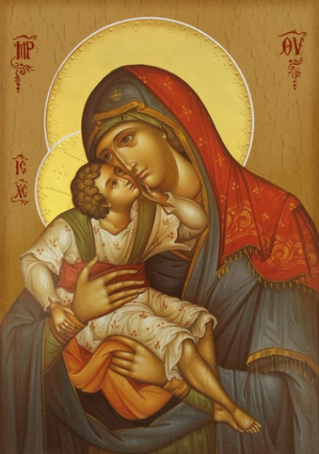
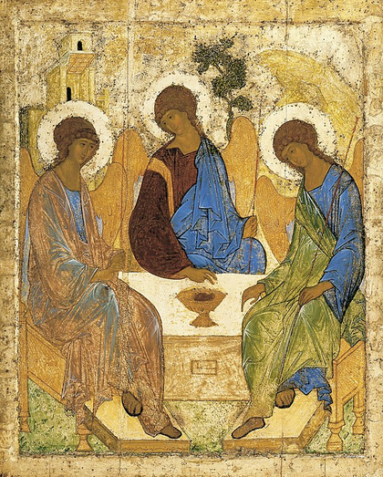
There is a wealth of symbolism in icons.
  For example, the halo around the head of a Saint denotes the light of Christ shining from within
.
  A blue garment indicates humanity and red indicates divinity. Thus, Christ has a red undergarment and a blue outer garment, because He is divine and put on humanity.
  Mary, on the other hand, has a blue undergarment and a red outer garment, as she was human but she became divine by bearing Christ.
  Buildings in icons cast no shadows, since shadows indicate sun passing through the sky; the icon picture is meant to have a spiritual, timeless quality.
  The monogram IC XC is composed of the first and last letters of Jesus Christ in Greek (iota and sigma meaning “Jesus” and chi and sigma meaning “Christ”). The sigmas are both rendered in “C” form, resulting in “IC XC.” This monogram is commonly written on icons of Christ near His halo to identify Him. It sometimes appears in the phrase “IC XC NIKA,” meaning “Jesus Christ Conquers.”
  The letters traditionally written on the cross in Christ’s halo are a reference to the name of God revealed to Moses during the burning bush episode (Exodus 3:14). This name was “I am” or “I am that I am.” So this reminds us that Jesus is “The One who is God.”

Slide 6
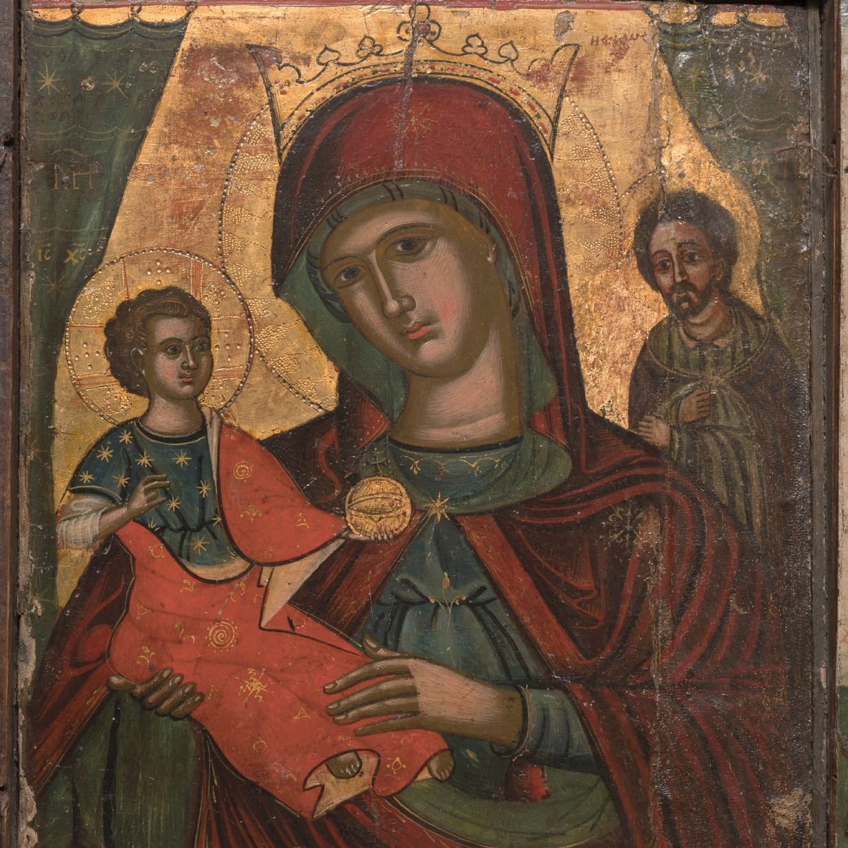
How to practice praying with icons
First of all, find an icon of Jesus, Mary, or one of the saints. If possible, light a candle or burn some incense nearby. This can further enhance the atmosphere of prayer, engaging all the senses. Then, simply gaze at the icon.
Many spiritual writers explain that praying with icons is a receptive experience, where we gaze into heaven and allow God to touch our heart.

Slide 7
  It is important to simply look at the icon and notice the various details and colours. An icon is often called a “theology of colours” and can teach us a great deal about the Christian faith. Everything in the icon is symbolic and points to some spiritual truth about God. If the subject of the icon is a saint, there are typically various symbols that create a “spiritual portrait” of the saint, reflecting attributes or events that contributed to the person’s holiness. The gold background is a reminder of the presence of God and his uncreated light. It is an invitation to enter his presence and be taken up into a spiritual realm of beauty.
  Listening is an important part of praying with icons as it allows us to hear the word of God and what he desires to speak to us. It reinforces the reality that prayer is essentially a conversation where we deepen our love of God.
  When looking at the icon, remain silent and still and recognise where your eye is drawn. What effect does the color have on you? What feelings does the icon stir up?
  Notice the eyes of the individual in the icon. Often the eyes are looking back at us. Let the eyes of Jesus, Mary, or one of the saints penetrate your soul. What are they trying to tell you?
  Take as much time as you need with the icon. At first, try spending 10 or 15 minutes with the icon. This type of prayer requires a contemplative heart, one that slows down, taking a break from the fast-paced society that we live in.
  After sufficient time has passed, thank God for the opportunity to be with him and store the icon in a suitable place. Praying with icons can be a beautiful experience, one that can be repeated each and every day.

Slide 8
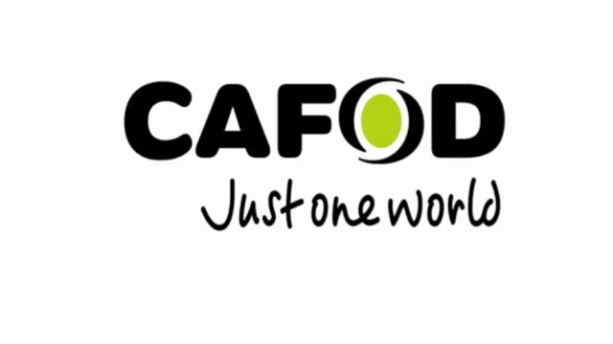
Example: FEEDING OF THE FIVE THOUSAND ICON
Christ’s outer blue garment signifies the contemplative, yet earthly aspect of his being.
The red garment symbolises Christ born of Mary, through the Holy Spirit.
Over his arm, a striped stole represents the Priesthood of Christ.
Each part of the cross in Christ’s halo has one bar on one side and two bars on the other.
The single bar represents his one person as truly God and truly man.
Two bars represent his two natures: fully God and also fully human.
The letters are a shortened form of “I am who I am” - the words God spoke to Moses in the burning bush.
Christ’s hands are covered as he offers the loaves and fishes to his Father. This symbolises the Eucharist, and a blessing for the miracle of the multiplication of the loaves and fish.
Peter stands in front of Christ; his hands are also covered, ready to receive the holy offering.
Andrew collects loaves in baskets behind Jesus, while other disciples share the food out among the crowd. “They all ate as much as they wanted, and they collected the scraps left over, twelve baskets full.”
The trees, plants and flowers represent the life-giving Spirit that pervades all creation, is present in and fills all things, including the Eucharistic Bread.
The birds, as the psalmist says “look to You to give them their food in due season” - they are ready to feed on the crumbs and sing praises to the Lord!
In icons, mountains represent the Lord’s presence. The distant mountain is where Jesus spoke with Elijah and Moses and became transfigured.
Influenced by Byzantine hymnology we can pray: By your feeding of the five thousand in the desert, grant us a readiness to share the goods you give us.
By your strengthening the hungry and giving life to the weary, strengthen us to share your
life with others.
By your raining down manna in the wilderness for your wandering people, rain down your
manna of good will for a fair distribution of food among all peoples.
By your giving us life in the Eucharist strengthen us to take and give your life to others and
those less fortunate than ourselves.
And we give glory, praise and thankfulness for your merciful compassion and care for all
peoples of the earth.
Prayer and icon by Sr Esther of the Benedictine Community in Turvey, Bedfordshire and donated to CAFOD to support the Hungry for Change campaign
Explaining praying with an icon

