Slide 1

"It can have lengthy entries or short notes. It can be cute or plain. There’s a lot of ways to do it, and none of them are wrong, as long as they aid in reflecting on God’s love."
Faith Noah
Spiritual Journaling
Personal record of time spent in prayer.

Slide 2
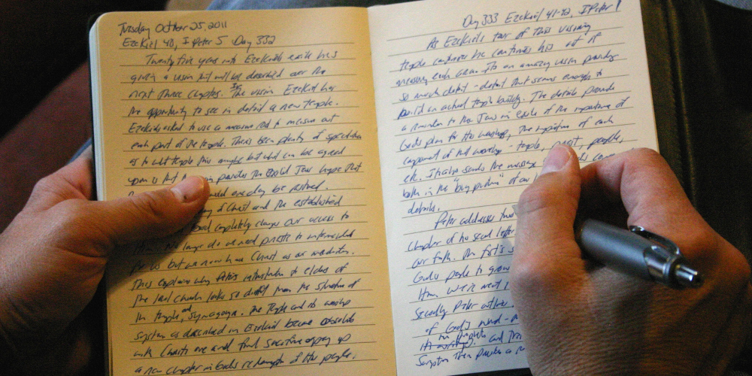
Meaning of spiritual journaling
Simply put, a spiritual or prayer journal is a place (like a notebook or binder) where you keep track of your prayers. These prayers can be prayer intentions, standard prayers that you like, prayers that you have created, Bible passages that have touched you that you want to use in prayer, quotes related to prayer, or things related to prayer that have touched your heart.
Keeping a spiritual journal can be a means of deepening our relationship with the Lord. By jotting down our thoughts, insights and emotions, we “remember” them, and they become a source of review when determining where we’ve been and where we’re going in the spiritual life.

Slide 3

The origins of
spiritual journaling
There’s always been a special place in the Catholic Church for the keeping of spiritual journals. Some of our most beloved saints, including St. Therese of Lisieux (her journal was published as The Story of a Soul) and St. Ignatius Loyola (whose journal became the Spiritual Exercises), kept spiritual journals.
Closer to our own time, Pope John XXIII kept a personal journal from when he was a teenager until he died, and Pope John Paul II’s personal notes are also soon to be published in English.
These journals were originally meant to be simply dialogues between individual souls and God; but they continue to be a source of inspiration and encouragement to millions of people who can grow and learn from these revelations of great saints’ interior lives.

Slide 4
“Habits serve us,” observes Katie Dawson, director of evangelization and parish faith formation for the Diocese of Orange. “Establishing a rhythm in our lives that includes prayer through journaling can help us keep track of where God has been showing up in our life.”
Dawson says journaling is best when it is rooted in each day’s Scripture readings. “Prayer journals force us to notice what speaks to us in those readings, showing us where God is speaking to us, challenging us, or consoling us.
“What people who persistently journal find is that they can discern the presence of God using their journal,” she says.
Writing about life’s challenges and re-visiting that writing later helps us to gain clarity in our relationships with God, ourselves, and others, says Father Dairo Diaz. “Over a period of time, patterns of acting, relating, and thinking all emerge as tools for self-understanding,” Fr. Diaz writes. “We begin to see evidence of God’s work in our lives, reminding us of our inner beauty and gently confronting our limitations.”
A prayer journal shows the journey of the heart. In a prayer journal, we pour our hearts out to God, we pray for others, we contemplate who God is, and we learn more about waiting on God’s timing.
We can learn to grow in faith, love, and trust of God.
Why you might pray using journaling

Slide 5
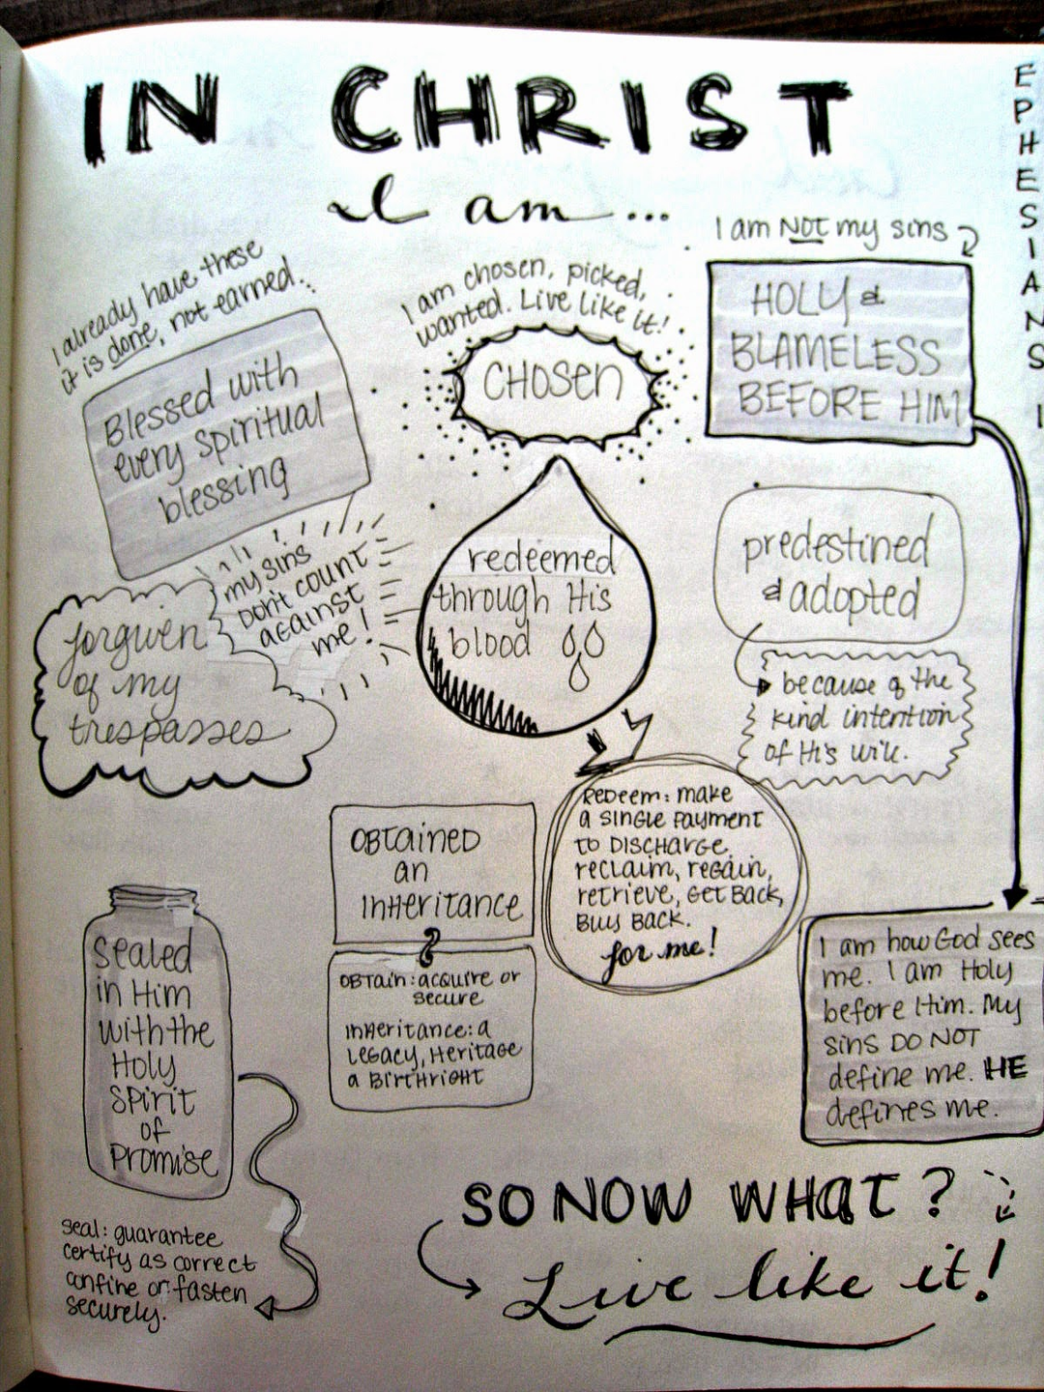
How to use a journal in your prayer life
A prayer journal should feature the following aspects:
  Thanksgiving: Aim every day to reflect over your day and record what you're grateful for.
  Prayer Intentions: Record each day what you're praying for; consider who or what situation needs your prayers.
  Prayer Goals: Record which prayer practices you'd like to pay attention to and then record whether you've achieved your goal. e.g. going to bed on time.
  Free-Form: Fill in the blank pages with whatever the Spirit puts into your heart.

Slide 6
A response to meditation or a time of prayer
  A spiritual prayer journal can be used to respond to meditation or a time of prayer. It works in well with other forms of meditation like the Examen or Praying in Colour.
  Any form of notebook or school exercise book - plain or decorated - can be used as a prayer journal.
  The response to prayer can be recorded by writing words, sentences, poetry or in drawings.
Some possibilities for ‘sentence starters’ include:
  God, today I would like to tell you about...
  Gracious God, I would like to thank you for…
  Listening God, sometimes I find it really hard when
  Ever Present God, I ask you to help…
  Loving God, today I feel…
  Caring God, sometimes I feel afraid that…

Slide 7
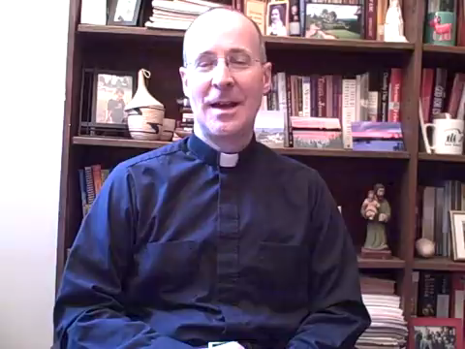
Explaining Spiritual Journaling

