Slide 1

“Authentic Christian art is that which, through sensible perception, gives the intuition that the Lord is present in his Church, that the events of salvation history give meaning and orientation to our life, that the glory that is promised us already transforms our existence. Sacred art must tend to offer us a visual synthesis of all dimensions of our faith”.
St. John Paul II, Veneration of Holy Images, no. 11
Visio Divina
How to practice visio divina, pray with Art

Slide 2
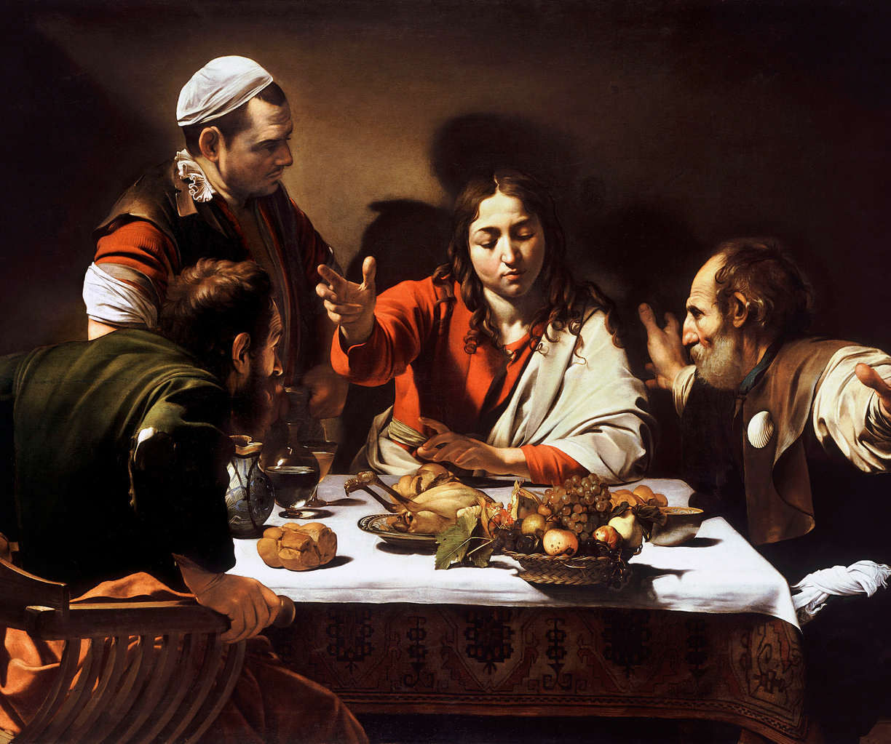
Meaning of visio divina
Visio Divina is translated as “divine seeing”. It is related to the prayer form Lectio Divina (divine reading), but instead of Scripture, this form of prayer uses visual elements to help set your mind on prayer.
It allows God to speak into your heart through the image.
The visible makes the invisible present in a palpable way.

Slide 3
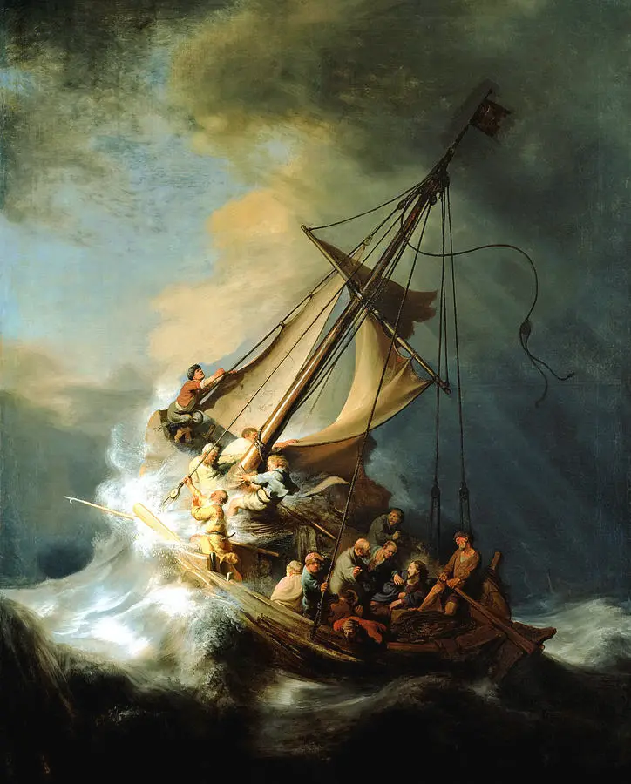
The origins of visio divina
This form of prayer has been used throughout the centuries, more popular in Catholic and Eastern Orthodox communities where icons are often used in prayer.

Slide 4
Visio Divina invites us to see at a more contemplative pace. It invites us to see all there is to see, exploring the entirety of the image. It invites us to see deeply, beyond first and second impressions, below initial ideas, judgments, or understandings. It invites us to be seen, addressed, surprised, and transformed by God who is never limited or tied to any image, but speaks through them.
Why you might pray with visio divina
Visio Divina sets our interior stage for a soulful connection with our Maker where intimate communion is possible. I have discovered that Visio Divina encourages the practice of viewing all of life through a sacred lens uncovering the messages hidden within creation. All of life then becomes hallowed ground.

Slide 5
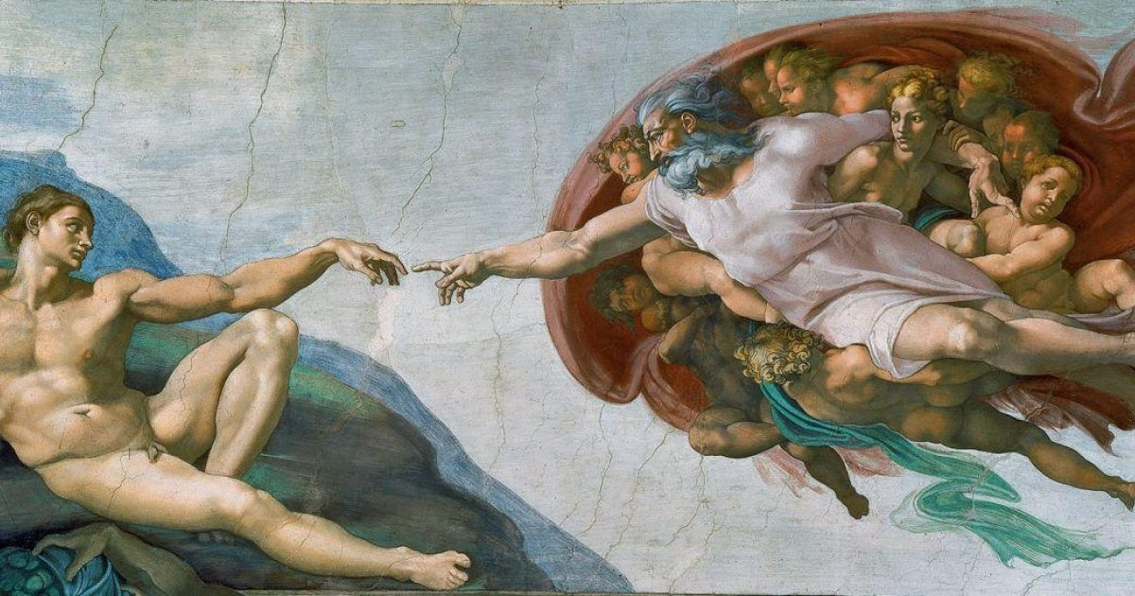

How to practice visio divina
Select a piece of Art
Gaze
Identify the art that will be the subject of your reflection. Then pick a comfortable place where you will not be disturbed or distracted. Relax. Closing your eyes and focusing on your breath can be a helpful way to center yourself in the divine.
Gaze at the entire picture. Notice the shapes, the colours, and the lighting. Notice the detail of both the foreground and background. Once you have visually canvased the artwork, note what has drawn your attention. Just like in Lectio Divina, it is God that is luring you to a treasure meant just for you.

Slide 6
Meditate (meditatio)
Meditate on the part of the picture that has drawn your attention. How is God speaking to you? Why do you think God drew your attention to this particular part? Is a message conveyed that pertains to your life today? Do you sense an invitation? Do you hear a call? Is a memory aroused? Allow these thoughts to descend to your heart. What emotion is evoked? What word describes your inner stirring as you embrace this feeling? Allow God’s communication to touch you deep within where the Spirit dwells.
Pray (oratio)
God has been speaking to you as you meditated on this artwork. It’s now time for you to respond to the divine. Allow your words to be born in the recesses of your soul. What is your response? What is your prayer? Articulate any yearnings or desires that arise. Give voice to the emotion that is whirling within.
Contemplate (contemplatio)
Words are never sufficient to express our deepest selves. Turn to silence to simply rest in communion with our Creator – the One who kissed your soul before placing it in your body – the One who loves you beyond measure. Savor the stillness. Be soothed by Love.

Slide 7
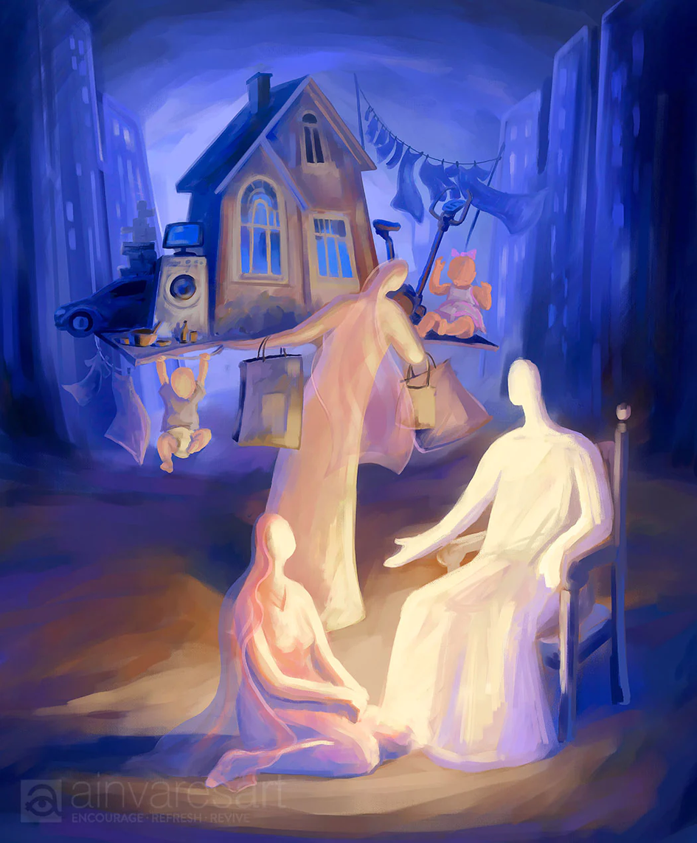
Example
Title: "At the Home of Martha and Mary"
Scripture inspiration: As Jesus and his disciples were on their way, he came to a village where a woman named Martha opened her home to him. She had a sister called Mary, who sat at the Lord's feet listening to what he said. But Martha was distracted by all the preparations that had to be made. She came to him and asked, "Lord, don't you care that my sister has left me to do the work by myself? Tell her to help me!" "Martha, Martha," the Lord answered, "you are worried and upset about many things, but only one thing is needed. Mary has chosen what is better, and it will not be taken away from her." Luke 10:38-42
There is a time for everything, and a season for every activity under heaven. Ecclesiastes 3:1
  Keep your attention on that one part of the image that first catches your eye.
  Try to keep your eyes from wandering to other parts of the picture.
  Breathe deeply and let yourself gaze at that part of the image for a minute or so.
  Now, let your eyes gaze at the whole image.
  Take your time and look at every part of the photograph.
  See it all. Reflect on the image for a minute or so.
  Consider the following questions:
  What emotions does this image evoke in you?
  What does the image stir up in you, bring forth in you?
  Does this image lead you into an attitude of prayer? If so, let these prayers take form in you.
  Write them down if you desire.
  Now, offer your prayers to God in a final time of silence.

Slide 8
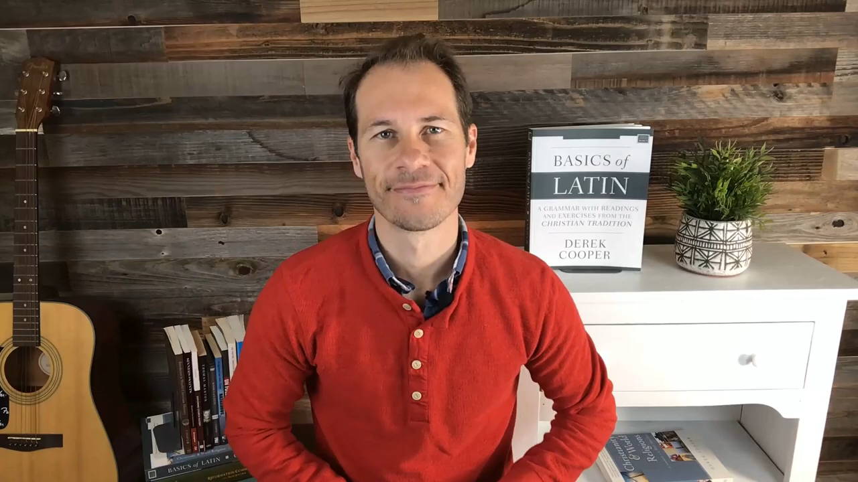
Explaining Visio Divina

