Slide 1
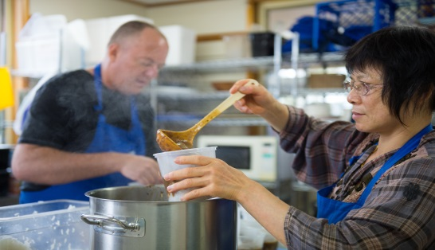
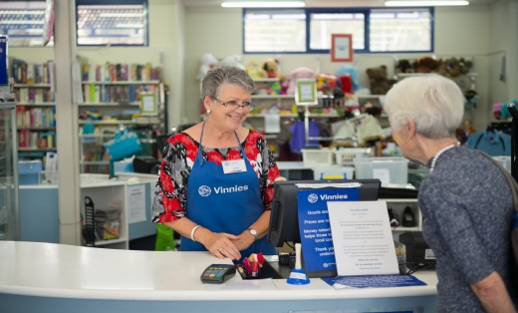
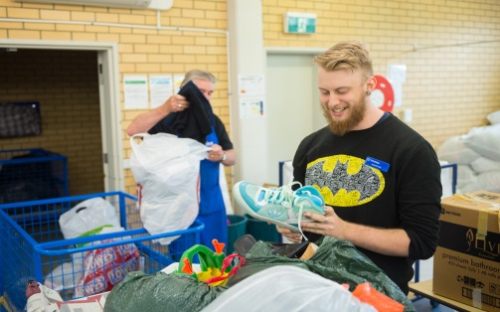
Information Session
Conference Recruitment
www.vinnies.org.au

Slide 2

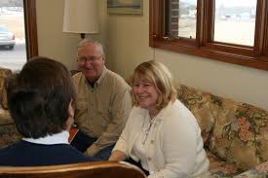

Conference Recruitment
Our Vision and Mission
The origins of the Society
What the Society does
What it looks like for us
What is a Conference
What happens next
Members - Society of St. Vincent de Paul Madison, WI
Notes:
Today we want to talk you about the St Vincent de Paul Society and extend a invitation for you to consider joining us and become a member of our Conference.
Quickly read through the headings above and indicate that these will be the areas that we will touch on in our presentation
We will have time for questions at the end of the session but if at anytime you have a question or wish clarification of any point please feel free to ask.
Just before we begin some housekeeping:-
Are you comfortable?
is it too hot or cold?
can you hear me or do I need to speak louder or softer?
the amenities are situated …………
If applicable:-
And once the session is over you are more than welcome to stay and join us for morning/afternoon tea

Slide 3
VISION
The St Vincent de Paul Society aspires to be recognised as a caring Catholic charity offering “a hand up” to people in need. We do this by respecting their dignity, sharing our hope and encouraging them to take control of their own destiny.
MISSION
The Society is a lay Catholic organisation that aspires to live the gospel message by serving Christ in the poor with love, respect, justice, hope and joy, and by working to shape a more just and compassionate society.
Notes:
Invite the participants to quietly read both statements:-
ask if they have any comments or if something stands out for them about either or both statements and discuss these
Now take the opportunity to expand on the statements by considering:-
Vision:-
It is through the living of the vision that members of Conferences are able to provide a hand up to those we serve, not just a hand out, therefore enabling them to take control of their destiny.
Mission:-
* The Society enjoys a close relationship with the Catholic Church and the local parishes and schools provide the Society with significant support.
* We see Christ in those with whom we serve and this service brings about love, respect, justice, hope and joy which leads to a more just and compassionate society.

Slide 4
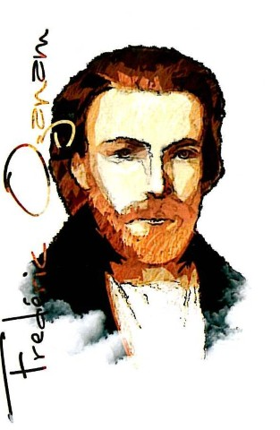
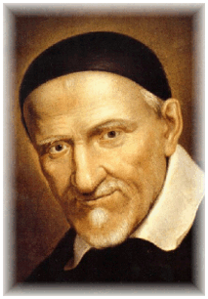
Our History
The Society was founded in France in 1833
Principal Founder: Frederic Ozanam
The Society was named after the Patron Saint of Christian Charity, St Vincent de Paul
Today the Society has more than 950,000 members in 150 countries
“Never see a need without doing something about it”
St Mary of the Cross Mackillop
Notes:
Emphasize that the Society began as a group of people who met together in what was the first Conference
Quickly read through this and let the participants know that new members undertake an induction and orientation program that expands on the history of the Society as well as the works of the Conference

Slide 5

Notes:
What we are going to see now is a short presentation that gives us more of what Blessed Frederic accomplishes in the development of the Society and how it has expanded into the services we provide today.

Slide 6
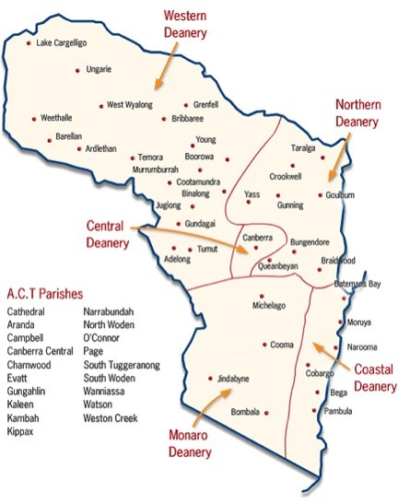
Canberra/Goulburn
  First NSW conference was at
  St Bede’s Braidwood in 1886
  First ACT conference was at St
  Christopher’s Manuka in 1924
  50 Conferences spread across
  the six regions of the Society
Notes:
The Archdiocese stretches from just north of Lake Cargelligo in central west New South Wales to the Victorian border near Eden on the far south coast. It covers and area of 88,000sq km. It is the only Catholic diocese in Australia that crosses state and territory borders
Therefore the reason we have two ‘starting’ dates for Conferences in our Archdiocese.

Slide 7
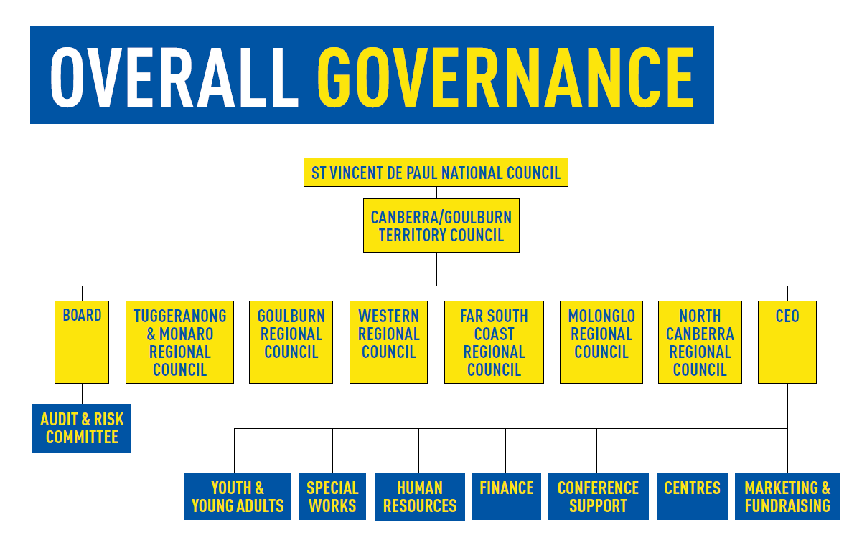
Notes:
Each diocese has its own Society council which operates under the Rule (have a copy to show) which has been approved by the International Council General of the Society in Paris and is also affiliated with the St Vincent de Paul National Council
The slide gives an overview of the structure of the Society in the in our Archdiocese:-
* you can see that the Territory Council is made up of the Board (which will be further explained in the next slide)
* the six Regional Presidents and the Society’s CEO
* note that employees support the operations of the Society through the various works directed by the Society’s CEO

Slide 8
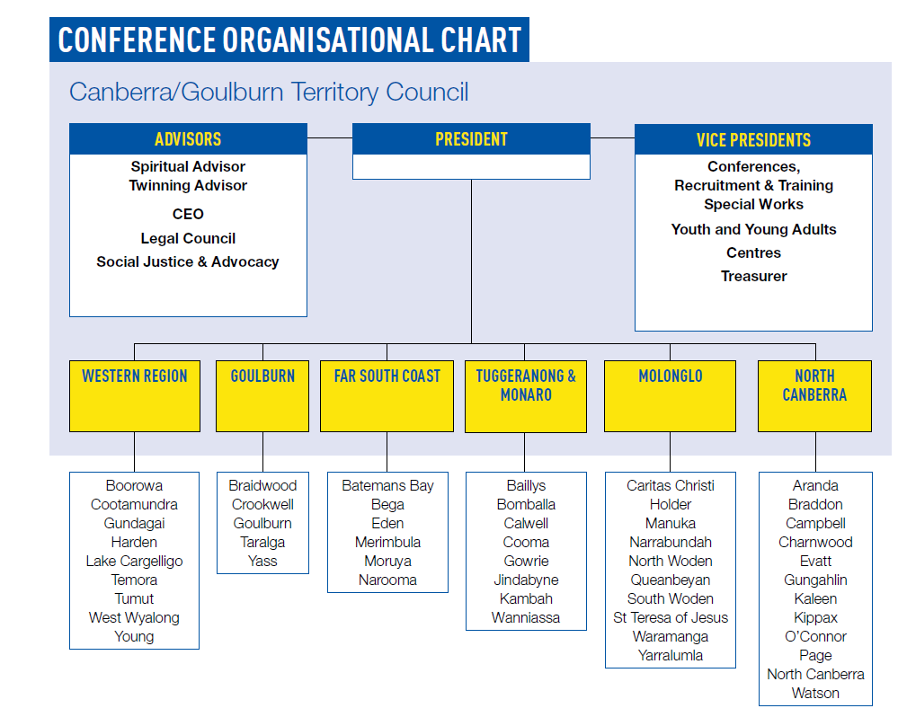
Notes:
This slide further outlines the Conference Organisational structure:-
it shows that the Board is made up of the
Territory President – who represents us at the National level,
Advisors and,
the Vice Presidents of the main works of the Society
It also shows which Conferences belong to which region of the Society.

Slide 9
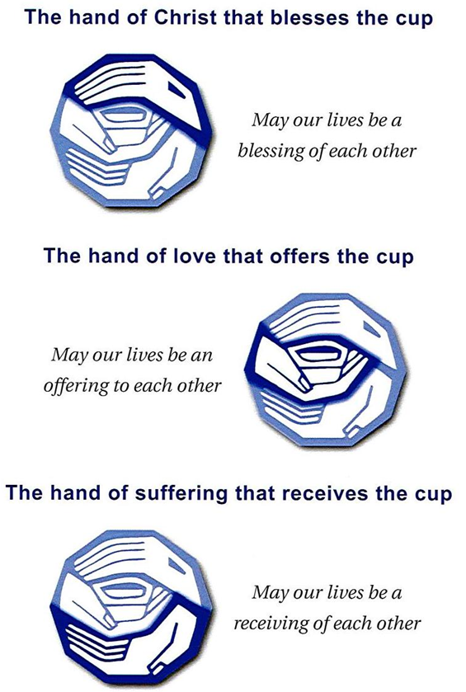
Conferences
Our Conferences are made up of individuals within our community - they are a core group that gathers together in prayer and friendship and responds to those in need by undertaking home visits or interviews.
There are three types of membership:-
          Conference,
          Associate and
          Volunteer
Notes:
With all this the Conference is still the core group of the Society because as we gather in prayer and friendship we model the vision of Blessed Frederic and the original Conference
We in the ___________ Conference always seek to be the face of Christ to the needy in our parish, just as the first Vincentians did in 1833
We talk of three types of membership – if you decide to journey further with us there will be more detail about this in the orientation work that you will undertake
It maybe useful to explain the three parts of the Society’s logo.

Slide 10
Conferences
“No work of charity is foreign to the Society”
Our members, who come from diverse backgrounds, experiences and beliefs, bring a great depth of understanding, expertise and compassion to their service and involvement in the Society.
Members also meet regularly to share their experiences, reflect on their service, and monitor and discuss local needs. The Society’s founder, Blessed Frederic Ozanam, believed strongly that for each act of service to be a true expression of faith and love, members must come together in prayer, to explore and grow their personal and Vincentian spirituality.
“The poor have much to teach you. You have much to learn from them.” –
St Vincent de Paul
Notes:
You could again allow the participants to read this slide
Or you could highlight aspects you believe are important.

Slide 11
Conferences
“No work of charity is foreign to the Society”
Dependent on local need, members have the opportunity to be involved in a range of services, including home visitation and:
Education, training and supported employment opportunities
Homeless services
Disaster relief
Mobile and fixed meal services
Migrant and refugee services
Housing support and emergency accommodation
Mentoring and social support programs
Advocacy
Youth programs – including kids and young carers camps,
Budget counselling
Material assistance; and much more.
Notes:
It would be useful to talk through this slide as it lists roles the participants may not have been aware of the scope of the work undertaken by the members

Slide 12
Conferences
Current Vincentians will now talk to us about how
and why they became members
* the benefits and challenges
* talk a little about their experiences

Slide 13

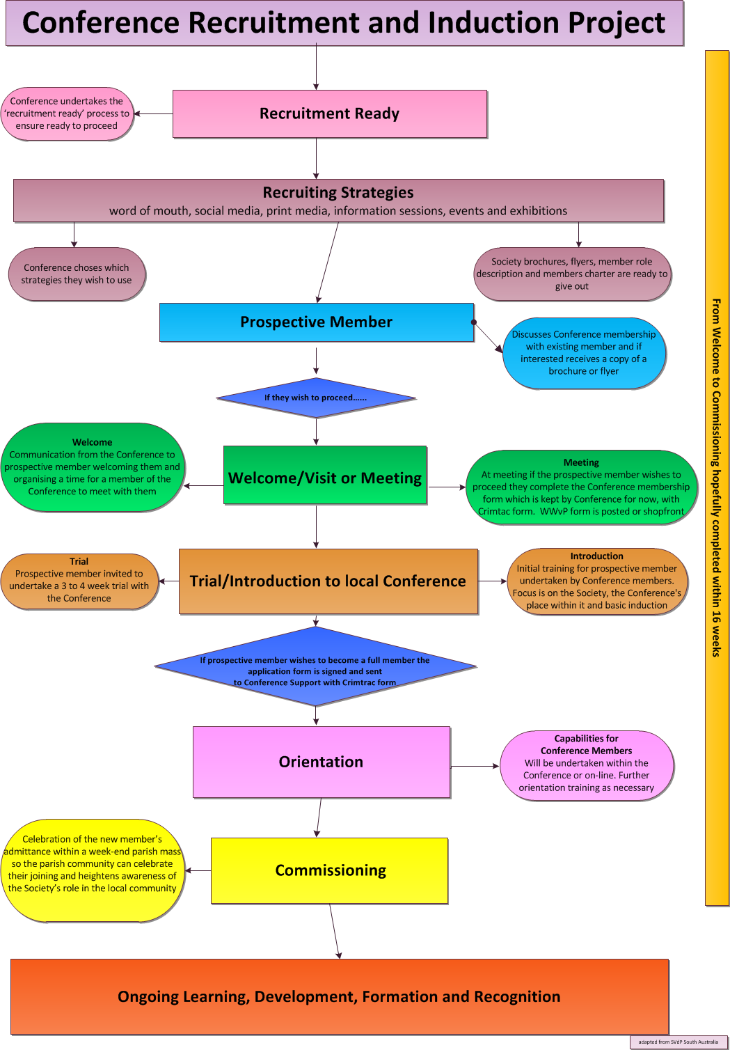
Notes:
Have the participants take the flowchart from their pack and walk them through each step and explain what is involved
Allow an opportunity for the participants to ask questions at this stage

Slide 14

If you decide to become a member there are some documents that you will need to complete:-
for everyone:-
MEMBERSHIP APPLICATION FORM
NATIONAL POLICE CHECKING SERVICE (NPCS) INFORMED CONSENT FORM
for ACT applicants only:-
WORKING WITH VULNERABLE PEOPLE FORM
www.xerox.ca
Notes:
The participants will have these documents in their pack please ask them to get them out and go through them.
Again you may have questions asked of you.

Slide 15

www.studentjob.nl
“Volunteering (members of Conferences are volunteers)
is time willingly given for the common good and without financial gain”.
Volunteering Australia
Notes:
As a member of a Conference you are a volunteer and it is useful to consider the recent revised definition of a volunteer from Volunteering Australia.
Read it out and ask for any comments.

Slide 16
What happens next?
A member of the local Conference will be in contact and discuss with you whether you would like to undertake a trial with the Conference, if so.
They will meet with you and help you to complete the paperwork before the trial begins. It will give you the opportunity to see first hand how we endeavour to give others a hand up as well as undertake an orientation into the Society .
If after attending Conference meetings for 3 to 4 weeks you decide you would like to officially join the Conference your application form is signed and sent to the head office and you are a member.
There will be ongoing induction programs to help you in your Conference works and a Commissioning process.
Notes:
Even though there is reference to this process in the CR&IP flowchart it is important to highlight to the participants that they will be contacted and if they wish they will be invited to trial being part of a Conference.
During this time they can gain a better understanding of the Society and its good works and decide if they wish to become a member of the Conference

Slide 17
???? Questions ????
Notes:
Indicate to the participant that the power point has concluded and offer them an opportunity to as any questions that they may have.
Allow enough time for question.
If there is morning /afternoon tea please invite the participants to join with the members of the Conference

