Slide 1
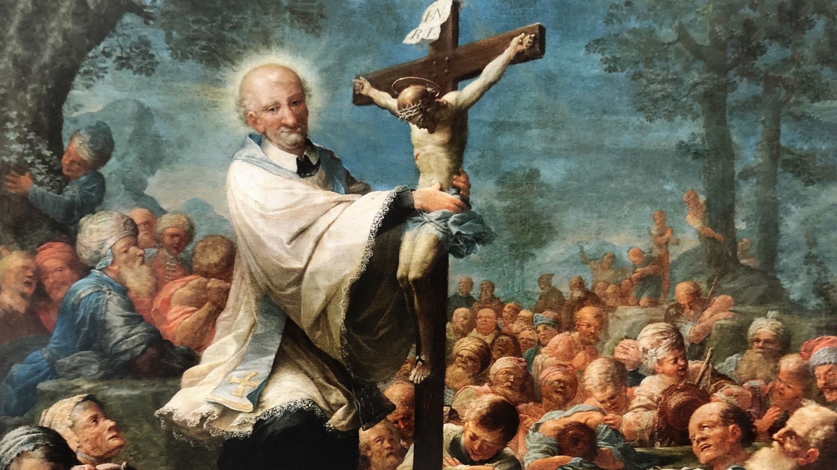
Vincentian Virtues
For Canberra Goulburn Council

Slide 2
Simplicity
Transparency
Open communication – communicating as much as is possible
No hidden agendas
Being straightforward
Honesty
Seeking elegant solutions
Breaking things down into accessible parts
clarity

Slide 3
Humility
Not doing everything yourself
Being yourself
Servant leadership
Harnessing the energy of others
Allowing others to take projects and own them
Accepting that you can’t control everything
Acknowledging that we don’t have all the answers
Recognising a shared sense of humanity
Patience
Being with others
Continually being open to new things

Slide 4
Gentleness
Patience
Acceptance of others
Respect
Kindness
Calmness
Listening fully to the other
Reassuring the other
Not responding out of anger
Recognising when it is appropriate to take a stand
Recognising other’s strengths and meeting them accordingly

Slide 5
Selflessness
Recognising that we receive as much as we give
We are advocates for others
Recognise that we have other responsibilities in life
Need to have a range of interests
Moderation
Being willing to give of our time which is our most important gift

Slide 6
Zeal
Being able to be relied upon
Passionate
Persistent
Do we wait for the call or go where we are needed?
Doing the best we can
Caring for our past members
Having a spark which is attractive to others

