Slide 1


Frederic Ozanam
200 Years of Influence

Slide 2
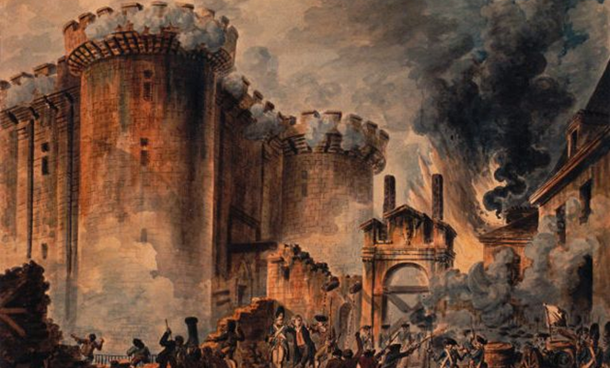

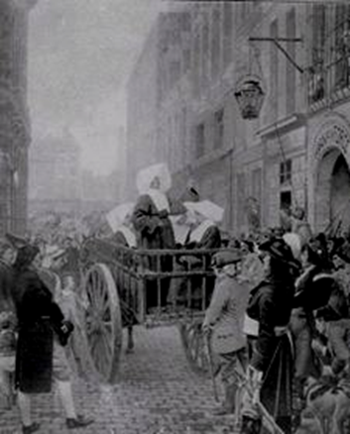
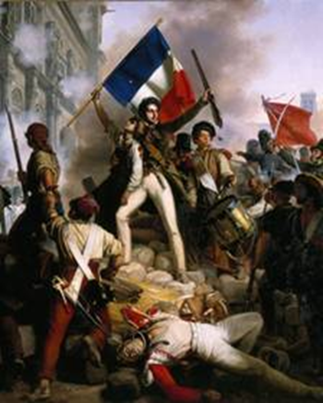
Born into Dark Times

Slide 3
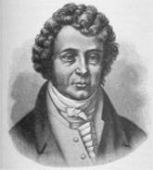

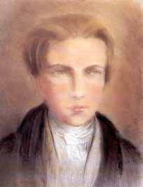
Formative Years In Paris
Frédéric arrived in Paris 1831 to study at the University of Paris
Adjustment to city difficult
Is taken into the home of famous physicist André-Marie Ampere

Slide 4
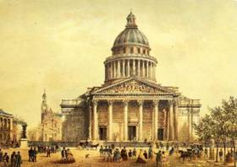
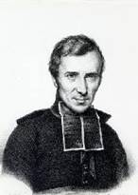
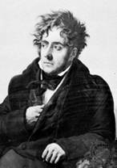
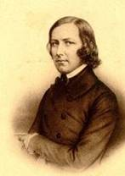
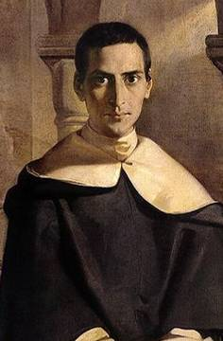
Formative Years In Paris
Frédéric meets the important thinkers, artists and politicians of the day
Pantheon & St. Etienne
Lamennais
Chateaubriand
Count Montalembert
Fr Henri Lacordaire

Slide 5
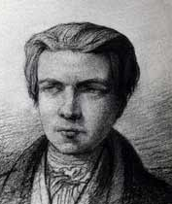
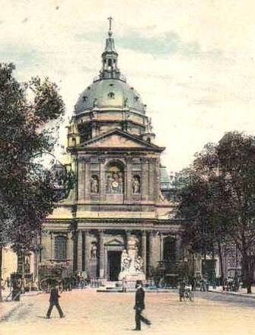
Young Organizer
challenges anti-Catholic Faculty
Frédéric challenges anti-Catholic statements by professors. Circulates a petition signed by many other students with well thought out rebuttal of statements by Professor Jouffroy.

Slide 6
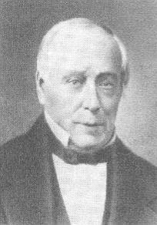
Young Organizer
organizes Conference of History
Frédéric meets Emmanuel Bailly. With his guidance, Frédéric and friends formed a society called the “Conference of History” which met weekly to considered the social issues of the day.

Slide 7
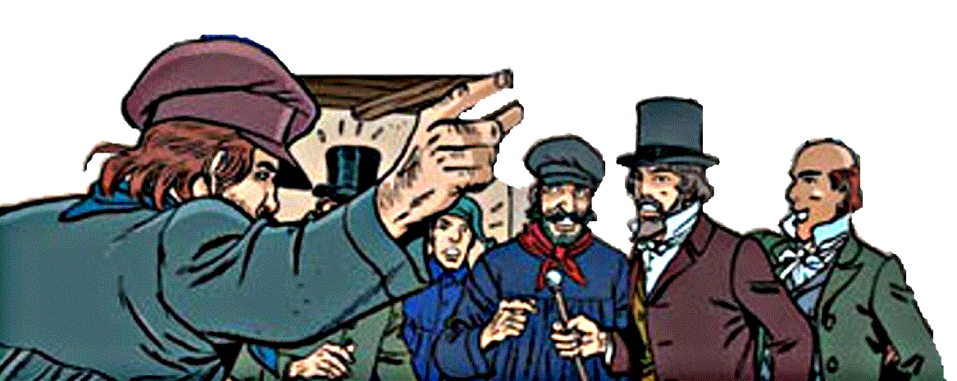
Young Organizer
organizes Conference of History
Conference of History included some hostile to the Catholic Church. A St. Simonians challenged the members saying:
“Christianity did wonders in the past but it is now dead. You who boast of being Catholic, what do you do?
Where are your works?”

Slide 8
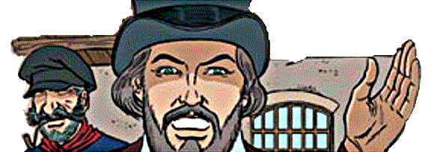
Young Organizer
founds the Society of St. Vincent de Paul
“What must we do to live our Catholicism?
Let us no longer talk so much about charity.
Let us put it into practice and go
to assist the poor.”

Slide 9
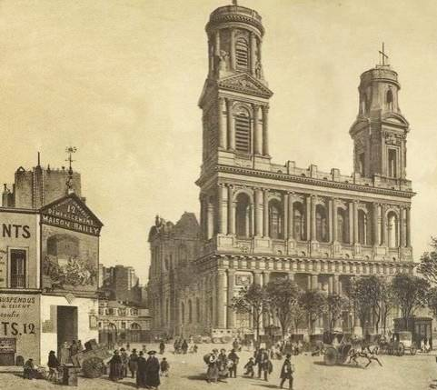

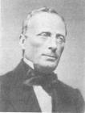
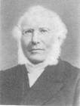
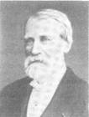
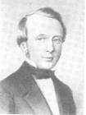
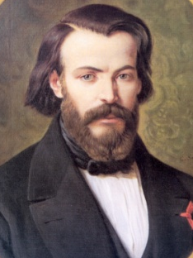
Young Organizer
founds the Society of St. Vincent de Paul
On April 23, 1833 six students gathered in Emmanuel Bailly’s office of La Tribune Catholique to form a new organization
– a Conference of Charity
Bailly Deveaux Lallier LeTailandier Lemache Ozanam Clave

Slide 10
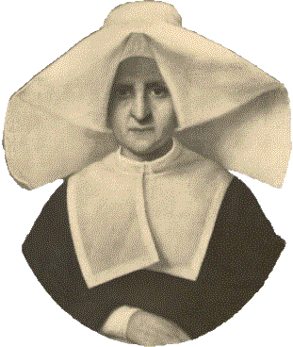
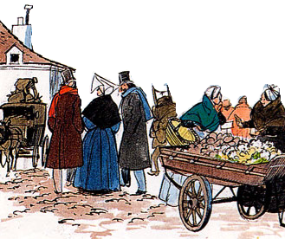
Young Organizer
founds the Society of St. Vincent de Paul
Sr. Rosalie Rendu was sought out. She mentored the young men and is considered a co-founder

Slide 11

Young Organizer
founds the Society of St. Vincent de Paul
Conference grew rapidly, to over a
100 members within a year.
In December of 1834 discussion to divide into
2 conferences was heatedly debated.
(Frédéric promoted his vision for the organization)
February 17, 1835 split into two groups.
Rule developed and approved Dec. 8, 1835
Notes:
Obviously the Society was attractive to a large number of young and old alike. It struck the right balance of idealism and practical activity and it grew rapidly. The meetings became cumbersome and unruly. It was difficult to do the business, discuss cases and to maintain the original spirit of friendship. But because the spirit of friendship was such an important part of the groups dynamics it was very difficult to split. What to do was debated for weeks. Finally another conference formed and then the group split.
This is one of the most important events in the organizations evolution. It was necessary if continued growth was to occur.

Slide 12
Spread of the Society Throughout the World
In its first decade the Society spread to 48 other cities in France and Italy and numbered over 9,000 members. After some years the Society reached Rome (1842), England (1844), Belgium, Scotland, Ireland (1845) and the United States of America (1846).
First Conference in Australia 1854
First Conference in our region 1886 (Braidwood)

Slide 13
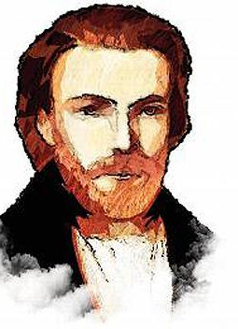
OZANAM’S WORDS
Yours must be a work of love, of kindness; you must give your time, your talents, yourselves.
The poor person is a unique person of God's fashioning with an inalienable right to respect.
You must not be content with tiding the poor over the poverty crisis.
You must study their condition and the injustices which brought about such poverty, with the
aim of long term improvement."

Slide 14
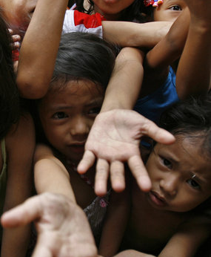
For if the question
which today disturbs
the world around us is
neither an individual
question nor a
question of political
forms, but a social
question; if it is the
struggle of those who
have nothing with
those who have too
much

Slide 15
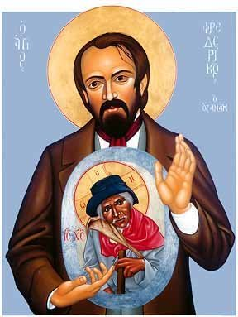
“You are our masters, and
we will be your servants. You
are for us the sacred image
of that God whom we do
not see, and not knowing
how to love Him otherwise
shall we not love him in your
persons? …how much charity,
devotion and patience do we
not need at present to heal
the sufferings of these poor
people”

Slide 16
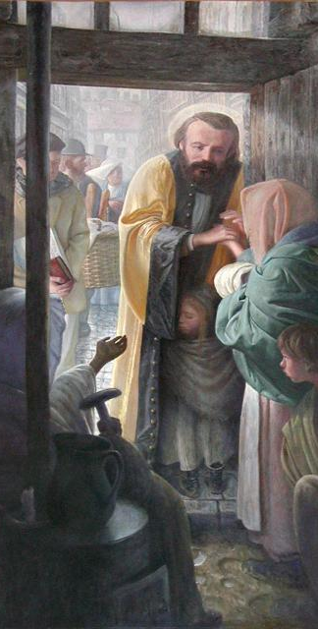
Now, the strongest tie, the
principle of true friendship is
charity. Charity cannot
exist in the hearts of many
without outwardly
overflowing; it is a fire
which dies for want of
being fed, and the food of
charity is good works.

Slide 17

Protectionof the weak
The problem that divides men in our
day is no longer a problem of
political structure; it is a social
problem; it has to do with what is
preferred, the spirit of self-interest or
the spirit of self-sacrifice, whether
society will only be a great
exploitation to the profit of the
strongest or a consecration of each
individual for the good of all and
especially for the protection of the
weak.

Slide 18
You are part of the 180 years of the Society.
How do you live out the mission of the Society today?

