Slide 1

Frederic Ozanam,
Catholic Social Teaching and the St Vincent de Paul Society

Slide 2
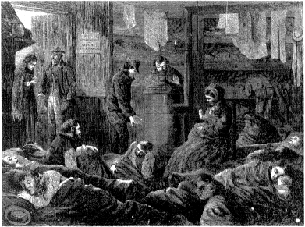
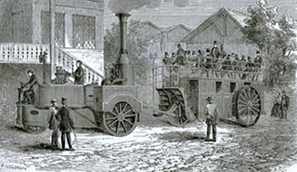
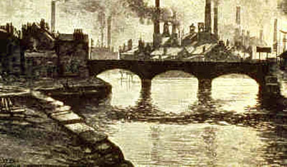
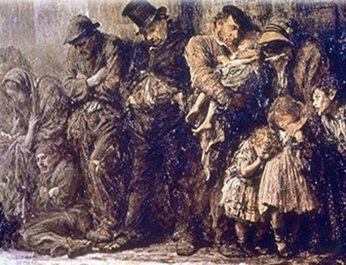

Slide 3
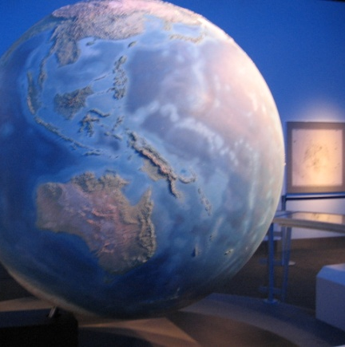
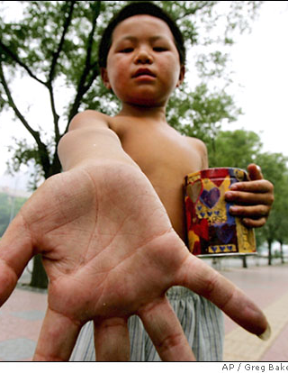
World Poverty
1960: richest 20% owned 70%
poorest 20% owned 2.3%
Today: richest 20% own 86%
poorest 20% own 1%

Slide 4
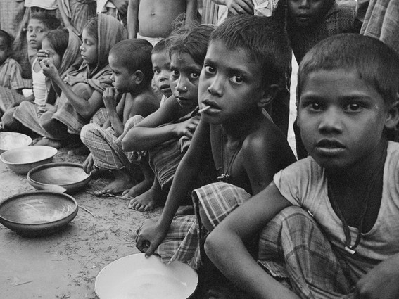
World Poverty
40 million die of malnutrition annually
1.4 billion in absolute poverty
16,000 children die daily - malnutrition
14 million children die before age 5
1 in 6 adults – illiterate
1-2 million trafficked annually

Slide 5
If the world were a village of 100
20 - eat 80% of food
50 - are malnourished
94 - have no health care
4 - die before age 5
80 - have substandard housing
17 - cannot read
1 - has university education and a computer

Slide 6
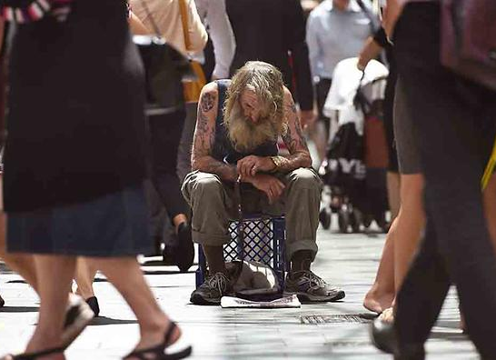
Poverty in Australia
Two million people live in poverty today – one in ten Australians

Slide 7
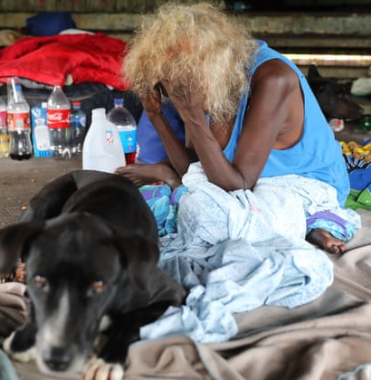
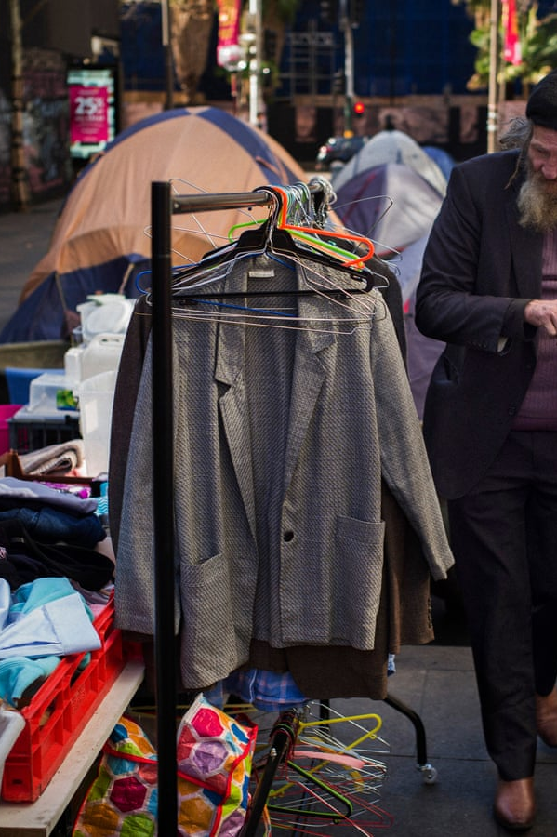
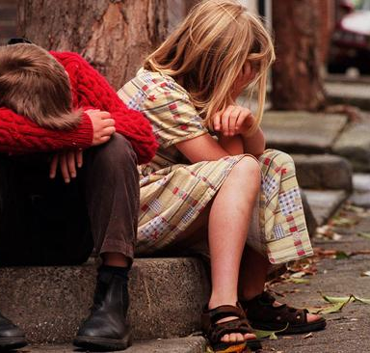
Groups at risk of poverty
58% of Indigenous people
28% of unemployed people
28% of people renting
22% of single parents

Slide 8

4 out of 5 of families earning
the lowest 20% of income had
social security payments as
their main source of income
and have no one employed in
the household
48% of them are single parent
families

Slide 9
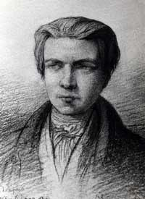
Frederic Ozanam
Founded the St Vincent de Paul Society
A great intellect
Contributed to Catholic Social Thought

Slide 10
…You have felt the hunger for truth crying out within you…
“Young men, the moral regeneration of our ancient land of France will be our special work. You have felt the emptiness of material pleasures, you have felt the hunger for truth crying out within you; you have gone for light and comfort to the barren philosophy of modern apostles. You have not found food for your souls there. The religion of your forefathers appears before you today with full hands.”

Slide 11

... Religious ideas can have no value if they have not a practical and positive value. Religion serves less to think than to act; .... The value of Christianity is in this, and not in the attraction which its dogma may present to men of imagination and of mind

Slide 12
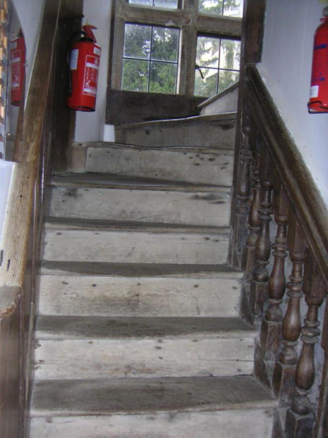
The knowledge of social well-being and of reform is to be learnt, not from books, nor form the public platform, but in climbing the stairs to the poor man’s garret, sitting by his bed-side, feeling the dame cold that pierces him, sharing the secret of his lonely heart and troubled mind. When the conditions of the poor have been examined … it is then and then only, that we know the elements of that formidable problem, that we begin to grasp it and may hope to solve it.

Slide 13

“the public authorities of Paris have not discharged all their responsibility, when they have voted six million francs for the maintenance of unemployed workmen, which is the rate of three half-pence per head per day up to the month of the following April; and further that the time has not yet arrived to forget public starvation, simply because Winter and cholera are no longer there to remind us of them.”

Slide 14

“the social problems, the conflict between poverty and riches, between self-interest that wants to take and self-interest that wants to keep, succeeds political problems. And the confrontation between these two self-interests, the poor who have the force of numbers and the rich that of silver, will be terrible if charity does not interpose, become a mediator, if Christians do not dominate with all the force of love.”

Slide 15
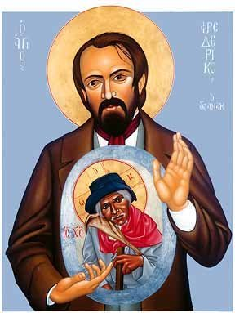
“You are our masters, and we will be your servants. You are for us the sacred image of that God whom we do not see, and not knowing how to love Him otherwise shall we not love him in your persons? …how much charity, devotion and patience do we not need at present to heal the sufferings of these poor people”

Slide 16
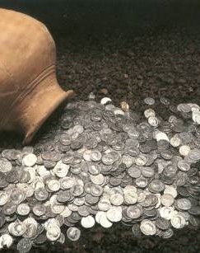
“The problem that divides men in our day is no longer a problem of political structure; it is a social problem; it has to do with what is preferred, the spirit of self-interest or the spirit of self-sacrifice, whether society will only be a great exploitation to the profit of the strongest or a consecration of each individual for the good of all and especially for the protection of the weak”

Slide 17

“Charity is the
Samaritan who
pours oil on the
wounds of the
traveller who has
been attacked.
It is justice’s role
to prevent the
attacks.”

Slide 18

“We are not …socialists… in the sense that we do not want the overthrow of society, but we want a free, progressive, Christian reform of it … One cannot avoid the social issues; precisely because they are formidable… We must lay a bold hand on the sore of pauperism”

Slide 19
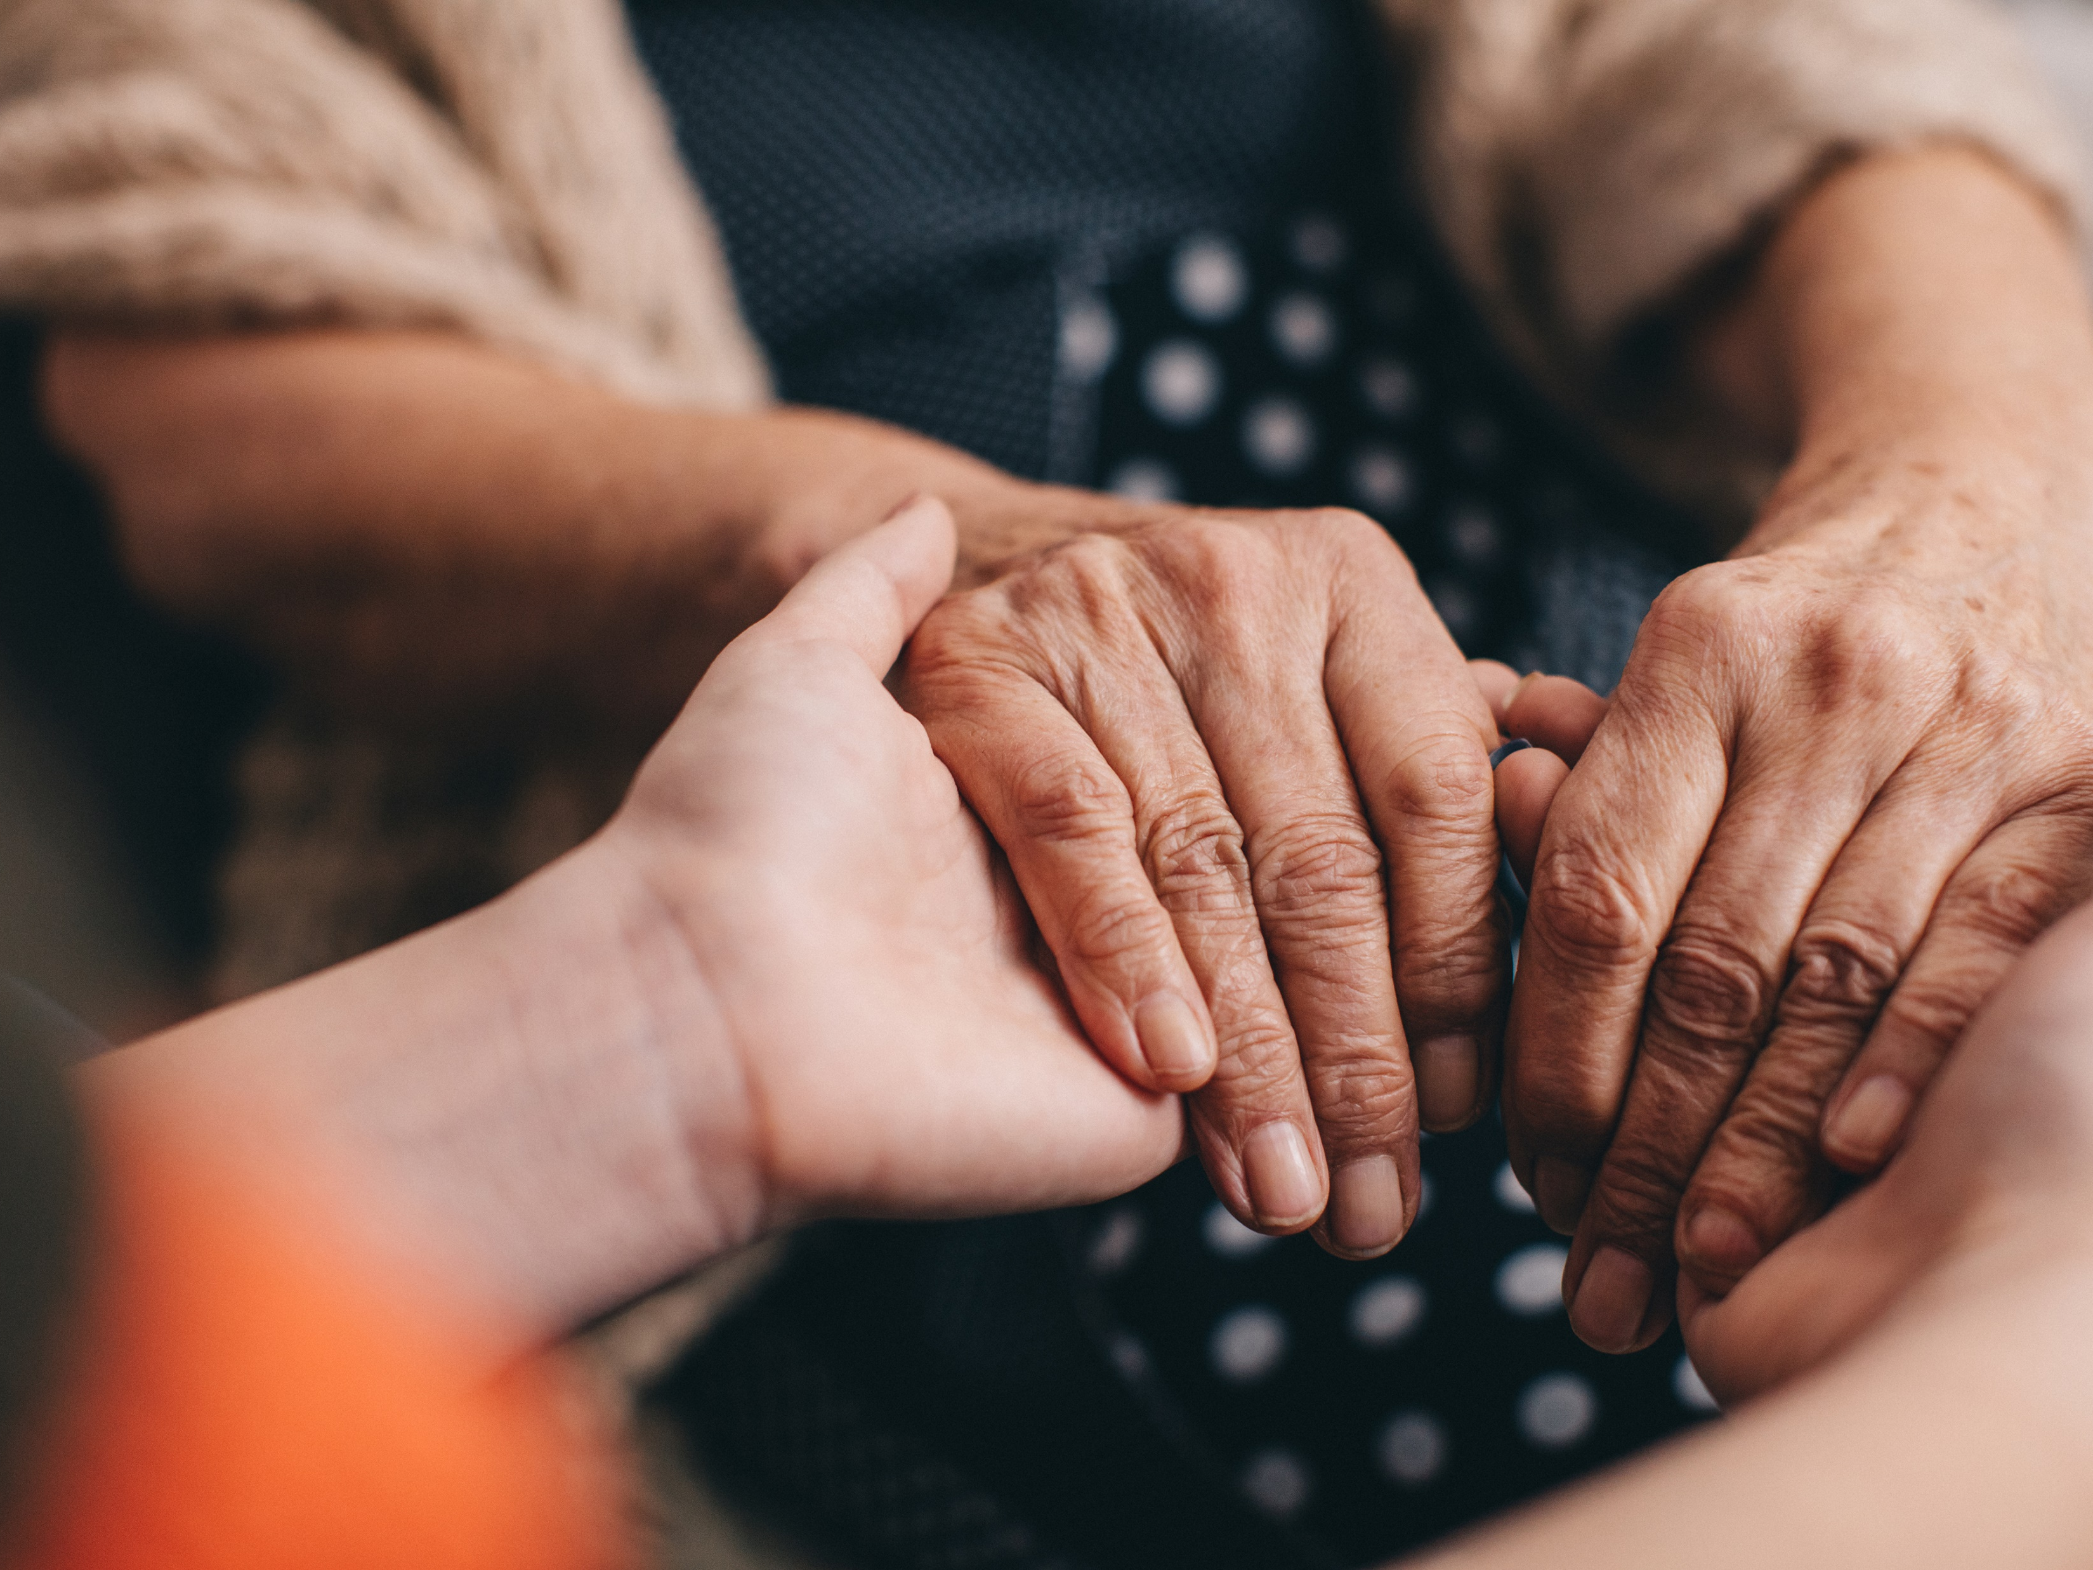
Catholic Social Teaching
The social doctrine of the Church developed in the nineteenth
century when the Gospel encountered modern industrial society
with its new structures for the production of consumer goods, its
new concept of society, the state and authority, and its new forms of
labour and ownership. the development of the doctrine of the
Church on economic and social matters attests the permanent value
of the Church's teaching at the same time as it attests the true
meaning of her Tradition, always living and active.

Slide 20
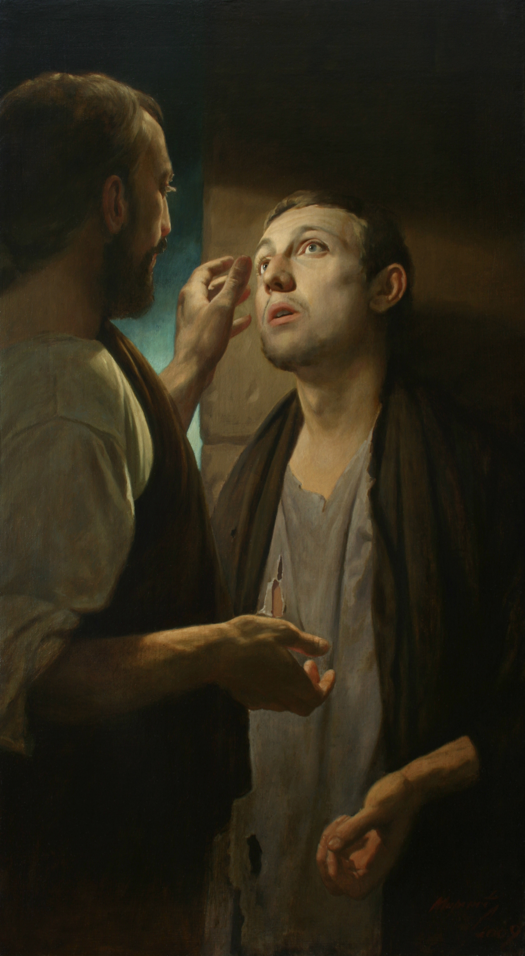
Human dignity
Every human life, from the moment of conception until death, is sacred because the human person has been willed for its own sake in the image and likeness of the living and holy God.

Slide 21
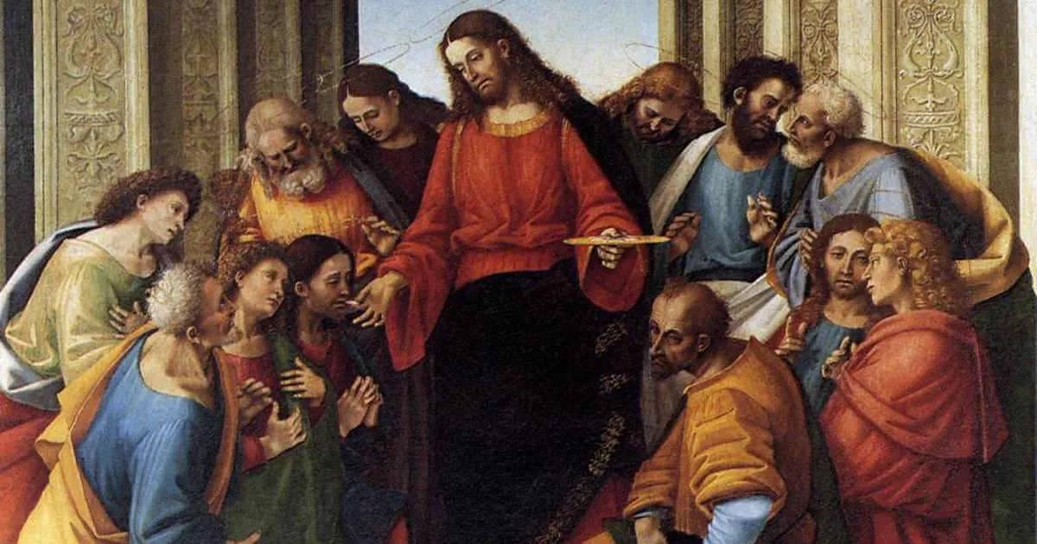
Community and the Common Good
Goods of production material or immaterial such as land, factories, practical Or artistic skills, oblige their possessors to employ them in ways that will benefit the greatest number. Those who hold goods for use and consumption should use them with moderation, reserving the better part for guests, for the sick and the poor.

Slide 22
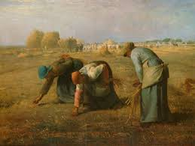
Rights and Responsibilities
The right to private property, acquired by work or received from others by
inheritance or gift, does not do away with the original gift of the earth to the
whole of mankind. The universal destination of goods remains primordial, even
if the promotion of the common good requires respect for the right to private
property and its exercise.

Slide 23
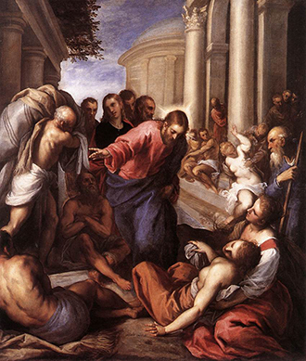
Option for the poor and vulnerable
"The Church's love for the poor . . . is a part of her constant tradition." This love is inspired by the Gospel of the Beatitudes, of the poverty of Jesus, and of his concern for the poor. Love for the poor is even one of the motives for the duty of working so as to "be able to give to those in need."

Slide 24
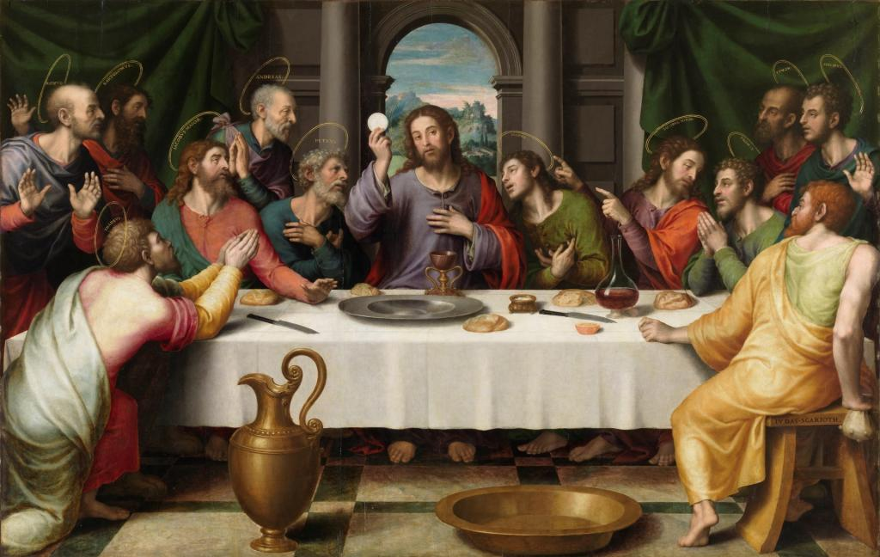
Participation
It is the duty of citizens to work with civil authority for building up society in a
spirit of truth, justice, solidarity, and freedom

Slide 25
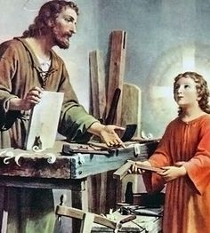
Dignity of work
In work, the person exercises
and fulfils in part the potential
inscribed in his nature. The
primordial value of labour
stems from man himself, its
author and its beneficiary. Work
is for man, not man for work.²¹³
Everyone should be able to
draw from work the means of
providing for his life and that of
his family, and of serving the
human community

Slide 26
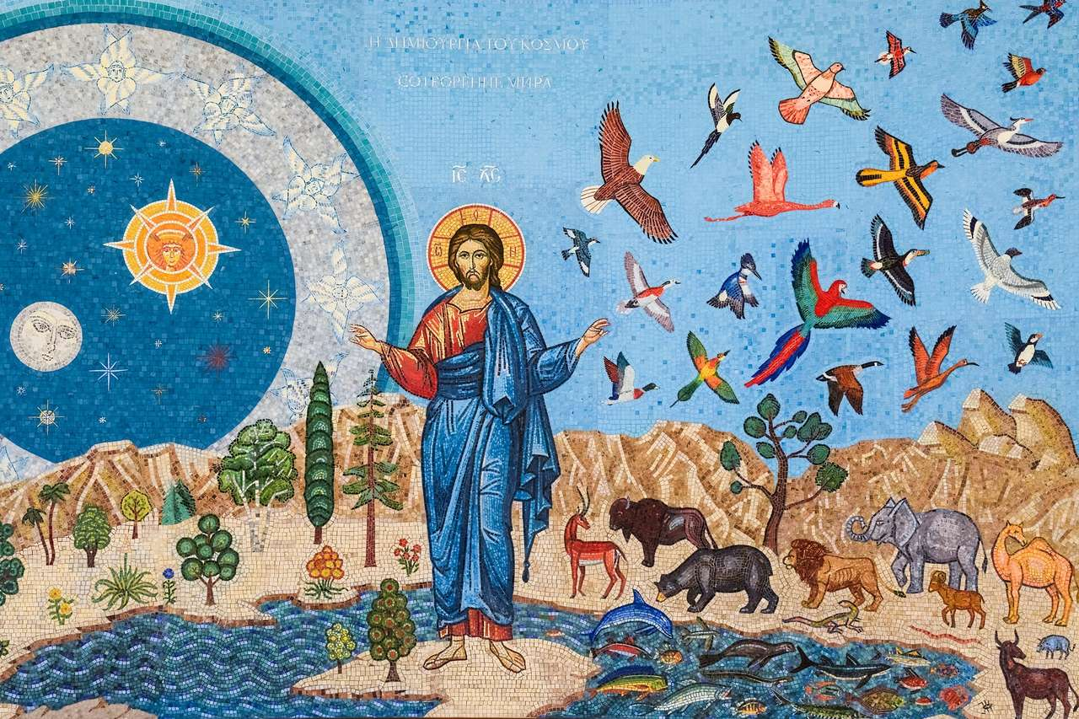
Stewardship of creation
Animals, like plants and inanimate beings, are by nature destined for the common good of past, present, and future humanity. Use of the mineral, vegetable, and animal resources of the universe cannot be divorced from respect for moral imperatives. Man's dominion over inanimate and other living beings granted by the Creator is not absolute; it is limited by concern for the quality of life of his neighbour, including generations to come; it requires a religious respect for the integrity of creation

Slide 27
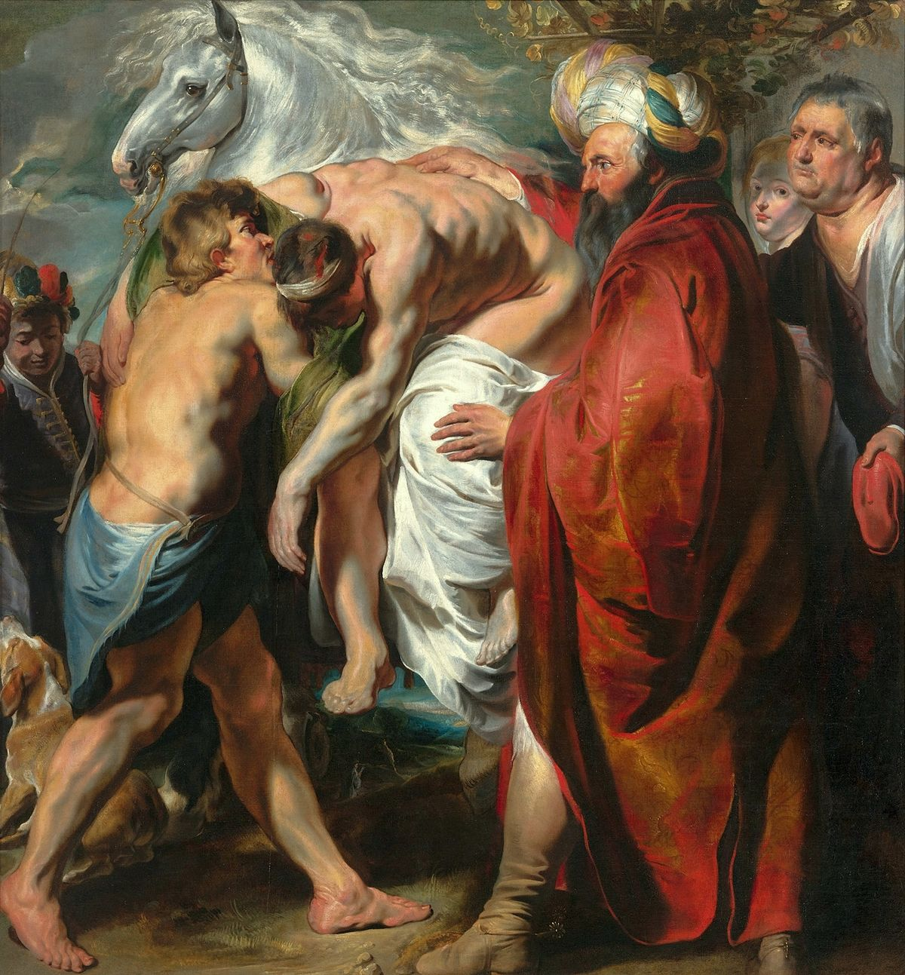
Global Solidarity
Rich nations have a grave moral responsibility toward those which are unable to ensure the means of their development by themselves or have been prevented from doing so by tragic historical events. It is a duty in solidarity and charity; it is also an obligation in justice if the prosperity of the rich nations has come from resources that have not been paid for fairly.

Slide 28
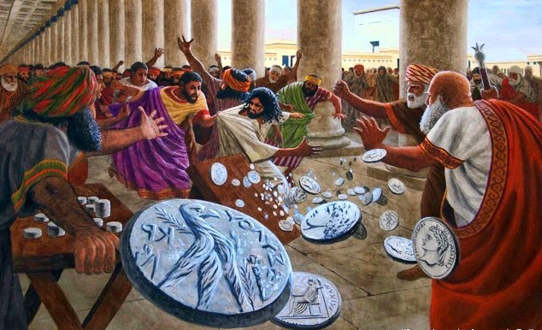
Constructive Role for Governments
Public authority is obliged to respect the fundamental rights of the human person and the conditions for the exercise of his freedom.

Slide 29
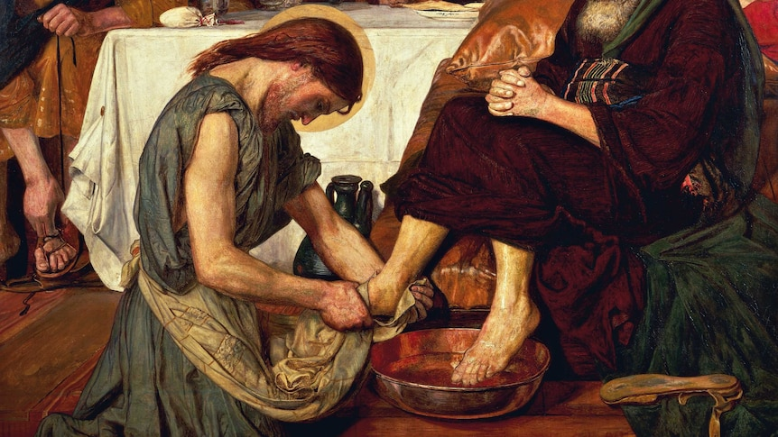
Promotion of Peace
Respect for and development of human life require peace. Peace is not merely the absence of war, and it is not limited to maintaining a balance of powers between adversaries. Peace cannot be attained on earth without safeguarding the goods of persons, free communication among men, respect for the dignity of persons and peoples, and the assiduous practice of fraternity. Peace is "the tranquillity of order."Peace is the work of justice and the effect of charity.

Slide 30
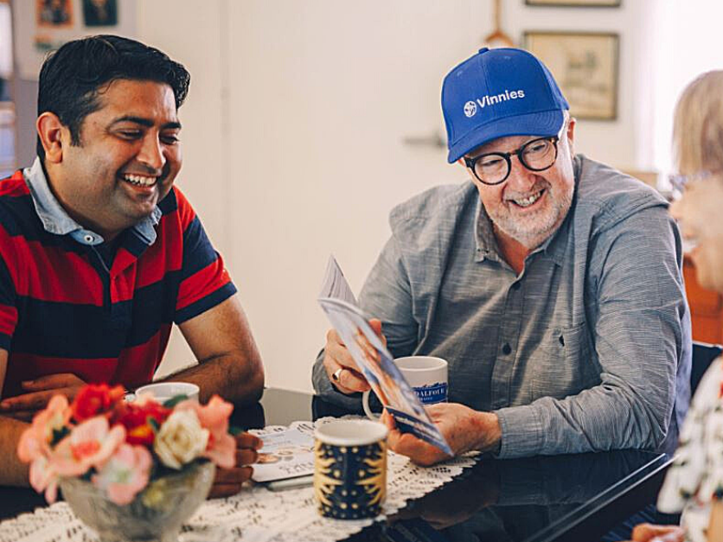
Home Visitation
Visiting people in need in their homes
Food
Clothing
Material needs
Companionship
Support

Slide 31
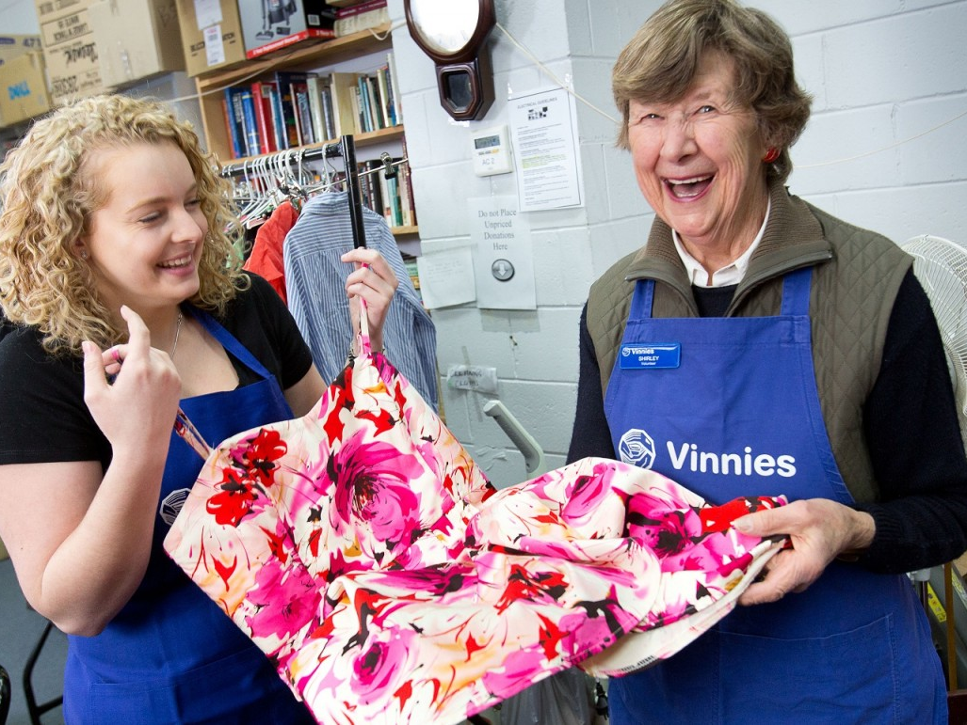
Centres
Low cost second hand clothing and household goods
Raising money

Slide 32
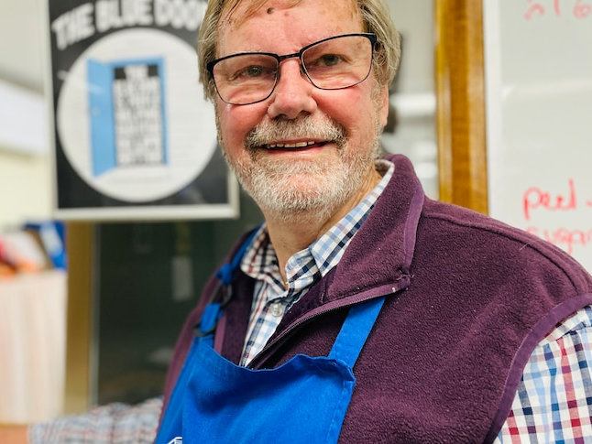
Blue door
Drop in centre
Meals
Advice
Support
Information
advocacy

Slide 33
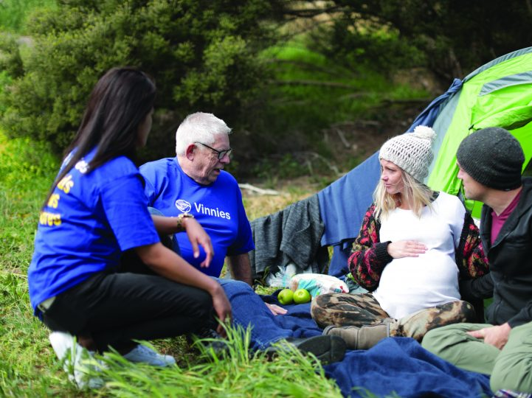
Family Service
Outreach and supported accommodation to up to 80 families who are homeless or at risk of homelessness

Slide 34
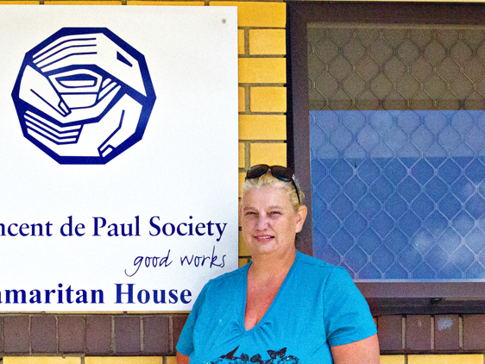
Samaritan House
12 bed hostel providing crisis accommodation and support to homeless men
Longer term accommodation and support to men with a mental illness

Slide 35
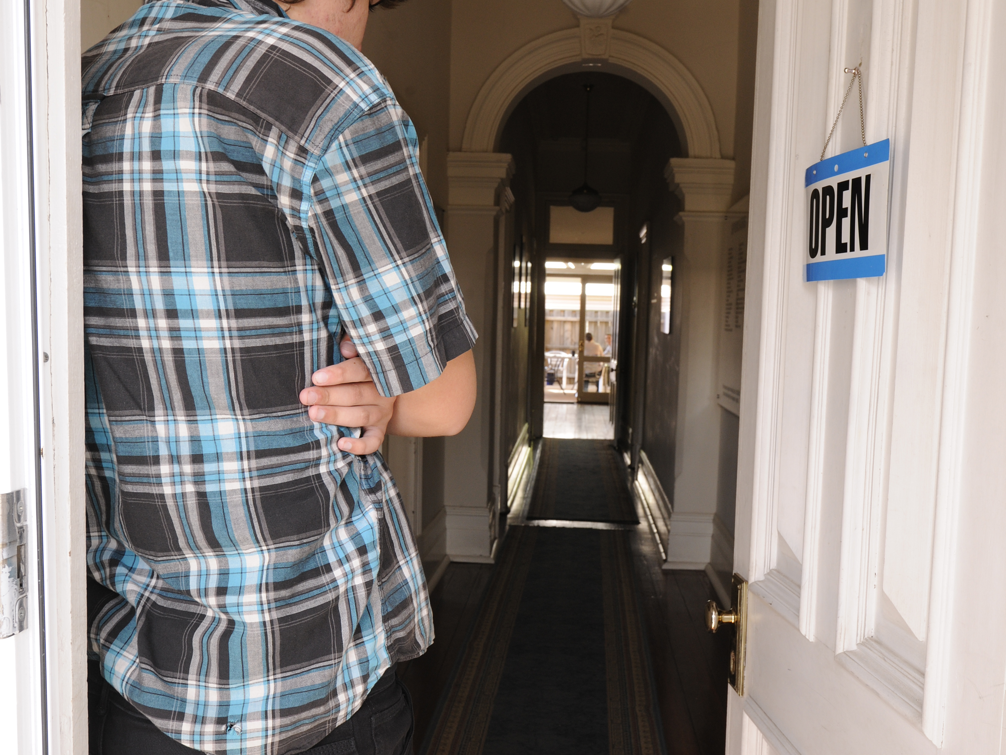
Kennedy House
A 40 bed hostel offering crisis accommodation and support to homeless men

Slide 36

St Anthony’s
A Crisis accommodation service for single women without children

Slide 37
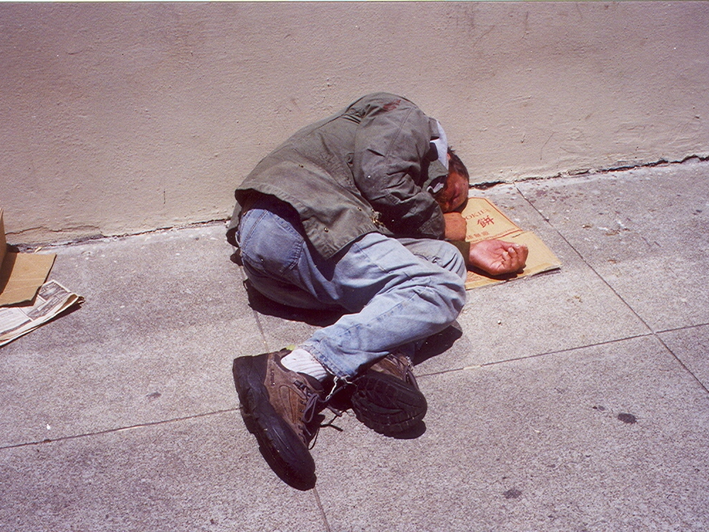
Street to Home
Flexible outreach to chronically homeless people

Slide 38
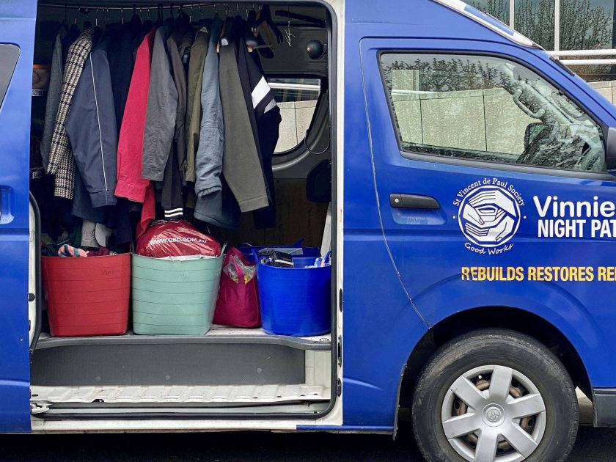
Night Patrol
A mobile street van that provides food and friendship to people on the streets at night

Slide 39
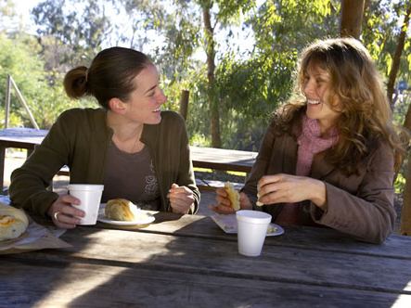
Compeer
Links a volunteer with a person suffering with mental illness for friendship and support

Slide 40

Clemente
A free university course for people who have suffered trauma or setback in their lives.

Slide 41
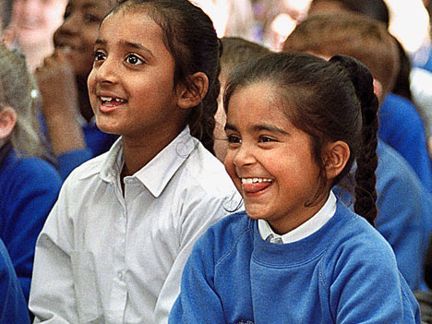
Migrants and refugees
Support to people who are newly arrived in the country

Slide 42
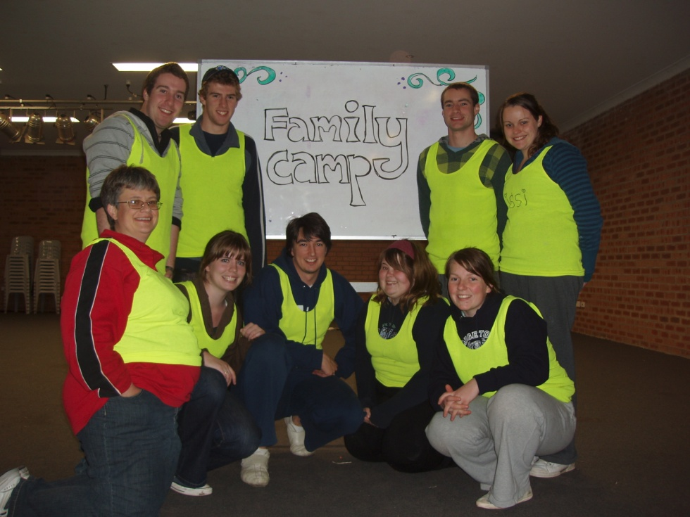
Youth
Young volunteers offer camps and recreation activities to children from disadvantaged backgrounds and young carers

Slide 43
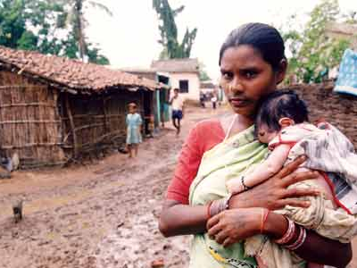
Twinning
Assistance to conferences in developing countries
57 twins in India
37 twins in Indonesia
5 twins in Thailand
1 twin in the Philippines

Slide 44
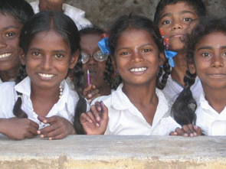
Assist a Student
A sponsorship program that provides support of $70 to a student in a developing country for one year

Slide 45

Social Justice and Advocacy
The Society’s focus on Social Justice has facilitated research into issues relating to homelessness, poverty, disaster relief, health, as well as campaigning for basic human rights for migrants and refugees and people with disabilities and those experiencing a mental illness.

Slide 46
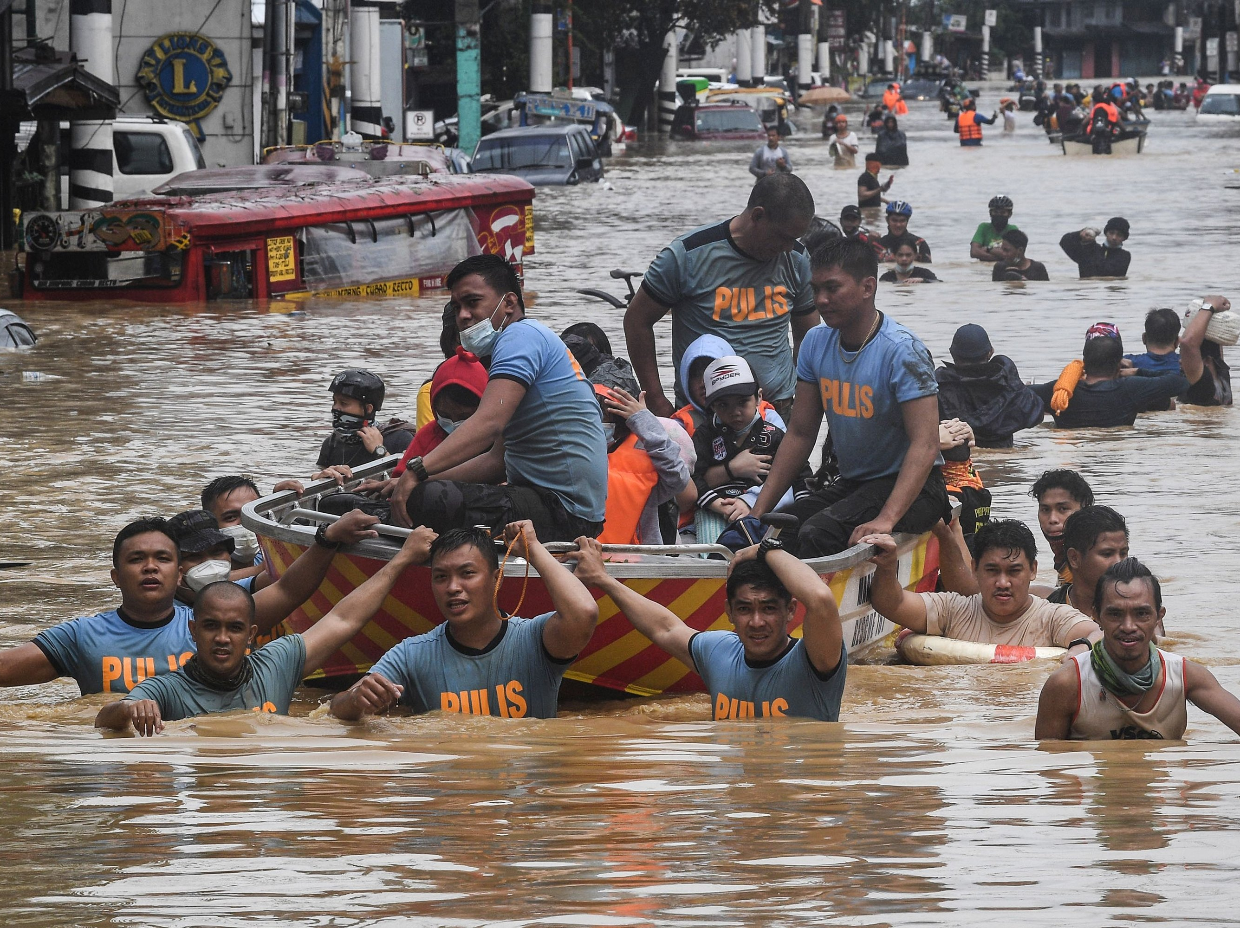
International

Slide 47
What will you leave to the next generation?
Are you building your lives on firm foundations, building something that will endure?
Are you living your lives in a way that opens up space for the Spirit in the midst of a world that wants to forget God, or even rejects him in the name of a falsely-conceived freedom?
How are you using the gifts you have been given, the ‘power’ which the Holy Spirit is even now prepared to release within you?
What legacy will you leave to young people yet to come?
What difference will you make?

