Slide 1

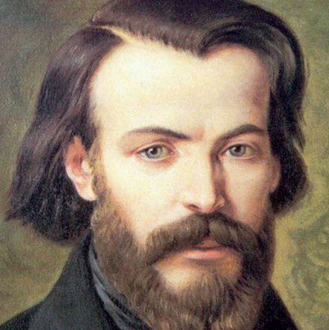

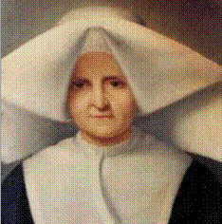
FREDERIC OZANAM AND ROSALIE RENDU
as models for today
Notes:
Today we will be reflecting on Blessed Frederic Ozanam and Blessed Rosalie Rendu as models for us who work for the Society. In the first session I will be reflecting on Blessed Frederic and then after lunch on Blessed Rosalie. I will be sharing some thoughts with you and then giving you some reflection time. I will be asking some reflection questions throughout the presentation but will also give them to you for reflection at the end.

Slide 2
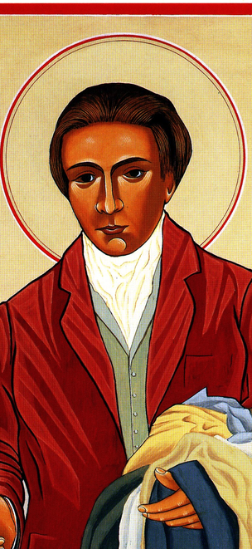
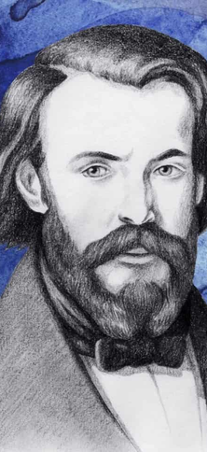
FREDERIC'S BEGINNINGS
Frederic was born into turbulent times. There were 7 changes of government, 2 revolutions, many uprisings and 2 major cholera epidemics.
France 19th Century - political unrest, civil war, oppression & exploitation
Australia Today - economic fluctuations, international war, division between rich & poor
Family
Frederic’s father was a doctor who cared for many people and approximately a third of them at no charge. It is also said that “Frederic Ozanam learned the secret of visiting poor families by accompanying his mother through the streets of Saint-Pierre parish. He knew the poor years before his personal involvement as a member of the Society of Saint Vincent de Paul.”
How did your own family influence you and lead you towards being a volunteer with the Society?
What other early influences taught you about caring for others?
Notes:
Frederic was born into turbulent times. There were 7 changes of government, 2 revolutions, many uprisings and 2 major cholera epidemics. Frederic described what he saw in Paris in 1832
“The cholera has taken frightening hold. In the space of 14 days it has attacked 3,075 people, killing 1,200 of them. Yesterday there were 717 sick, and in the street wagons loaded with five, ten or twelve coffins can be seen. Few wealthy people have been struck down ...Nevertheless, the calamity strikes with increasing force: it is feared it that it will affect 20,000 people before it runs its course.” Letter to His Mother 8th April 1832 Dirvin P 23
The society in which Frederic lived faced many challenges and of course the poor were the ones who suffered the most. Although the challenges we face are different we can draw parallels between Frederic’s time and ours.
France 19th Century - political unrest, civil war, oppression & exploitation
Australia Today, economic fluctuations, international war, division between rich & poor
Family
For most of us our parents and families provide the most significant formative influences on us. For Frederic this was also true. He was born into a family of deep faith and learnt to love God in this cradle of faith.
Frederic’s father was a doctor who cared for many people and approximately a third of them at no charge. It is also said that
“Frederic Ozanam learned the secret of visiting poor families by accompanying his mother through the streets of Saint-Pierre parish. He knew the poor years before his personal involvement as a member of the Society of Saint Vincent de Paul.” P21 Hosanna
When they were older his parents agreed that they wouldn’t climb higher than the fourth storey to visit a family in need, however, a short time after this caught each other on the threshold of a garret.
How did your own family influence you? What other early influences taught you about caring for others?

Slide 3

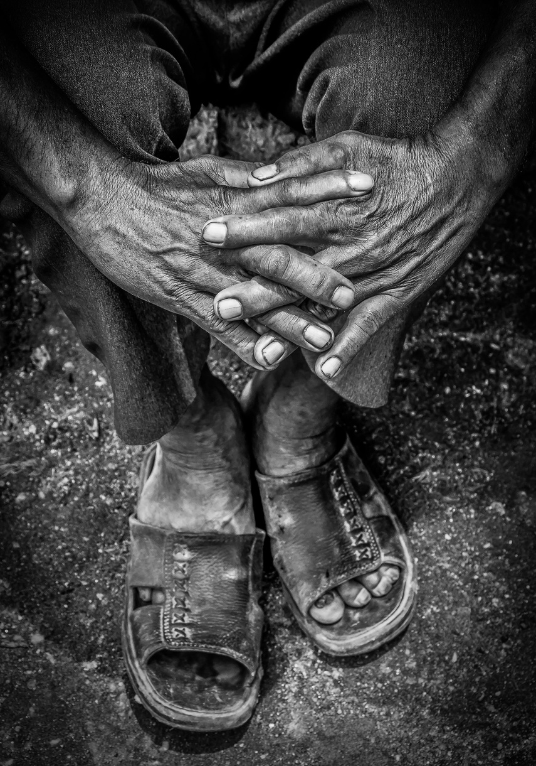
Suffering
“I was seven when my sister, my good sister, died.
I certainly shared the common sorrow.
Oh the grief I had!”
This suffering had a profound effect on Frederic, how has suffering affected you?
Notes:
His family too knew great suffering as eleven of the fourteen children born to Marie and Jean-Antoine did not reach adulthood. For Ozanam himself perhaps the greatest suffering was the death of his sister Eliza. Eliza was 13 years older than Frederic and she died when she was 19. She helped her mother educate the young Frederic. He was particularly close to her and felt her loss keenly. He wrote
“I was seven when my sister, my good sister, died. I certainly shared the common sorrow. Oh the grief I had!”
This suffering had a profound effect on Frederic, how has suffering affected you?

Slide 4

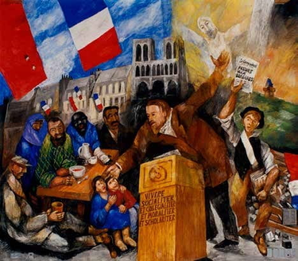
Faith
“After constantly listening to unbelievers and to expressions of unbelief, I commenced to ask myself why I believed. I began to entertain doubt, and yet I wished to believe.” Ozanam in his correspondence...
“Later, the sounds of an unbelieving world reached me. I experienced all the horror of those doubts which gnaw at the heart during the day, and which one finds at night in a bed wet with tears. The lack of certitude about my eternal destiny left me no rest. It was then that a priest philosopher saved me. He put order and light into my thoughts. From then on, I believed with a certain faith and, touched by such a rare gift, I promised God to devote my days to the service of the truth that was giving me peace.” P43
Have you had periods of doubt or struggle?
Who and what helped you through these periods?
Notes:
Faith
Frederic suffered a period of doubt when he was a teenager. Don’t you find this consoling? Even a holy person like Frederic had periods in which he questioned the meaning of life and God. He was helped particularly at this time by Fr Noirot, who was the first in a succession of mentors who helped him. Ozanam said of this period
“After constantly listening to unbelievers and to expressions of unbelief, I commenced to ask myself why I believed. I began to entertain doubt, and yet I wished to believe.” Ozanam in his correspondence p10
“Later, the sounds of an unbelieving world reached me. I experienced all the horror of those doubts which gnaw at the heart during the day, and which one finds at night in a bed wet with tears. The lack of certitude about my eternal destiny left me no rest. It was then that a priest philosopher saved me. He put order and light into my thoughts. From then on, I believed with a certain faith and, touched by such a rare gift, I promised God to devote my days to the service of the truth that was giving me peace.” P43
Faith gave Frederic this fresh vision. After his period of doubt his faith was stronger and he grew in faith over the rest of his life. Indeed his faith gave shape to his life and what he was to do.
Have you had periods of doubt or struggle? Who and what helped you through these periods?

Slide 5
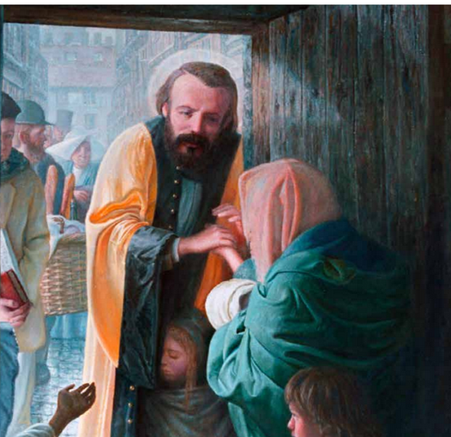

VOCATION
May God guard the woman he seems to have chosen for me, and whose smile is the first ray of sunshine that I have had in my life since, the death of my dear father. You will find me tenderly overwhelmed! But I am not hiding from it, and I cannot sometimes keep from laughing over it, me, who used to think that I had a heart of bronze.
15 Days of Prayer with Frederic Ozanam p53
“So many graces stabilized my vocation in this world and put an end to keeping my family apart. A new grace arrived to make me know probably the greatest joy that one can experience her below: I’m a father.”
15 days of prayer P57
Who and what has been influential in shaping your life path?
Notes:
Vocation
Frederic wanted to live a life devoted to God and he thought seriously about the priesthood, however, that was not his vocation. He was called to live a life of faith and holiness as a lay person. In this he is a great example for Vincentians who also live this lay life.
Frederic met Amelie and found in his relationship with her that he was taught more about love
May God guard the woman he seems to have chosen for me, and whose smile is the first ray of sunshine that I have had in my life since, the death of my dear father. You will find me tenderly overwhelmed! But I am not hiding from it, and I cannot sometimes keep from laughing over it, me, who used to think that I had a heart of bronze.
15 Days of Prayer with Frederic Ozanam p53
He was able to see that his love for her had changed him for the better and to laugh at himself about it.
This love was extended even further when his daughter was born. He said
“So many graces stabilized my vocation in this world and put an end to keeping my family apart. A new grace arrived to make me know probably the greatest joy that one can experience her below: I’m a father.” 15 days of prayer P57
“I know of nothing sweeter on earth than when I come home to find my beloved wife and my dear child in her arms. I then become the third member of the group.” 15 Days of Prayer P62
Who and what has been influential in shaping your life path?

Slide 6
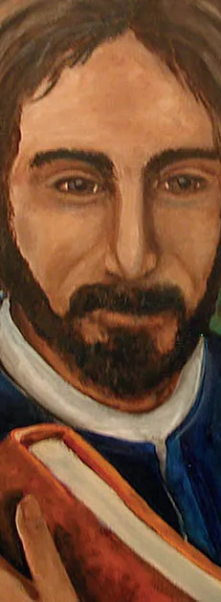

Friendship
“Your nice letter consoled me greatly. Really, nothing is more consoling than remembering those to whom one is closely attached in the heart. I think you already said it: the enjoyments of a family are very precious, blood has its innate and unavoidable rights; but friendship has acquired and sacred rights, enjoyments which never give out. Relatives and friends are the two sorts of companions that God has given us along the road of life. The presence of one cannot make us forget the absence of the others.” P64
“I realized that you are somewhat reticent with me on just one point, since you doubtless fear to open your soul to me: I mean, to speak about faith! I am certain that in this matter, revolutions have occurred in your spirit that you never told me about, and in which nevertheless, I would love to take part, not, of course, to teach you – I couldn’t do that, but to share your worries a little and to offer some consolation.” P66
“He laid out his convictions with a frankness and simplicity that we never (ever?) dare to proclaim and even less hand on to others, even when we are in a small group or at a Conference meeting.” 15 Days p67
How comfortable are you to challenge others when necessary?
Notes:
Perhaps one of Frederic’s greatest gifts was for relationships and networking. He had many friends and his influence on them was profound. He wrote to one of his friends:
“Your nice letter consoled me greatly. Really, nothing is more consoling than remembering those to whom one is closely attached in the heart. I think you already said it: the enjoyments of a family are very precious, blood has its innate and unavoidable rights; but friendship has acquired and sacred rights, enjoyments which never give out. Relatives and friends are the two sorts of companions that God has given us along the road of life. The presence of one cannot make us forget the absence of the others.” P64
Friends were a vital part of Frederic’s life and he was a wonderful friend. His idea of friendship was based on his idea that “the principle of true friendship is charity, and that charity cannot exist in the hearts of many without pouring one’s heart outward.” ( charity really means love)
He wrote to Ernest Falconnet, one of his closest friends, when he was having a difficult time
“I realized that you are somewhat reticent with me on just one point, since you doubtless fear to open your soul to me: I mean, to speak about faith! I am certain that in this matter, revolutions have occurred in your spirit that you never told me about, and in which nevertheless, I would love to take part, not, of course, to teach you – I couldn’t do that, but to share your worries a little and to offer some consolation.” P66
Frederic did not hold back from challenging his friends.
“He laid out his convictions with a frankness and simplicity that we never (ever?) dare to proclaim and even less hand on to others, even when we are in a small group or at a Conference meeting.” 15 Days p67
This is a challenge for us. How comfortable are you to challenge others when necessary?

Slide 7


“I feel better when I have poured out my heart into the heart of a friend who is a better person than I am. Without realising it in this way you are doing me some good; and these lines that you will read in a few days will have strengthened my heart and will energise my for some time.”
15 Days p68
“Your letter filled me with joy. I have not kept this joy to myself, since I told it to some of my friends who belong to our little group.”
Frederic was someone who built community wherever he went.
How do you build community around you?
Notes:
Frederic’s relationships were not just one way and he was able to find support from his friends as well.
“I feel better when I have poured out my heart into the heart of a friend who is a better person than I am. Without realising it in this way you are doing me some good; and these lines that you will read in a few days will have strengthened my heart and will energise my for some time.”
15 Days p68
Frederic also shared the happiness he received from his friendships.
Your letter filled me with joy. I have not kept this joy to myself, since I told it to some of my friends who belong to our little group.
Frederic was someone who built community wherever he went. How do you build community around you?

Slide 8
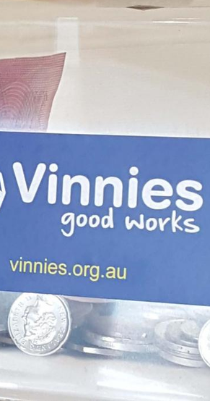
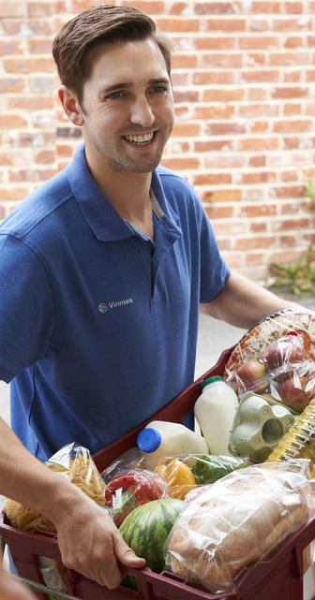
St Vincent de Paul Society
What can we do? That which Jesus Christ did when he was preaching the Gospel. If our efforts in these History Conferences have not been crowned by success in the way that we anxiously desire and if many of our University companions pass over to the Saint Simon camp, it will be due, without any doubt, to the fact that our apostolate lacks something in order to be blessed by God. And that something cannot but be charity. Let us accomplish charitable works and in that way we will receive the blessing of the poor, which will be the blessing of God. Let us go, then, to the poor in order to receive that blessing, in order to convert charity into a means of sanctifying us, so that our Conferences might thus be successful.
Frederic Ozanam
Do you think, then, that God granted to some to die in the service of civilization and the Church, and to others the task of living with their hands in their pockets, or sleeping among the roses?
Frederic Ozanam
What led you to volunteer with the Society?
Have you been able to inspire others to join as well?
Notes:
St Vincent de Paul Society
Frederic liked to debate about his faith with those who were against the faith, in particular the Saint-Simonians, who believed that religion was no longer necessary or helpful to society. Frederic’s response to the challenge of the Saint-Simonians was
What can we do? That which Jesus Christ did when he was preaching the Gospel. If our efforts in these History Conferences have not been crowned by success in the way that we anxiously desire and if many of our University companions pass over to the Saint Simon camp, it will be due, without any doubt, to the fact that our apostolate lacks something in order to be blessed by God. And that something cannot but be charity. Let us accomplish charitable works and in that way we will receive the blessing of the poor, which will be the blessing of God. Let us go, then, to the poor in order to receive that blessing, in order to convert charity into a means of sanctifying us, so that our Conferences might thus be successful.
The Vincentian Charism in the Laity: Frederick Ozanam Ambrosio R. Carranza Vincentian Heritage Vol 7:1 p73
Frederic was someone who took up the challenge that was given to him. He was able not only to respond personally but to inspire others to do so too.
He was quite blunt in challenging people to serve people and the church
Do you think, then, that God granted to some to die in the service of civilization and the Church, and to others the task of living with their hands in their pockets, or sleeping among the roses?
What led you to volunteer with the Society? Have you been able to inspire others to join as well?

Slide 9
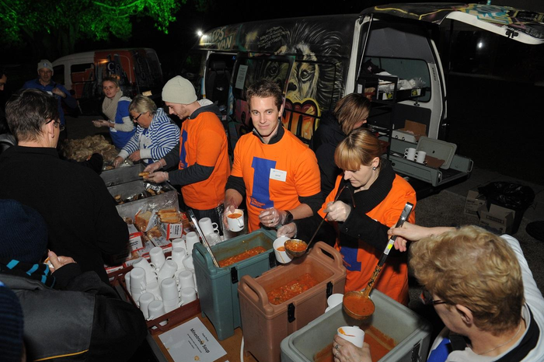

Serving the Poor
If we do not know how to love God as they loved Him, that should be without doubt a reproach to us, but yet our weakness is able to find some shadow of excuse, for it seems to be necessary to see in order to love and we see God only with the eyes of faith and our faith is so weak! Both men and the poor we see with the eyes of flesh; they are there and we can put our finger and hand in their wounds and the scars of the crown of thorns is visible on their foreheads; and at this incredulity no longer has place and we should fall at their feet and say with the apostle, Tu est Dominus et Deus meus. You are our masters and we will be your servants. You are for us the sacred images of that God whom we do not see, and not knowing how to love him otherwise shall we not love him in your persons?
Frederic Ozanam
How much charity, devotion and patience do we not need to heal the present sufferings of these poor people?
Frederic Ozanam
How do you feel about the people that you visit?
What helps you to be empathic and to see their situation from their point of view?
What do you receive from the people you visit?
Notes:
Serving the Poor
Frederic’s manner of serving the poor is an example for us. The people he visited became his friends and he loved them. When he entered a home he would say “I am your servant”. His attitude was one of love, respect and service.
Frederic also spoke about his respect for people who suffered poverty and how they handled the suffering that life had dealt them. He came from a position of humility and questioned whether he would be able to handle what they had handled. He was able to show empathy and consider what it might have been like to walk in their shoes.
If we do not know how to love God as they loved Him, that should be without doubt a reproach to us, but yet our weakness is able to find some shadow of excuse, for it seems to be necessary to see in order to love and we see God only with the eyes of faith and our faith is so weak! Both men and the poor we see with the eyes of flesh; they are there and we can put our finger and hand in their wounds and the scars of the crown of thorns is visible on their foreheads; and at this incredulity no longer has place and we should fall at their feet and say with the apostle, Tu est Dominus et Deus meus. You are our masters and we will be your servants. You are for us the sacred images of that God whom we do not see, and not knowing how to love him otherwise shall we not love him in your persons?
He goes on to reflect on upon the challenge to the Church that these people provided.
Alas, if in the Middle Ages, sick society was not able to be healed except by the immense effusion of love shown in a special way by St Francis of Assisi, if much later new sorrows cried out to the soothing hands of St Philip Neri, St John of God and St Vincent de Paul, how much charity, devotion an patience do we not need to heal the present sufferings of these poor people (Letter 137. 13th November 1837, p 96 Frederic Ozanam a life in Letters, Translated by Joseph Dirvin, 1986)
The challenge that he offered is one that still exists for us today. Frederic also challenges us to see mutuality in our interactions with people in need. He reminds us that
Help honours when to the bread that nourishes it adds the visit that consoles , the advice that enlightens, the friendly shake of the hand that lifts up the sinking courage; when it treats the poor man with respect, not only as an equal but as a superior
He goes on to remind us that we must be open to receiving from the people we serve as well. Perhaps this is one the biggest challenges for us. Often when we are motivated to help others it because we see how much we have and want to share with others. This is good however, to be truly Vincentian we must also be open to receive. An experience of mine - Christabel
How do you feel about the people that you visit? What helps you to be empathic and to see their situation from their point of view? What do you receive from the people you visit?

Slide 10


Social Justice
“deeply imbued with the great truths of Christianity, which contain for me consolation and hope, I find myself forced to express what my soul feels.”
“Young men, the moral regeneration of our ancient land of France will be our special work. You have felt the emptiness of material pleasures, you have felt the hunger for truth crying out within you; you have gone for light and comfort to the barren philosophy of modern apostles. You have not found food for your souls there. The religion of your forefathers appears before you today with full hands.”
Frederic Ozanam
... Religious ideas can have no value if they do not have a practical and positive value. Religion serves less to think than to act; ....
The value of Christianity is in this, and not in the attraction of its teachings. Frederic Ozanam
Notes:
Social Justice
In Ozanam’s time the industrial revolution caused “The movement of the peasant class from the land into the industrialised cities, which brought into focus the needs of those working in the factories and those who could no longer find work. “Starvation wages were paid: employment was uncertain; women and children were toiling 12 and 14 hours a day under unhealthy conditions and drunkenness and disease were rampant.” (Schimberg p 205)
The conditions that were before him caused Frederic to think about the causes of such poverty and exploitation. Ozanam’s social thought was the forerunner to much of the social teaching of the church; his teachings were 40 years before Rerum Novarum(a key document in the church’s social teaching). He was able to balance hands on care of the poor with advocacy and work for justice.
Ozanam said that he was
“deeply imbued with the great truths of Christianity, which contain for me consolation and hope, I find myself forced to express what my soul feels.” Baunard p18
He was critical of the anti-religious philosophy of his day
“Young men, the moral regeneration of our ancient land of France will be our special work. You have felt the emptiness of material pleasures, you have felt the hunger for truth crying out within you; you have gone for light and comfort to the barren philosophy of modern apostles. You have not found food for your souls there. The religion of your forefathers appears before you today with full hands” Baunard p20

Slide 11

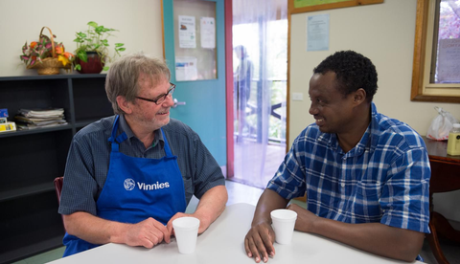
The social order rests on two virtues: justice and charity. But justice supposes great love, since we have to love a person greatly to respect his rights, which border on our rights, and his liberty which troubles our liberty. Yet, while just has limits, charity has none.
Frederic Ozanam
We are not …socialists… in the sense that we do not want the overthrow of society, but we want a free, progressive, Christian reform of it … One cannot avoid the social issues; precisely because they are formidable… We must lay a bold hand on the sore of pauperism
31st May 1848 New Era
Should we remain inactive therefore in the midst of a suffering and groaning world? No, there is a preparatory path open to us: before taking action for the public good we can take action for the good of individuals; before regenerating France, we can solace poor persons. I would further wish that all young people might unite in head and heart in some charitable work and that there be formed through the whole country a vast association for the relief of the common people.
Frederic Ozanam
How do you balance hands on care and work for justice?
In what way do the words of Pope Francis challenge you in your service?
Notes:
He also challenged other young Catholics saying that:
... Religious ideas can have no value if they do not have a practical and positive value. Religion serves less to think than to act; .... The value of Christianity is in this, and not in the attraction of its teachings
He also linked charity and justice
The social order rests on two virtues: justice and charity. But justice supposes great love, since we have to love a person greatly to respect his rights, which border on our rights, and his liberty which troubles our liberty. Yet, while just has limits, charity has none.
In this statement I am reminded of Pope Francis’ statement about the Church
How are we treating the people of God? I dream of a church that is a mother and shepherdess. The church’s ministers must be merciful, take responsibility for the people and accompany them like the Good Samaritan, who washes, cleans and raises up his neighbour. This is pure Gospel.
These words of Francis’ could be applied to us and how we take care of the people who are entrusted to us.
Ozanam recognised that people would criticise him and call him a socialist because he wanted to reform society but he said that:
“We are not …socialists… in the sense that we do not want the overthrow of society, but we want a free, progressive, Christian reform of it … One cannot avoid the social issues; precisely because they are formidable… We must lay a bold hand on the sore of pauperism 31st May 1848 New Era
Frederic didn’t want people to be overwhelmed by the enormity of the need in his time and so he said
Should we remain inactive therefore in the midst of a suffering and groaning world? No, there is a preparatory path open to us: before taking action for the public good we can take action for the good of individuals; before regenerating France, we can solace poor persons. I would further wish that all young people might unite in head and heart in some charitable work and that there be formed through the whole country a vast association for the relief of the common people.
In saying this he also challenges us to do what we can and not to be discouraged by the great need that exists.
How do you balance hands on care and work for justice? In what way do the words of Pope Francis challenge you in your service?

Slide 12
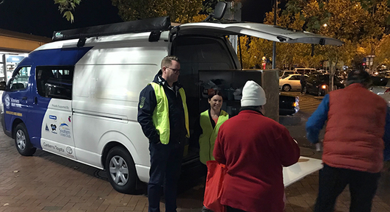

Learning from the people we visit
How many times, burdened by some interior suffering and worried about my continuing ill-health, have I walked full of my own sadness, into the dwelling of a poor person confided to my care. There, because so many unfortunates have more to complain about than I, I scolded myself for being discouraged. I felt strengthened even more against sorrow, and I thanked that poor person who had consoled and strengthened me through the sight of his own sufferings. From that time on how could I not love him?
Frederic Ozanam
What have you learnt from the people you visit?
Notes:
Learning From the People We Visit
The Vincentian tradition that Frederic builds on is based on seeing Christ in the poor. Frederic was a very humble person who learnt from every person he encountered particularly those most in need. He said;
How many times, burdened by some interior suffering and worried about my continuing ill-health, have I walked full of my own sadness, into the dwelling of a poor person confided to my care.
There, because so many unfortunates have more to complain about than I, I scolded myself for being discouraged. I felt strengthened even more against sorrow, and I thanked that poor person who had consoled and strengthened me through the sight of his own sufferings. From that time on how could I not love him?
What have you learnt from the people you visit?
Frederic’s life and faith journey gives us an example to follow. He was an ordinary person who did extraordinary things. For those of us who are part of the Vincentian family and follow in his footsteps we have much to learn from him. I hope that reflecting on his experiences and words help you to discover more about your journey and growth as a volunteer with the Society.

Slide 13
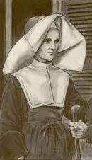
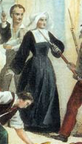
ROSALIE'S BEGINNINGS
Family
What did Rosalie learn from her mother that helped to make her the woman she was?
  Solid simple faith
  Generous respectful outreach to those in need
  Sharing of self and what they have with others
  Capacity to love family and friends (the poor as a D.C.)
  She imbibed her mother’s quiet courage in the face of danger
  Also imbibed her willingness to take risks.
Rosalie’s early life taught her about handling life’s challenges and taking risks for what is right, what were some of your early life lessons?

Slide 14
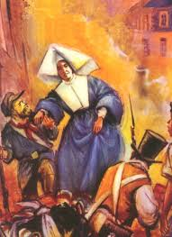
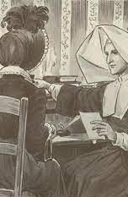
VOCATION
From the age of reason, Jeanne had thoughts of consecrating herself to God. None of the joys of this world attracted her. She wanted no part of its celebrations or glitter. At the same time she felt drawn by its groans and misery
(Armand Melun about Rosalie Rendu)
Rosalie found her seminary period difficult and yet she persevered in her vocation.
What difficulties have you faced in your service and what keeps you going?

Slide 15
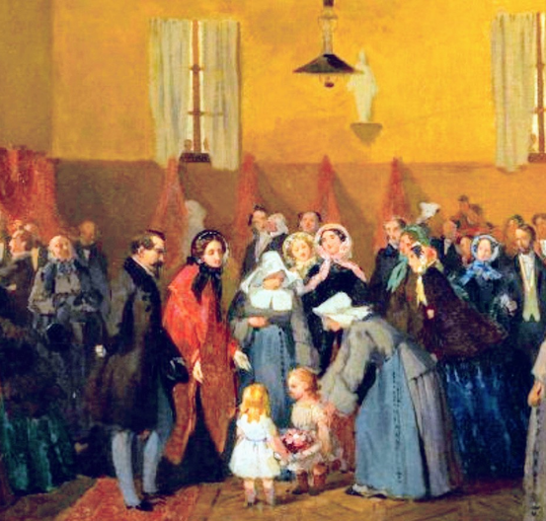
THE APOSTLE OF THE MOUFFETARD DISTRICT
Cherish them. Be patient. You will see that they will change. Above all, sisters, do not discourage them. Later they will feel your affection and want to please you. Rosalie Rendu
She also used to say, “Fear nothing, Sisters, you will never be without assistance so long as your two hands are like this.” She would then stretch one hand in the gesture of giving and extend the other to receive. She then added, “If one hand closes, it will be useless for the other to reach out…Give with measure…Manage well that goods of the poor and God will give to you in abundance . Rosalie Rendu
Sisters, … we are milestones. All have the right to lay their burdens upon us without our having the right to complain. Rosalie Rendu
Rosalie was a tireless worker for the poor and she found many new ways to help them.
What gives you energy in your service of people in need?

Slide 16
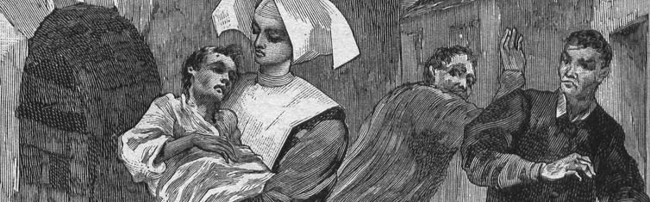
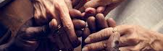
Superior and Formator
Rosalie showed great leadership of others, how do you show leadership, even if you are not in a formal leadership role?
Woman of Prayer
Let us support one another on the way of the Cross and let us walk in the footsteps of our Divine Master. Following His example, let us carry [our Cross] with courage and confidence in His infinite Mercy. Rosalie Rendu
I never pray so well as I do in the streets. Rosalie Rendu
Rosalie was able to blend prayer and service well, how do you manage balance of life?
What nourishes you for service?

Slide 17
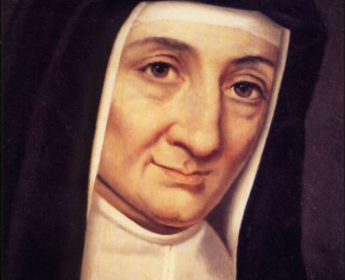
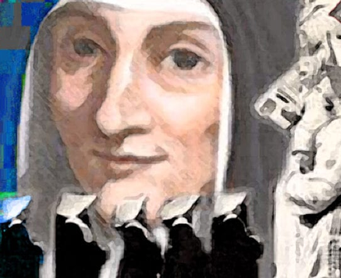
WOMAN OF COURAGE
I am a Daughter of Charity. I do not have a flag. I go to the aid of the unfortunate wherever I encounter them. I promise you, if ever you, yourself, are being pursued and you ask me for help, it would not be refused you. Rosalie Rendu
We are unlikely to be called upon to perform such feats of heroism but we are often called upon to display moral courage and to stand up for what is right.
How well do you stand up against injustice?

Slide 18
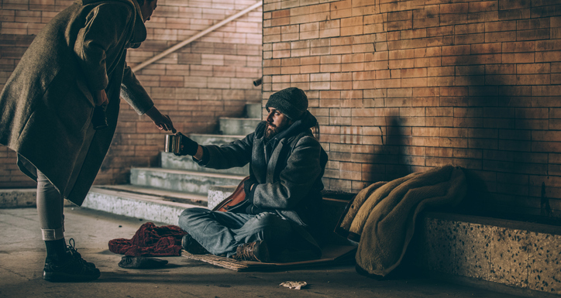
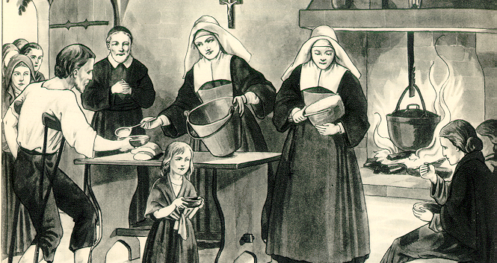
ROSALIE’S NETWORK OF CHARITY
Hate the sin but love the poor persons [who commit it]. If we has suffered as they have, if we had spent our childhood deprived of all Christian inspiration, we be far from their equal.
Be kind and love for love is your first gift to the poor. If you have nothing to give, give yourself.
What does Rosalie’s advice mean to you?
What helps you to see Christ, to see the good,
in the people you serve?

Slide 19
WHAT KIND OF TESTAMENT
WILL YOU LEAVE?

