Slide 1
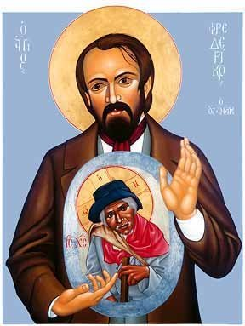
Frederic Ozanam as
Model of Holiness

Slide 2
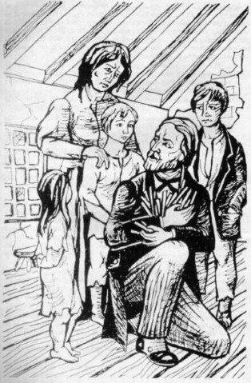
Family
My father was an extremely strong character, but a great heart, tender, compassionate and very sensitive, full of courage, honor and dedication.
…the faith, a noble character and a strong sense of justice, a tireless charity for the poor.

Slide 3
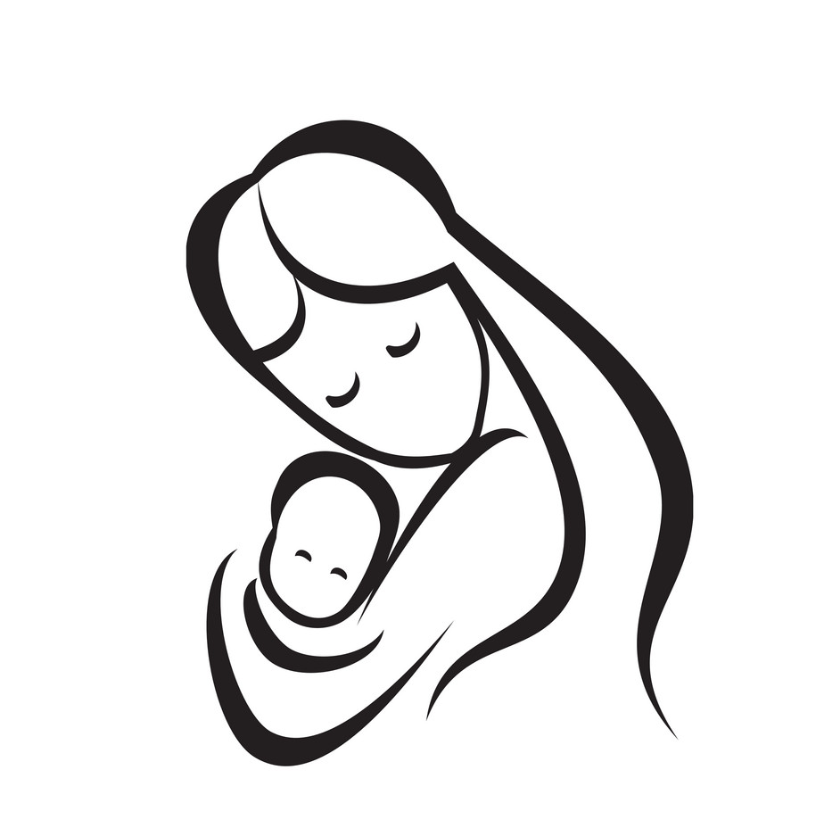
Mother
Frederic Ozanam learned the secret of visiting poor families by accompanying his mother through the streets of Saint-Pierre parish. He knew the poor years before his personal involvement as a member of the Society of Saint Vincent de Paul.

Slide 4
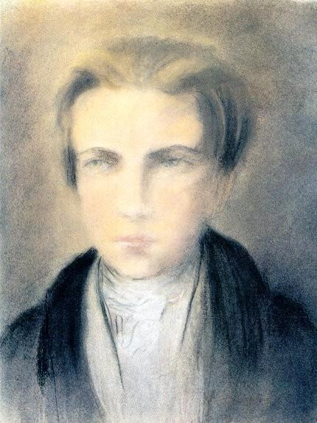
Character
As for the bad, I reduce it to four predominant faults: pride, impatience, weakness, and an extreme meticulousness.
As to the good in me, it is this: a heart which I think not perverse, an intention ordinarily excellent, but which often fails in certain circumstances, and a desire to do well that dominates me overall.

Slide 5
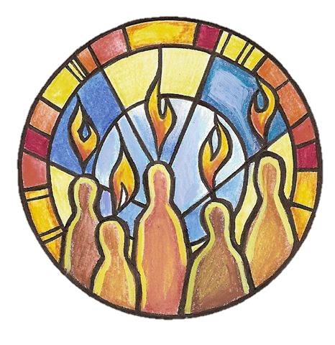
Faith
After constantly listening to unbelievers and to expressions of unbelief, I commenced to ask myself why I believed. I began to entertain doubt, and yet I wished to believe.

Slide 6
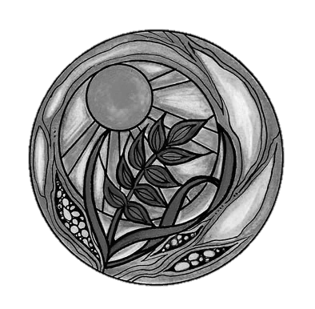
The lack of certitude about my eternal destiny left me no rest. It was then that a priest philosopher saved me. He put order and light into my thoughts. From then on, I believed with a certain faith and, touched by such a rare gift, I promised God to devote my days to the service of the truth that was giving me peace.

Slide 7
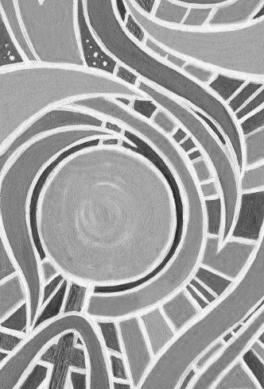
Lumen Fidei
Transformed by this love, we gain fresh vision, new eyes, to see; we realise that it contains a great promise of fulfilment. And that a vision of the future opens up before us. Faith, received from God as a supernatural gift, becomes a light for our way, guiding our journey through time.

Slide 8
If you knew how weak I am! …How I pass from ambitious presumption to discouragement and inaction! What vanity of thought, what puniness of works! What daily abuse of divine graces! What infidelity to generous inspirations! What loss of precious time!...Providence has embraced me with such great solicitude, it has provided me so handsomely with the benefits of education, it has lavished on me such good parents, wise teachers, exemplary friends, that often I am led to reflect that it wishes from me something more than common virtue; and meanwhile…my soul is like a sterile shore which the waves of heaven overflow without fertilizing.

Slide 9
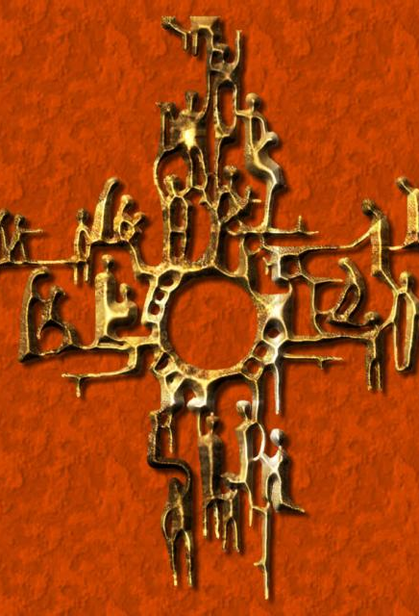
…piety seems to me a yoke, prayer a lip-habit, Christian practices the last branch to which I cling to save myself from falling into the abyss, but the fruit of which I cannot gather.

Slide 10
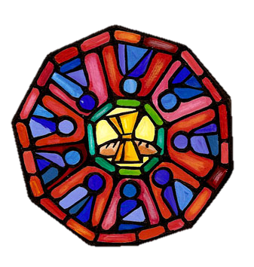
I…believe worship to be the expression of faith, the symbol of hope, the earthly result of the love of God. For that reason I practice it as much as I can and according to the best habits given me from childhood, and find in prayer and the sacraments the needed sustenance for my moral life amid temptations of a consuming imagination and fantasizing world.

Slide 11
…heard the call of holiness; he knew that call and the challenge to grow in the divine life which he had received when he was baptized. He pursued holiness first as a single male, then as a married man and father of a family. Frederic understood that unity with Jesus Christ depended on his willingness and readiness to chooser Him at progressively deeper levels whether it be daily or during each stage of his existence. Frederic was a man of exceptional piety throughout his entire life.

Slide 12
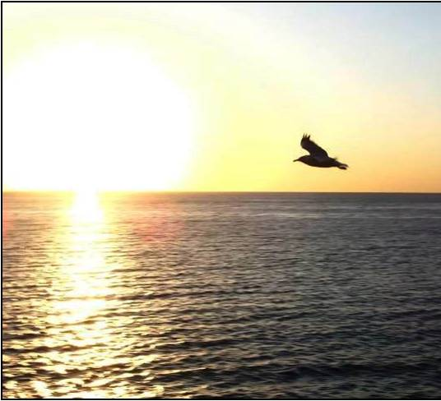
Beyond doubt Providence does not need us for the execution of its merciful designs, but we, we need it and it promises us its assistance only on the condition of our efforts.

Slide 13
Yes, we are unprofitable servants, but we are servants, and wages are given according to the quality of work we are doing in the vineyard of the Lord in the portion assigned to us. Yes, life is despicable if we consider it according to how we use it, but not if we recognize how we could use it, if we consider it as the most perfect work of the Creator, as the sacred vestments with which the Savior has willed to clothe himself: life then is worthy of reverence and love.

Slide 14
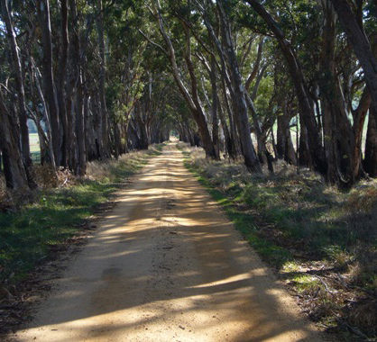
Have you had periods of doubt?
Who and what helped you through these periods?

Slide 15

Vocation
To fortify myself against such a fate, and to inoculate myself against such a contagion, to steep myself in the love of solitude and liberty, I have just concluded a pilgrimage with my brother to the monks of the Grand Chartreuse.

Slide 16
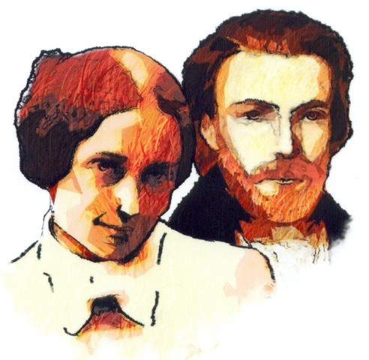
Amelie
May God guard the woman he seems to have chosen for me, and whose smile is the first ray of sunshine that I have had in my life since, the death of my dear father.

Slide 17
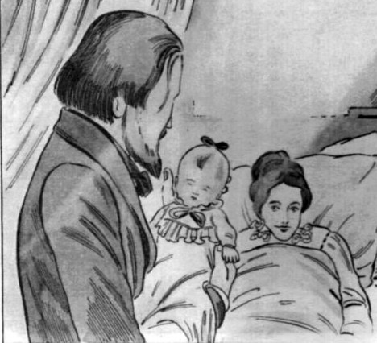
Marie
So many graces stabilized my vocation in this world and put an end to keeping my family apart. A new grace arrived to make me know probably the greatest joy that one can experience her below: I’m a father.

Slide 18
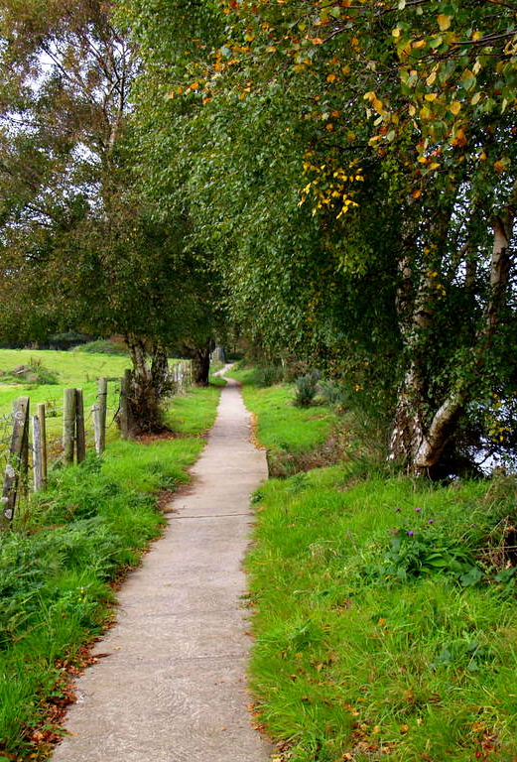
Reflect on your own vocation story and what experiences have led you to find your path in life.

Slide 19
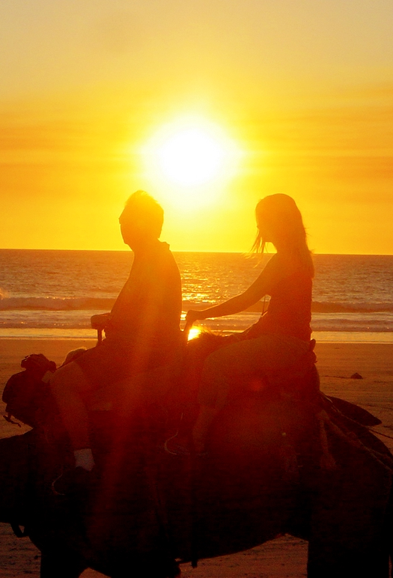
Friendship
friendship has acquired and sacred rights, enjoyments which never give out. Relatives and friends are the two sorts of companions that God has given us along the road of life.

Slide 20
I realized that you are somewhat reticent with me on just one point, since you doubtless fear to open your soul to me: I mean, to speak about faith! I am certain that in this matter, revolutions have occurred in your spirit that you never told me about, and in which nevertheless, I would love to take part, not, of course, to teach you – I couldn’t do that, but to share your worries a little and to offer some consolation.”

Slide 21

He laid out his convictions with a frankness and simplicity that we never (ever?) dare to proclaim and even less hand on to others, even when we are in a small group or at a Conference meeting.
This is a challenge for us.
How do we challenge members to share their faith?
What can we do to encourage this?

Slide 22
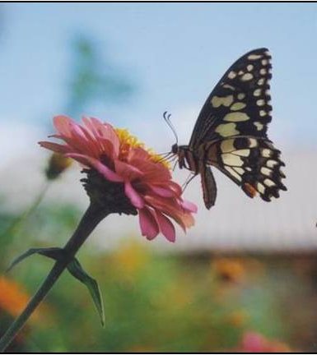
I feel better when I have poured out my heart into the heart of a friend who is a better person than I am. Without realising it in this way you are doing me some good; and these lines that you will read in a few days will have strengthened my heart and will energise my for some time.

Slide 23
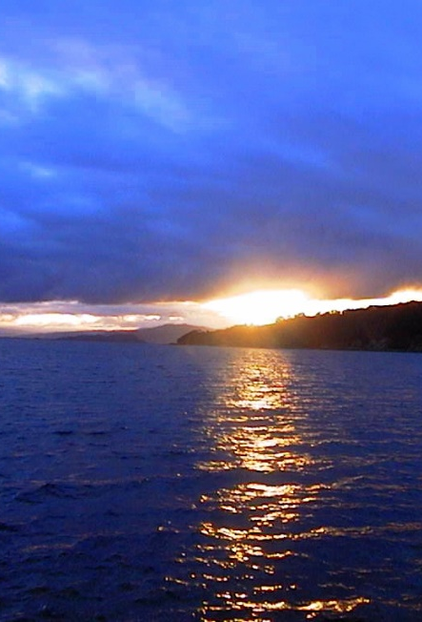
Once we discover the full light of Christ’s love, we realize that each of the loves in our own lives had always contained a ray of that light, and we understand its ultimate destination.
Lumen Fidei

Slide 24
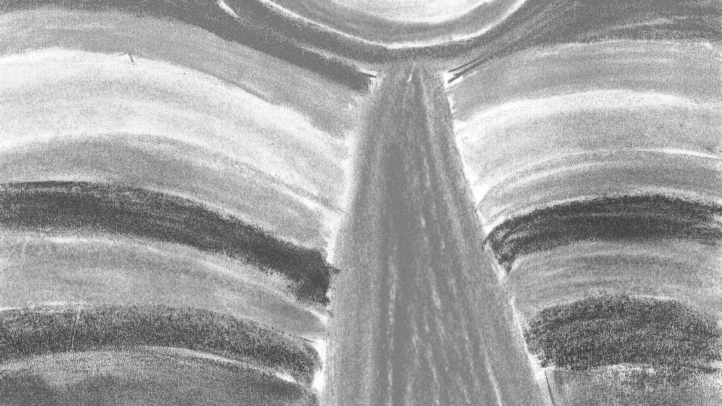
Frederic was someone who built community wherever he went.
How many of us are able to say the same?
Does our faith show through in our relationships?
What kind of role models are we for other Vincentians?

Slide 25
The Society
We understand very well that charity must be done in secret, the work must be unobtrusive. Here we are not strangers to one another; what we have done has been accomplished with the co-operation of one another. The principal end of our association is to do everything with one heart and one soul, of a sort that we recount to one another the different services we have delivered not to be adulated but to give advice and mutual encouragement, to give better service.

Slide 26
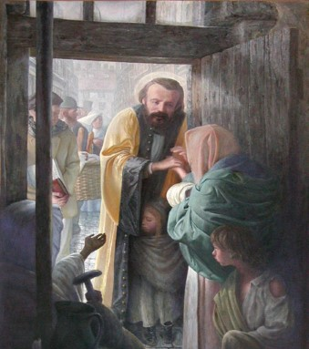
Charity does not consist so much in distributing bread as the manner in which it is distributed.

Slide 27
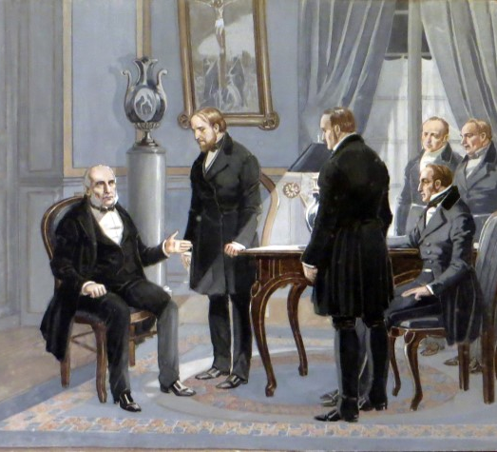
But do you not think that our charitable society itself in order to survive must make these changes, and the spirit of intimacy on which it is built and the daily growth it can only be achieved by breaking it up into groups which would have a common centre and from time to time general assemblies!

Slide 28
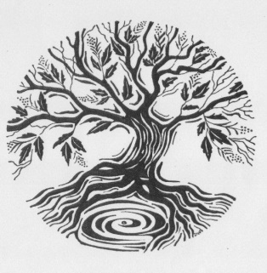
I am very rash to propose my young man’s ideas to you who have a long experience in charity and who are so radically acquainted with our needs and those of the poor.

Slide 29
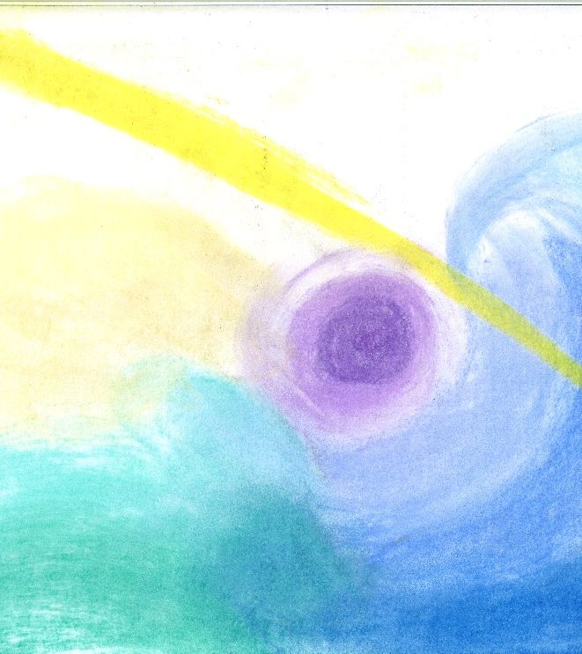
This dear Society is also my family. It is, after God, what kept me in the faith, when I had lost my good and pious parents. I love it, and will hold it in the deepest part of my heart.

Slide 30
A Man for Today
His spirituality fulfills the dual commandments of Jesus: "love God and love your neighbor as yourself." Frederic combined these into one mandate of love, after his patron, St. Vincent de Paul. For Frederic, as for Vincent, love was love; there was one love.
Fr Ronald Ramson

Slide 31
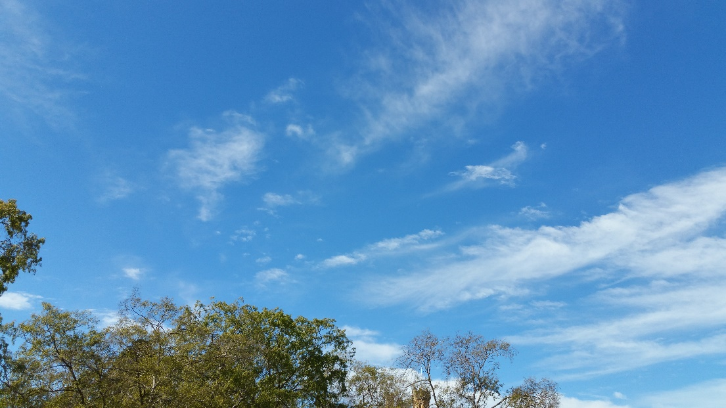
But the fact remains: Frederic was an apostle- one sent forth -to alleviate the spiritual and material misery of his less fortunate brothers and sisters. He was sent by God the service of truth.
Fr Ronald Ramson

Slide 32
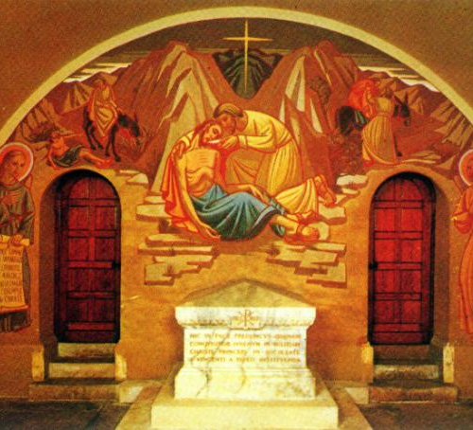
The spirituality of Frederic Ozanam is that of the person in the pew who burns with the desire to love God and neighbor and who, also, wants to put into practice that love. The spirituality of Frederic Ozanam is that of prayer and action, each supporting and fostering the other.
Fr Ronald Ramson

