Slide 1

Introduction to Vincentian Spirituality

Slide 2

What is spirituality?
Notes:
Slide 2
What is Spirituality?
Spirituality can be a somewhat confusing term as it can be used in different ways. People say “I am spiritual but not religious”. The dictionary describes spirituality as the nature of being spiritual and spiritual as relating to the human spirit or soul.
How do you define spirituality?

Slide 3
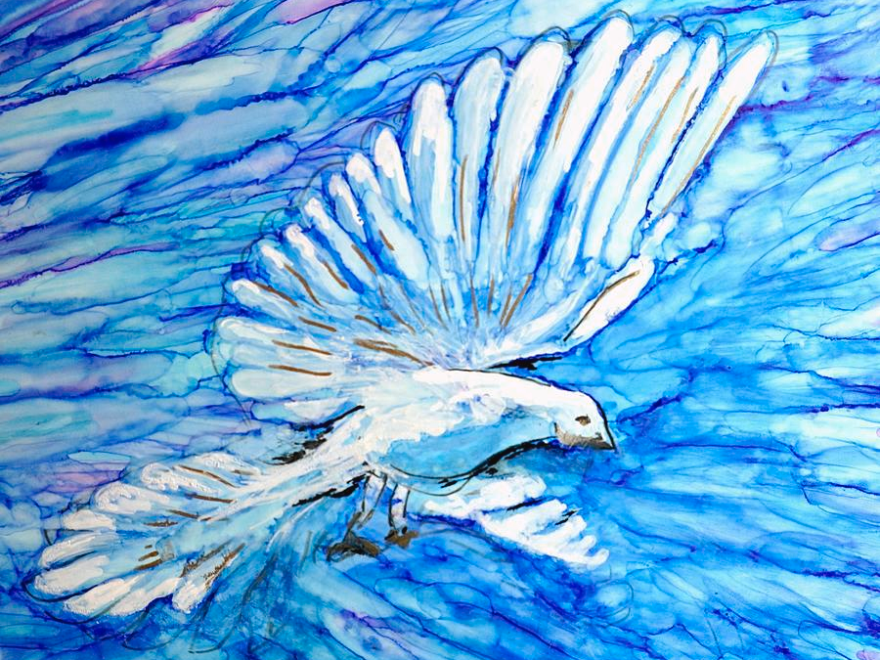
Spirituality
Spirituality is an energizing vision, a driving force. It is on the one hand, the specific way in which a person is rooted in God. It is on the other hand, the specific way in which he or she relates to the created world.
Notes:
Slide 3
I particularly like the way that Fr Robert Maloney describes it:
Spirituality is an energizing vision, a driving force. It is on the one hand, the specific way in which a person is rooted in God. It is on the other hand, the specific way in which he or she relates to the created world. It is insight as the source of action. It is a vision that generates energy and channels it in a particular direction, thereby enabling a person to transcend himself or herself. For a Christian, it is a way of seeing Christ and being in him that directs the individual’s energies in the service of the kingdom.1
What stands out in this definition? Does this fit with your own understanding?
Spirituality involves religious experience, it involves conscious awareness of our relationship with God. Spirituality has long been used by the Church to describe ways of following Christ. We talk about Franciscan spirituality, Benedictine Spirituality or Jesuit spirituality, just to name a few. St Vincent did not write a spiritual rule in the same way as many of these other spiritual leaders did, however, he did begin a way of following Christ.

Slide 4
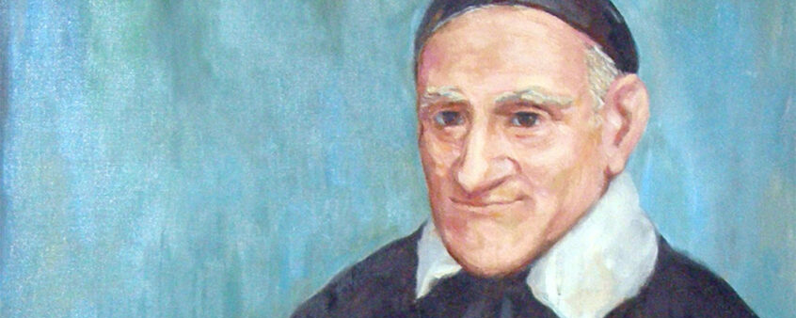
St Vincent de Paul
Notes:
Slide 4
Vincentian Spirituality
Vincent de Paul - Vincentian spirituality starts with the person of St Vincent de Paul. What do you know about St Vincent?
St Vincent was a priest who lived in 17th century France.
Key events in Vincent’s Spiritual Journey
The year was 1617 a year that proved to pivotal in Vincent’s life. In that year;
he heard the confession of the dying peasant
he gave a stirring homily which encouraged others to come to confession and saw how much spiritual need the was among the rural people
he encountered the sick poor at Chatillon and the response of the parishioners which encouraged him to organise charity
In 1625 he started the Congregation of the Mission and met Louise de Marillac. Louise and Vincent complemented each other beautifully and formed a wonderful collaboration, and in 1633 they started the Daughters of Charity. What we call Vincentian spirituality was shaped by Louise as well as Vincen

Slide 5
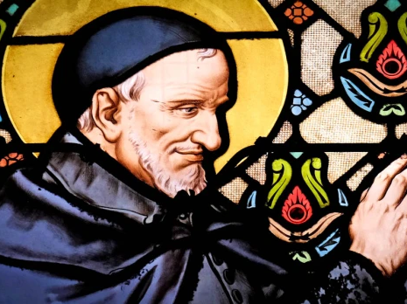
Vincentian Spirituality
Based in experience
“He paid close attention to events and even closer attention to the people who gave meaning to the events.”
Notes:
Slide 5
Vincentian Spirituality
Vincent’s Spirit
Vincent was a man whose spirituality was based in experience. He was the man who said “Such is my belief and such is my experience.”2 Vincent learnt from the experiences of his life, he saw what was happening around him and was changed by it. His experience with the dying peasant led him to realise the need that was out there and to want to help. Vincent was a man who reflected on his experiences, Dodin says “He paid close attention to events and even closer attention to the people who gave meaning to the events.”3 Vincent looked at this experience through the lens of faith.

Slide 6
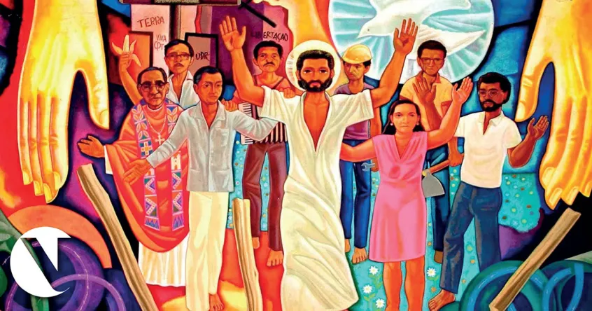
Jesus Evangelizer of the Poor
“He has sent me to bring good news to the poor”
Notes:
Slide 6
Jesus Evangelizer of the Poor
His faith was based on the person of Jesus. Jesus was for him the evangelizer of the poor who said:
The spirit of the Lord is on me, for he has anointed me to bring the good news to the afflicted. He has sent me to proclaim liberty to captives, sight to the blind, to let the oppressed go free, to proclaim a year of favour from the Lord. He then rolled up the scroll, gave it back to the assistant and sat down. And all eyes in the synagogue were fixed on him. Then he began to speak to them, 'This text is being fulfilled today even while you are listening.' ( LK 4:18-21)

Slide 7
charity is obligatory
This charity is obligatory; it’s a divine precept, which embraces several others. Each of us knows that the Law and the Prophets are included in the love of God and neighbor. Everything refers back to that; everything is directed to it; and this love has such strength and is so privileged that anyone who possesses it fulfills the laws of God because they all relate to this love, and this love helps us to do whatever God asks of us…
St Vincent
Notes:
Slide 7
For Vincent contact with people experiencing poverty was a vital part of his faith and his relationship with God. He said:
“This charity is obligatory; it’s a divine precept, which embraces several others. Each of us knows that the Law and the Prophets are included in the love of God and neighbor. Everything refers back to that; everything is directed to it; and this love has such strength and is so privileged that anyone who possesses it fulfills the laws of God because they all relate to this love, and this love helps us to do whatever God asks of us4

Slide 8
words of Holy Scripture
Jesus Christ must be involved in this with us—or we with Him—so that we may act in Him and He in us, that we may speak as He did and in His Spirit, as He himself was in His Father, and preached the doctrine He had taught Him; those are the words of Holy Scripture.
St Vincent
Notes:
Slide 8
This shows that for Vincent love and action are two important pillars of his spirituality. Vincent’s spirituality is incarnational, God is in the poor and the poor are in God. Everything that Vincent did was based in Jesus
Jesus Christ must be involved in this with us—or we with Him—so that we may act in Him and He in us, that we may speak as He did and in His Spirit, as He himself was in His Father, and preached the doctrine He had taught Him; those are the words of Holy Scripture.5

Slide 9
Effective and Affective Love
To understand this clearly, Sisters, you should know that there are two kinds of love: one is called affective, and the other, effective. Affective love proceeds from the heart. The person who loves is filled with warmth and affection, is continually aware of the presence of God, finds satisfaction in thinking about Him, and spends her life imperceptibly in such contemplation. …
Love is effective when we act for God without experiencing its warmth.
Notes:
Slide 9
St Vincent spoke of two kinds of love
To understand this clearly, Sisters, you should know that there are two kinds of love: one is called affective, and the other, effective. Affective love proceeds from the heart. The person who loves is filled with warmth and affection, is continually aware of the presence of God, finds satisfaction in thinking about Him, and spends her life imperceptibly in such contemplation. Thanks to this love, she does, with no difficulty-and even with pleasure-the most difficult things, and is vigilant and careful concerning anything that can make her pleasing to God; lastly, she basks in this divine love and takes no pleasure in any other thoughts.
Love is effective when we act for God without experiencing its warmth. This love isn't perceptible to the soul; it doesn't feel it, but it still produces its effect and completes its act.6

Slide 10
Where there is charity, God abides
Where there is charity, God abides. An important person has said that God’s cloister is charity. He enjoys being there, his place of delight is there; it is the dwelling place in which he is well pleased. Be charitable, be kind, have the spirit of forbearance, and God will live in your midst. You will be his cloisters, you will have him in your home and you will have him in your hearts.
St Vincent
Notes:
Slide 10
He believed that we must respond to the love of God by showing this love to others.
Where there is charity, God abides. An important person has said that God’s cloister is charity. He enjoys being there, his place of delight is there; it is the dwelling place in which he is well pleased. Be charitable, be kind, have the spirit of forbearance, and God will live in your midst. You will be his cloisters, you will have him in your home and you will have him in your hearts.7

Slide 11
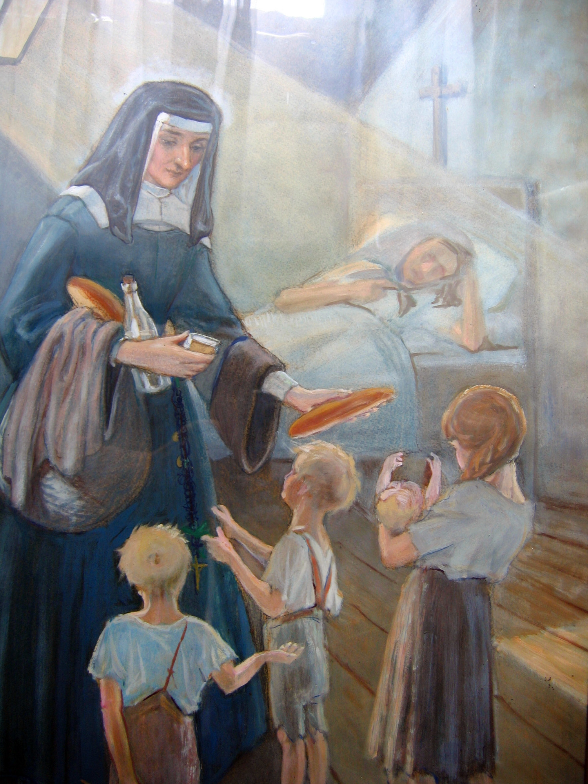
St Louise
Illegitimate,
Orphaned,
Married,
Mother,
Widow,
Single mother.
Notes:
Slide 11
St Louise – Vincent and in turn Vincentian spirituality were profoundly affected by St Louise.
St Louise’s Story
Louise de Marillac was born the illegitimate child of Louis de Marillac and an unknown mother. Her father recognised her as his child and provided for her. However, he remarried when she was 3 and she was not welcomed by her stepmother. She spent the first 12 years of her life at the Dominican convent at Poissy where she received a good education. Her Father died when she was 12 and she had to leave the convent and she went to a domestic school where she learnt many domestic skills.
Louise wanted to enter religious life and approached the Capuchin sisters but was rejected. Then her family arranged marriage for her to Antoine Le Gras. They had a happy marriage and soon had a son Michel. Their happiness was, however, short lived because within a few years Antoine became ill. Louise slipped into depression feeling guilty because she had not lived up to her promise to become a nun.
Light of Pentecost - it was about this time that Louise had a profound spiritual experience. She referred to this experience as her “Light of Pentecost”8. In this experience her mind was “mind was instantly freed of all doubt” and she was reassured that she should stay with her husband. She was also shown that “time would come when I would be in a position to make vows of poverty, chastity and obedience and that I would be in a small community where others would do the same.”

Slide 12
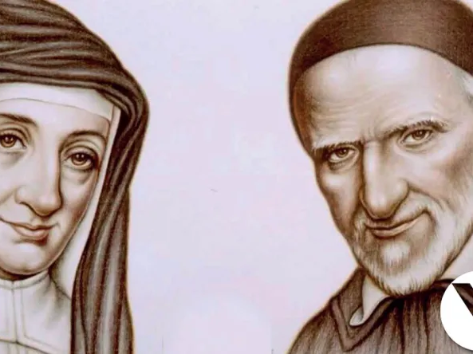
St Louise and St Vincent
Notes:
Slide 12
Antoine died in 1625 and it was around this time that Louise met St Vincent. This relationship would prove to be incredibly important for both of them and for the service of the poor in France. Vincent supported and encouraged her while she grieved for her husband and found her way in the world as a widow and single mother.
In 1629 Vincent sent her on mission to visit the Confraternities that he had started in various parishes throughout France. Louise was given the task of making sure that these Confraternities were following the Rules and providing for the sick poor appropriately. We see here Louise’s prodigious talents for organisation and for teaching others were put to great use. In time there were younger women offering to give themselves to help the Charities, and this inspired Louise to take them into her home and begin the Daughters of Charity.

Slide 13
beautiful virtues in us
Where are the gentleness and charity that you must preserve so carefully when dealing with our dear Masters, the sick poor? If we deviate in the slightest from the conviction that they are the members of Jesus Christ, it will infallibly lead to the weakening of these beautiful virtues in us.
St Louise
Notes:
Slide 13
Louise’s spirit is indicate in the following quotes:
Where are the gentleness and charity that you must preserve so carefully when dealing with our dear Masters, the sick poor? If we deviate in the slightest from the conviction that they are the members of Jesus Christ, it will infallibly lead to the weakening of these beautiful virtues in us. Spiritual Writings. L. 104B Pg.113

Slide 14
serving them from the heart
As for your conduct toward the sick, may you never take the attitude of merely getting the task done. You must show them affection; serving them from the heart; inquiring of them what they might need; speaking to them gently and compassionately.
St Louise
Notes:
Slide 14
As for your conduct toward the sick, may you never take the attitude of merely getting the task done. You must show them affection; serving them from the heart; inquiring of them what they might need; speaking to them gently and compassionately. Spiritual Writings. Pg. 773 A. 85

Slide 15
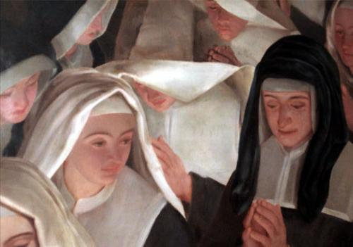
Gentleness, cordiality and forbearance must be the practices of the Daughters of Charity just as humility, simplicity and the love of the holy humanity of Jesus Christ, who is perfect charity, is their spirit.
St Louise
Notes:
Slide 15
Gentleness, cordiality and forbearance must be the practices of the Daughters of Charity just as humility, simplicity and the love of the holy humanity of Jesus Christ, who is perfect charity, is their spirit. 9
Vincentian spirituality was built on the inspiration of Vincent and Louise and then further shaped by each person who walked in their footsteps.

Slide 16
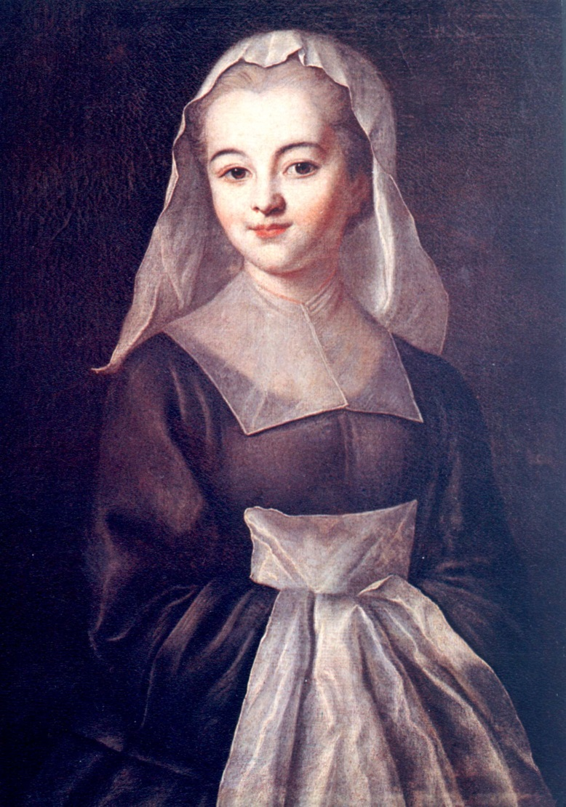
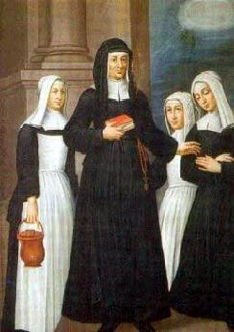
Daughters of Charity
Louise had finally realised her dream of religious life. She became a great Superioress who formed these young women into teachers, nurses and servants of the poor. The community quickly grew and spread to various locations in France and eventually to Poland.
Notes:
Slide 16
Daughters of Charity. As we saw above young women such as Marguerite Naseau were offering themselves to help the Charities. Marguerite Naseau died of the plague from sharing her bed with someone who was suffering with it. Louise saw that young women like her needed more support. She became convinced that these young women should be brought together. It took her some time to convince Vincent that this was the path to follow. On the 29th of November she took 4 young women into her home. Louise had finally realised her dream of religious life. She became a great Superioress who formed these young women into teachers, nurses and servants of the poor. The community quickly grew and spread to various locations in France and eventually to Poland. (In their lifetime)

Slide 17
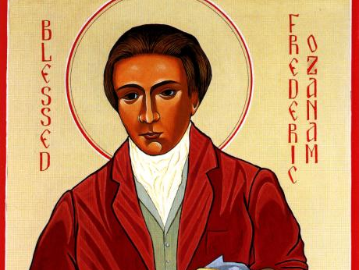
Frederic Ozanam
Nineteenth Century
Layman
Husband
Father
Founder
Notes:
Slide 17
Frederic Ozanam
Frederic Ozanam came along 2 centuries after Vincent and Louise and further developed Vincentian Spirituality. Frederic was a layman, a husband and father which gave a different dimension to his spirituality.

Slide 18
Frederic ozanam
It is all in order to love God, or at least one believes that he loves Him more than before because one feels a lively gratitude for Him, for him who on exile here on earth, in this capital of corruption, has reserved for us so large a share of happiness and life. It also makes one love more than ever a religion that makes all of its children equals and gathers together the great and the small who, despite the proud disciples of egoism hating and quarrelling among themselves, inspire you with so much love for humanity.
Frederic Ozanam
Notes:
Slide 18
Faith was what drove Frederic, it was the reason that he reached out to others. He began the Society because of a challenge to put his faith into practice. His life was founded on the love of God and because of this love he was enabled to reach out to others.
Frederic reminds us that
It is all in order to love God, or at least one believes that he loves Him more than before because one feels a lively gratitude for Him, for him who on exile here on earth, in this capital of corruption, has reserved for us so large a share of happiness and life. It also makes one love more than ever a religion that makes all of its children equals and gathers together the great and the small who, despite the proud disciples of egoism hating and quarrelling among themselves, inspire you with so much love for humanity. 10
These words tell us that Frederic was driven by love. He was a person of compassion and he showed this compassion to his family, his friends and the people in need that he helped. Along with this compassion was a recognition that in helping others there must be some mutuality.

Slide 19
humiliates when there is no reciprocity
Help is humiliating when it appeals to men from below, taking heed of their material wants only, paying no attention to those of the flesh, to the cry of hunger and cold, to what excites pity, to what one succours even in beasts. It humiliates when there is no reciprocity…
Notes:
Slide 19 & 20
Help is humiliating when it appeals to men from below, taking heed of their material wants only, paying no attention to those of the flesh, to the cry of hunger and cold, to what excites pity, to what one succours even in beasts. It humiliates when there is no reciprocity, when you give the poor man nothing but bread, or clothes or a bundle of straw – what, in fact there is no likelihood of his giving you in return…But it honours when it appeals to him from above, when it occupies itself with his soul, his religious, moral, and political education, with all that emancipates him from his passions and from a portion of his wants, with those things that make him free and may make him great. Help honours when to the bread that nourishes it adds the visit that consoles, the advice that enlightens, the friendly shake of the hand that lifts up the sinking courage; when it treats the poor man with respect, not only as an equal but as a superior, since he is suffering what perhaps we are incapable of suffering; since he is a messenger of God to us, sent to prove our justice and our charity and to save us by our works.11
This sense of mutuality adds another dimension to Vincentian Spirituality. In this vision we see the person as not only representing Christ to him but as being able to minister to him. This vision of the encounter between him and the people he served helped him to minister with humility and deep compassion.
Frederic was not only someone who provided practical care to the poor and encouraged others to do the same. He also was a person of deep empathy and gave spiritual care to the people that he helped.

Slide 20
friendly shake of the hand
Help honours when to the bread that nourishes it adds the visit that consoles, the advice that enlightens, the friendly shake of the hand that lifts up the sinking courage; when it treats the poor man with respect, not only as an equal but as a superior, since he is suffering what perhaps we are incapable of suffering; since he is a messenger of God to us, sent to prove our justice and our charity and to save us by our works.
Frederic Ozanam

Slide 21
LET US BE BETTER
Ah! My dear friend, what a troublous, but what an instructive time it is, through which we are passing! We may perish, but we must not regret having lived in it. Let us learn from it. Let us learn, first of all, to defend our belief without hating our adversaries, to appreciate those who do not think as we do, to recognize that there are Christians in every camp, and that God can be served now as always! Let us complain less of our times and more of ourselves. Let us not be discouraged, let us be better.
Frederic Ozanam
Notes:
Slide 21
Frederic was a collaborator and someone who built community and was inclusive. He encourages us to do the same.
Ah! My dear friend, what a troublous, but what an instructive time it is, through which we are passing! We may perish, but we must not regret having lived in it. Let us learn from it. Let us learn, first of all, to defend our belief without hating our adversaries, to appreciate those who do not think as we do, to recognize that there are Christians in every camp, and that God can be served now as always! Let us complain less of our times and more of ourselves. Let us not be discouraged, let us be better.

Slide 22
JUSTICE
AND
MERCY
Through the language of works: performing the works of justice and mercy which are a sign that the kingdom of God is really alive among us: feeding the hungry, giving drink to the thirsty, helping to find the causes of their hunger and thirst and the ways of alleviating it...
Notes:
Slide 22 &23
A good summary of Vincentian spirituality is that it is a union of contemplation and action. Vincentians say that we see Christ in the poor and in order to be able to do so, we need to reflect on our experience of service and become more open.
The following is a good summary of Vincentian spirituality:
Vincentians seek, in their relationship with those in need, to bear witness to the love of Christ for each one of us. The mission to the spiritually needy and the materially needy are integrally related and cannot be separated; one without the other is worthless. Our proclamation of the good news will resound in people’s hearts especially when we give vibrant witness:
•through the language of works: performing the works of justice and mercy which are a sign that the kingdom of God is really alive among us: feeding the hungry, giving drink to the thirsty, helping to find the causes of their hunger and thirst and the ways of alleviating it;
•through the language of words: announcing with deep conviction the Lord’s presence, his love, his offer of forgiveness and acceptance to all;
•through the language of relationships: being with poor persons, working with them, forming a community that shows the Lord’s love for all.
http://vinformation.famvin.org/vincentian-spirituality/

Slide 23
Word and deed
through the language of words: announcing with deep conviction the Lord’s presence, his love, his offer of forgiveness and acceptance to all;
through the language of relationships: being with poor persons, working with them, forming a community that shows the Lord’s love for all.

