Slide 1




Jesus’ Teaching on Servant Leadership
By John Maxwell

Slide 2
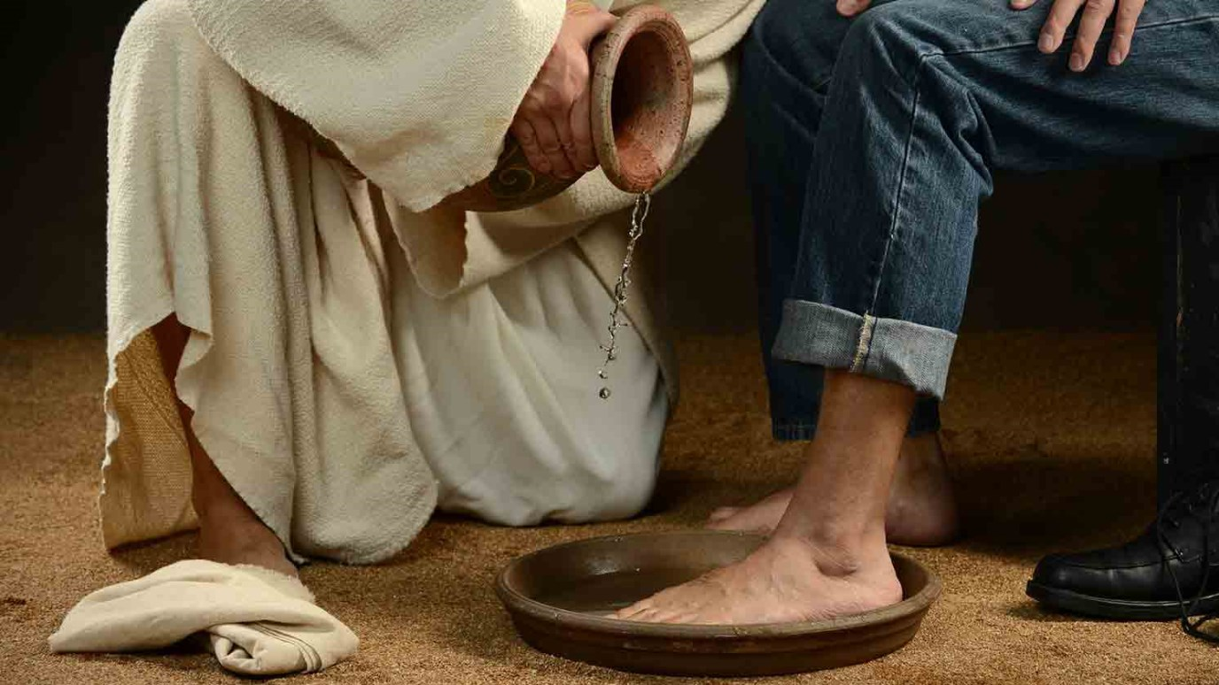
When you think of servanthood, do you envision it as an activity performed by relatively low-skilled people at the bottom of the flow chart? Often we assume that if we serve, people will lower their view of us. But this is wrong.
Think for a moment about the person who has served you more than anyone else in your life. Answers might vary, but most people will automatically respond, “My mother.” Moms seem to be the greatest example of servanthood as they naturally serve the members of their family.

Slide 3


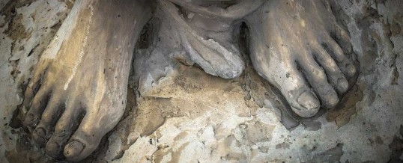
Now here’s another question:
Do you have a lower view of your mother because she serves you, or a higher view of her?
Most everyone would say a higher view. Why? Serving other people has exactly the opposite effect on them from what we think it will. People are drawn toward those who serve them sacrificially, not repelled by them. Service adds value to people.
Servanthood is not about position or skill. It’s about attitude. Leaders seek ways they can add value to others, and the primary way they do it is by serving them.

Slide 4

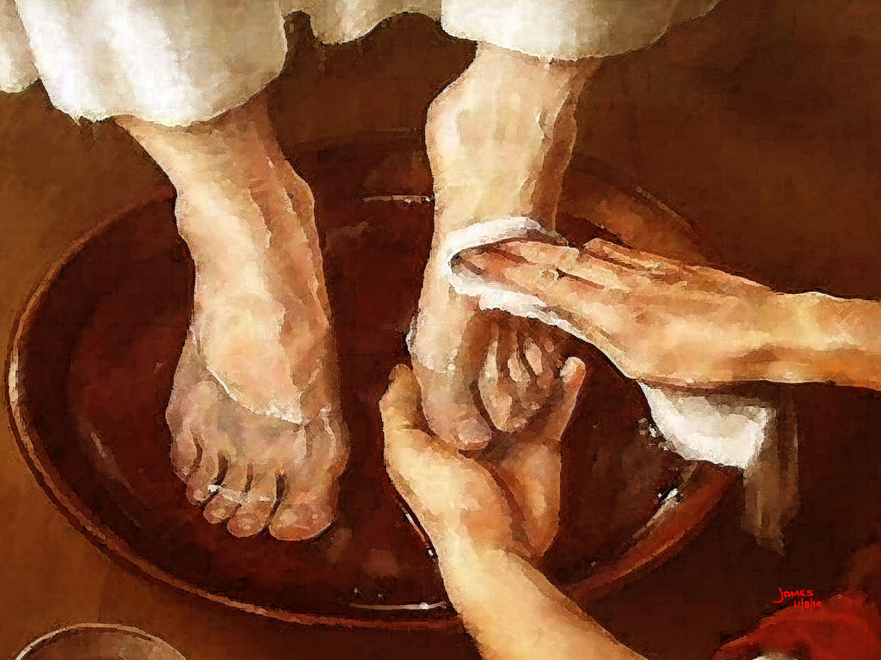
In John 13, the Saviour of the world exhibited that he was also the greatest Servant of all time. The story is familiar to many. When the disciples booked the upper room for the Passover feast, they forgot to secure the services of a servant to wash feet at the door. It was a custom to do this. Interestingly, as the disciples realized the servant was missing, none of them volunteered for the job. Instead, they argued over who was the greatest.
When Jesus saw this, he decided to make an object lesson out of it. So after supper, Jesus stripped down to a garment around his waist. He even looked the part of the servant! Then he took a basin of water and a towel and began washing his disciples’ feet. As Jesus interacted with his men, several lessons about service and adding value arose.

Slide 5

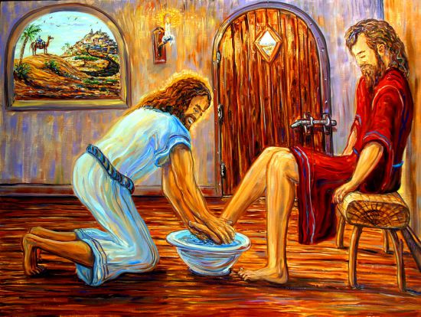
Christlike Servant Leaders …

Slide 6

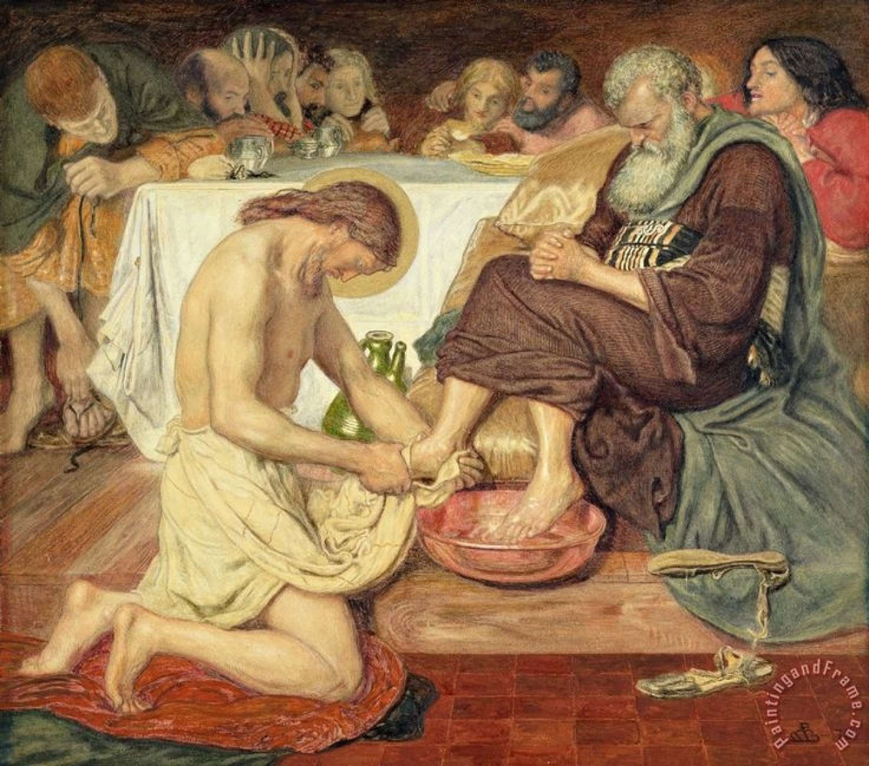

1. ARE MOTIVATED BY LOVE...
to serve others (John 13:1–2). Jesus’ love was undeserved, unending, unconditional and unselfish. It was not the worthiness or the merits of the disciples that drove Jesus to serve them. He wasn’t expressing gratitude, but grace. Love made him serve his disciples. Think about it: Jesus even washed the feet of Judas Iscariot, the man who would betray him and have him killed the next day.
2. POSSESS A SECURITY...
that allows them to serve others (John 13:3). Jesus knew who he was, and he was secure enough to get down on the floor and wash his disciples’ feet. He didn’t have to prove anything. In fact, he had nothing to prove, nothing to lose and nothing to hide. The insecure are into titles. The secure are into towels. Jesus’ security enabled him to both stoop and stretch.

Slide 7


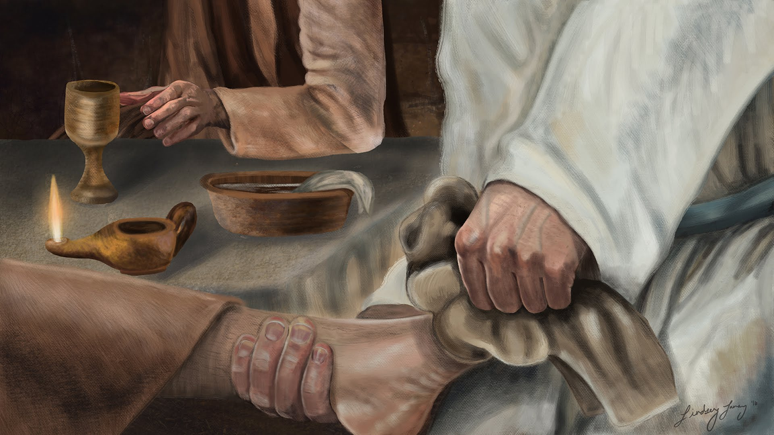

3. INITIATE SERVANT LEADERSHIP
to others (John 13:4–5). Jesus didn’t wait for someone to clarify protocol. He saw a need and met it. No one else had volunteered for the foot-washing job that night—so Jesus made an object lesson out of the event. He started something that he hoped would be passed down from those twelve disciples to others (see John 13:12–15). Foot washing will never be in vogue. It will be done by leaders who are willing to pioneer an act of humility and sacrifice.
4. RECEIVE SERVANT-MINISTRY
4. RECEIVE SERVANT-MINISTRY from others (John 13:6–7). A servant’s heart exposes pride in others. Peter had a hard time letting Jesus serve him. He still possessed a worldly mindset that assumed that someone of Jesus’ caliber should never stoop to wash feet. Sometimes leaders must learn to let others serve them. Because they become so used to serving others, it is difficult for them to relax and receive. In this instance, Jesus was asking Simon Peter to sit and allow the Master to serve him.

Slide 8
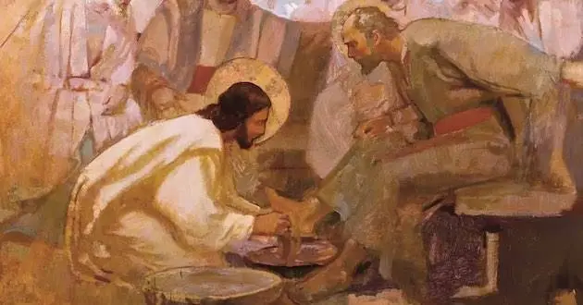
5. WANT NOTHING TO HIDER THEIR RELATIONSHIP...
with God (John 13:8–9). Peter moved from one extreme to the other. If Jesus was going to wash him, he didn’t want to miss anything he might do. He wanted Jesus to wash his entire body. Simon Peter exhibits a great attitude here. If Jesus was giving away, he wanted to receive all that Jesus had to give; he didn’t want anything to stand between him and his Lord.
6. TEACH SERVANTHOOD...
by their example (John 13:12, 15). Afterward, Jesus discussed the meaning of his foot washing. He reminded them that the Master and Lord had just washed their feet, so no position should prevent them from doing it for someone else. Jesus let them know that if the Master washed their feet, they ought to imitate him. His model was to be reproduced. In fact, his example was much more powerful than a lecture about the principles of service. Actions speak more loudly than words.

Slide 9
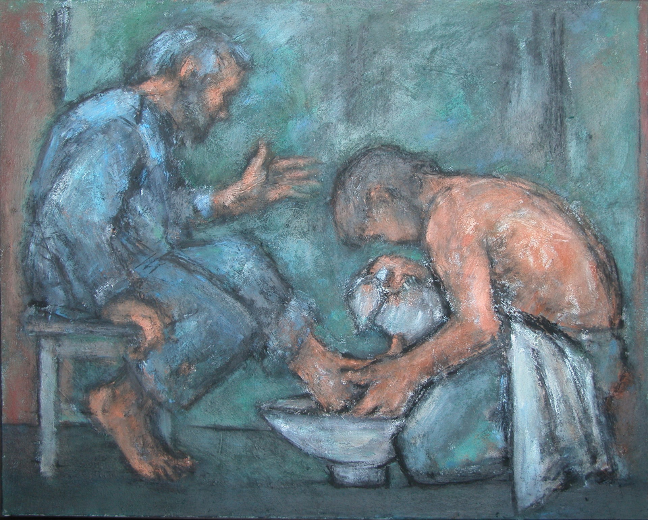
7. LIVE A BLESSED LIFE...
(John 13:16–17). Jesus reminded them they were blessed if they obeyed him in this lifestyle. The greatest blessing follows those who step out by faith and do the opposite of what the world is doing. God blesses those who “go countercultural” and serve people with no thought of getting something in return from them. The return comes in the form of God’s blessing.
When leaders serve, they add value to the people who receive their service. This value might be as simple as feeling worthwhile or special. It could be that the value is a resource we put in people’s hands or a word of encouragement we speak to them. Whatever it is, people always receive something and feel better about themselves because of their leader.
A good habit for a leader is try to add value to everyone he or she meets; try to add something to their lives rather than take away. Seek to replenish and resource them to live the higher life God has called them to. This is what Jesus did, day in and day out. Maybe that’s why people think so highly of him. He served.

Slide 10

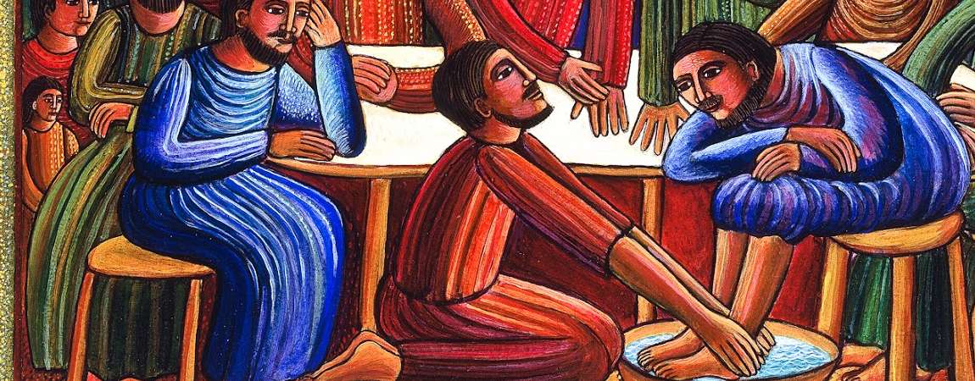
Leadership Applications
• Put others ahead of your agenda.
• Develop the confidence and security to take risks.
• Look for a need and take initiative.
• Perform small acts anonymously.
• Learn to walk slowly through the crowd.
• Begin your day reflecting on the love you have for others in your life.
• Develop a bias for action.

