Slide 1
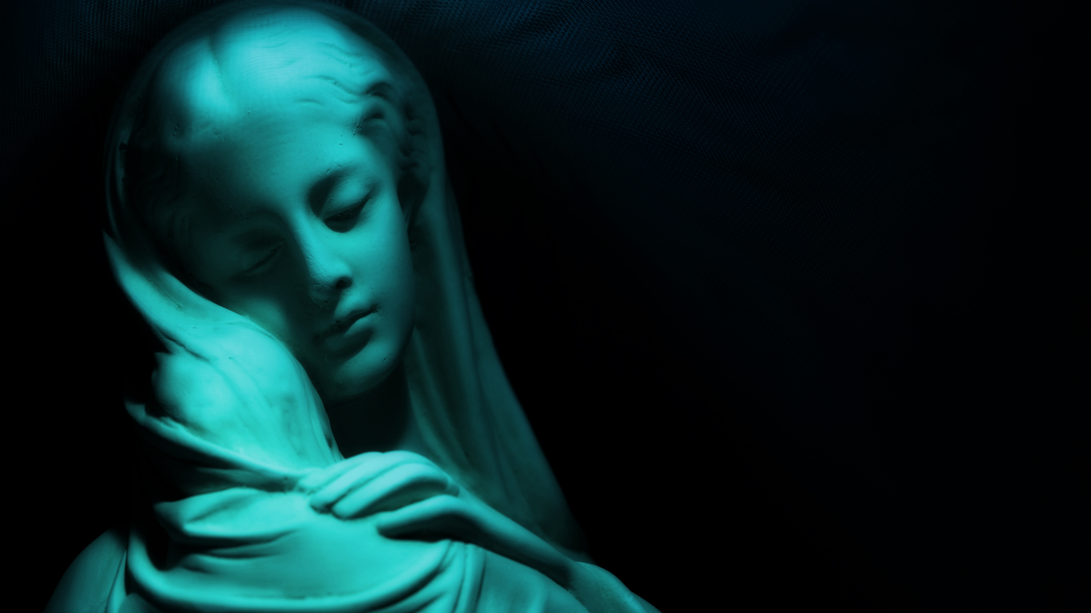
Mary
... in the Vincentian Tradition

Slide 2

Opening Hymn

Slide 3
I remember my mother telling me when I was very young. ““Go out and play with Michael and his brother; they’re nice boys!”
Of all the kids on the block, why Michael and his brother?
Answer: Because my Mum thought he’d be a good influence on me.
In her mind there was this thought: “I want you to hang around friends who are going to lead you in the right way and not the wrong.”
“People influence people for good or for bad. I want my children take in the good kind of influence.”
And that’s much of what’s behind our being with Mary, Louise and Vincent, as we all praise God.
They’re good influences (among the other things they are.)
In our wish to praise God, be in contact with God, come before God –
they can lead us rightly and fortify us.
they can show us some of the way, and open us
to what it is that energizes our own praising of God.
Interestingly, Vincent de Paul was not known for a special devotion to Mary.
He was wary of excesses that in his time had crept into Marian devotion.
And so, compared to a number of spiritual luminaries of his day, he was seen to downplay it.
But, when you read what he wrote, and watch him in the way he actually prayed, acted and praised God,
the figure of Mary looms large; she was very influential.
What are Vincent’s key insights about the Blessed Mother and Praising God?
Commentators tells us that his thoughts come together in the interplay of three events in Mary’s life he referred to often.
But more to our point this evening, he was attracted to these events because they carry three basic attitudes that enable us to praise God rightly,
and continue to do that ever more genuinely.

Slide 4
“Praise God!” Now there are two words that go together.
In the presence of God, the very first instinct is to praise
– How Great Thou Art, All Honor and Glory to
God, My Soul Glorifies the Lord. Praise God.
We come here to act out/on these words once again, praising God.
And the way we do it tells us that
there’s more than one way to do it.
We praise God by our good deeds and our sacrifices.
We praise by the example of a life generously lived.
We glorify God by treating the environment not as our possession but as God’s gift.
We will be using music to praise God.
There are of course words involved, but they are carried along by song.
There are these words I speak now, but music is more immediate,
a more primal speech, closer to the soul,
better able to carry praise from our insides,
where we feel it, to our outsides where we can say it and show it.
Music has always been a front line/first-response kind of praising.
The psalms demonstrate that. So does Mary’s classic song we’ll hear, the Magnificat.
Let's consider three things:
the praise music,
the Mary theme it will sing out,
and the spiritual legacy that comes to us from St. Vincent de Paul and Louise de Marillac.

Slide 5
So, what do we find out about Mary in Vincent’s life?
By looking at these 3 events in Mary’s life that Vincent was drawn to, we can see the “good influence” Mary had on him.
And by letting ourselves praise God with these same kinds of attitudes, we ourselves come under the good influence of Vincent.
I haven’t yet mentioned the Marian influence of the other Vincentian founder, St. Louise de Marillac.
What influence does she bring to the Vincentian Family.
And so let me do that.
People who study her suggest that her insight into praise of God is this she frequently wrote of the nourishment that comes from identifying with Mary.
With Louise it was identification with their common experience of Motherhood. She understands Mary primarily through Louise’s own experience of being a mother.
She knows of Mary’s special brand of joy (Magnificat Joy) through of her own joy at having a son.
She knows of Mary’s sorrows from the inside through the pains and worries she suffered as a mother.
In other words, she knows Mary’s stance before God through the hard things she learned and had to re-learn through this very central experience in her own life.
The point here is not necessarily about motherhood itself, but rather identification with aspects of Mary’s life.
This a way to help us in our praise of God.
And so we identify with Mary’s fears, and with the trust with which she faced those fears.
We know Mary’s poverty(her lowliness) in our own, and learn the way she turned that lowly state into openness to God,
and present-moment gratitude for what she’s being given.
Louise would influence us by pointing how powerful and nourishing it can be if we let our life’s experience be an entrance into how it was inside of Mary
as she came before God, -- as she praised God. That is, through identification, Mary teaches us how to praise God.

Slide 6
The first is the Immaculate Conception, Mary conceived without sin.
This is a teaching/devotion that wants to shine a light on the fact that Mary put up no resistances to the workings of God within her.
She was 100% cooperative.
Rather than closing down to the movements of God within her, she was wide open to them, fully sensitive to them.
Rather than filtering out any of the light of God shining within her, right from the beginning she let herself be totally exposed to it.
So, the praise-attitude that Mary images here (and that Vincent notices) is
be open, as open as you possibly can be, to the promptings of God’s Spirit within and around you.
Praise God this way.
The second is the Annunciation, the scene where the angel visits Mary and announces she is to be the Mother of God.
At the end of the conversation (which as you might remember wasn’t an easy conversation), she offers herself for whatever God wants
“Be it done unto me according to your word.”
And this is our second attitude in praising God: I’m here at your beckoning; show me Your way and I’ll walk it.
“Who am I that the Lord should come to me? But the Lord did come to me -- and I’m at his service. My spirit rejoices in God my Savior
Praise God this way.
The third is the Visitation, the time when Mary travels to be with her Cousin, Elizabeth, to help her in her old-age pregnancy.
The detail that Vincent picks up on is how Mary went to Elizabeth, how she left her own house in haste.
She is not just open to God, not just ready to serve – but she actually serves, actually gets on the road, really jumps at the chance to act.
She follows through, in action, on her offer of herself.
Vincent sees this quality as an integral part of coming before God – not only being ready and willing to serve God’s cause, but actually serving.
Praise God this way.

Slide 7
So, is Mary part of this Vincentian way to praise God?
Definitely Yes.
The Blessed Virgin Mary, Mother of Our Lord
Jesus Christ, enters intimately into Louise and
Vincent’s style of giving praise.
Her influence weaves through their worship.
When we come to praise God, they would tell us,
identify with Mary in her openness,
her offer of her whole self to what God asks,
her ready service to God’s people.
With this little word-widow onto
Mary’s influence on our Vincentian legacy,
onto Mary’s act of praise,
let us get onto the real, fuller praying of this night,
the heart-and-soul praying that comes through
the kind of praise that only music can give.
Praise God, Praise God.
And let the Church say
Praise God

Slide 8


