Slide 1
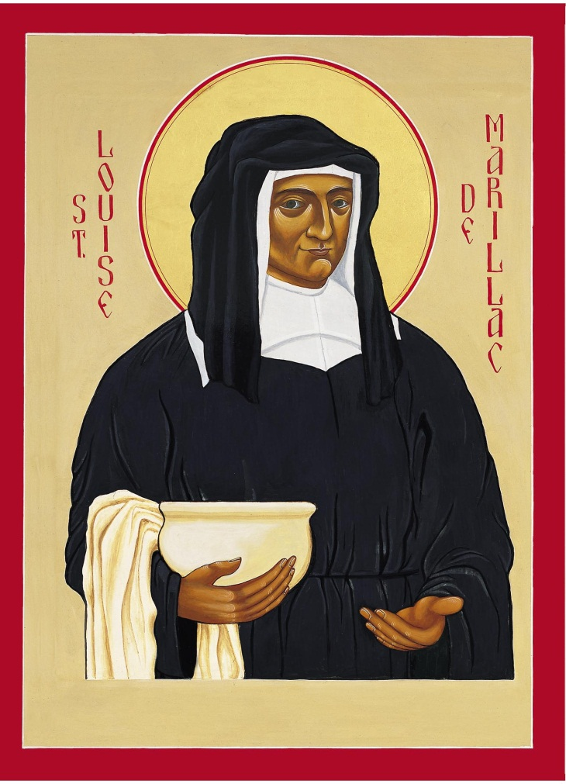
Moments in St Louise de Marillac’s Life

Slide 2
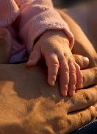
Birth
Born 12th August 1591
Unknown mother who died soon after she was born
Louis de Marillac claimed him as his natural daughter and called her his “greatest consolation”
Notes:
Birth – Louise de Marillac was born on the 12th of August 1591 to an unknown mother. Her father, Louis de Marillac claimed her as his daughter although she was born out of wedlock. Louise loved her and called her his “greatest consolation”.

Slide 3
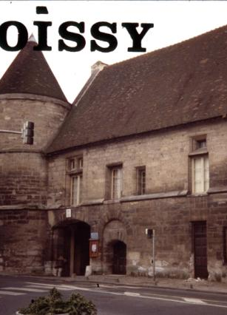
Early Life
Placed in the convent at Poissy from an early age
Received a classical education and spiritual formation
Father died when she was 12
Lived with a good woman and learnt household and medical skills
Notes:
Early Life – She was placed at the Dominican convent at Poissy from an early age (perhaps as young as three months old)
Her father married when she was three and she was not welcome in their home and she must have felt this exclusion very keenly.
At Poissy she received a classical education and spiritual formation that were remarkable for a woman of her time
Her father died when she was 12
She then went to live at the house of a “good devout spinster” where she learnt many practical household skills including herbal remedies

Slide 4
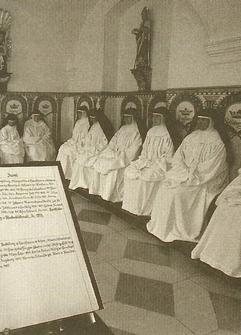
Young adulthood
Wanted to enter the convent
Was rejected because of her frail health
“God had other designs on her
Notes:
Young adulthood – Louise wanted to join the Daughters of the Passion but was rejected because of her frail health and also perhaps because of her illegitimacy. Her spiritual director told her that “God had other designs on her” words that would prove to be prophetic.
Her family then arranged for her to marry Antoine Le Gras

Slide 5
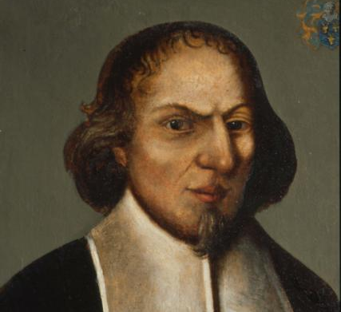
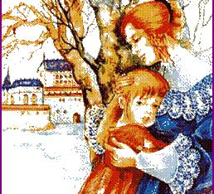
Marriage
Married Antoine Le Gras
A happy marriage
Son Michel
Antoine became ill and suffered depression
Louise felt that she was being punished for not entering the convent
Notes:
Marriage – Louise and Antoine had a happy marriage and Louise gave birth to a son, Michel. Louise finally had the family she had always longed for.
Seven years after they married Antoine’s health began to deteriorate and he became depressed and difficult to live with.
Louise also became anxious and depressed at this time and felt that Antoine’s illness may have been punishment for not keeping her promise to enter the convent.
Louise then had her Light of Pentecost experience in which she was reassured that she should remain with her husband but that a time would come when she would be in a position to make vows of poverty, chastity and obedience, and that she would be in a small community in which others would do the same. She also wrote about this experience “I felt that it was God that was teaching me these things and that, believing there is a God, I should not doubt the rest.”
Louise anxieties had been eased and she cared for her husband until his death in 1625. She was then a single mother

Slide 6
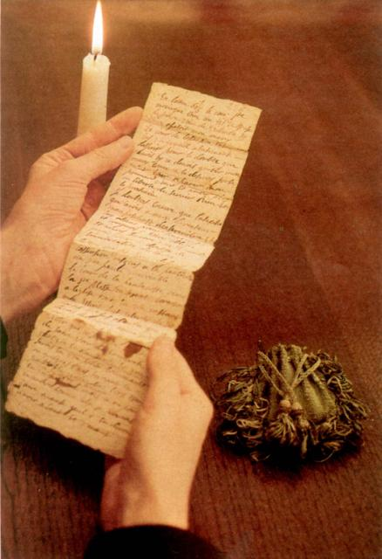
Light of Pentecost
Greatly troubled
While praying on the feast of Pentecost had an experience of God
Mind freed of doubt
A time would come when she would make vows of poverty. Chastity and obedience with others
Believed that God was showing her these things and that she should trust them

Slide 7
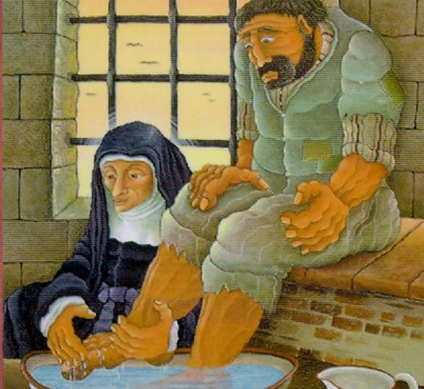
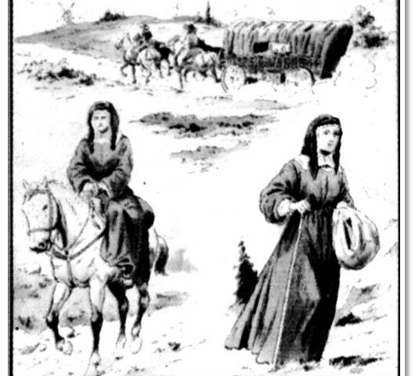
Ministry
Met Vincent de Paul
He sent her on mission to visit the Confraternities of Charity
Louise’s skills for organising and teaching were put to good use
In 1633 she took 4 young women into her home and formed them to be the first Daughters of Charity
Notes:
Ministry – Louise met St Vincent de Paul and their partnership was to be a strong and lasting one that had profound impact on the Church and France.
In 1629 Vincent sent Louise on mission to visit the Confraternities of Charity and ensure that they were following the rule and serving the poor as they should. Louise’s profound organisational skills were put to good use in this mission.
In time Louise saw that the women of the Confraternities were sending their servants to take the food to the poor in the areas of town that they did not feel comfortable to go themselves. At the same time young women came to offer their help. So in 1633 Louise took 4 young women into her home and the Daughters of Charity were born.
The Daughters of Charity ministered to the sick in their homes and in hospitals, orphans, the elderly, prisoners, the mentally ill, and they taught girls.
Louise is credited with setting up the first foster-care system to care for the foundlings.

Slide 8
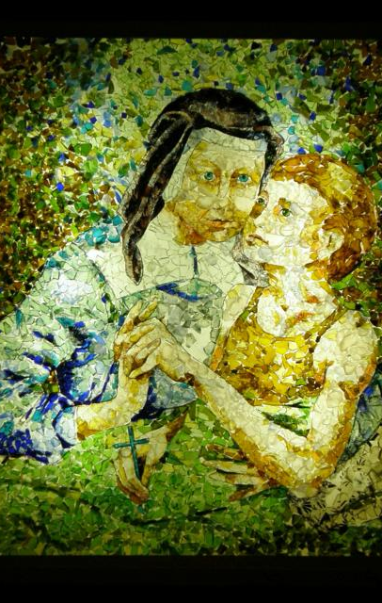
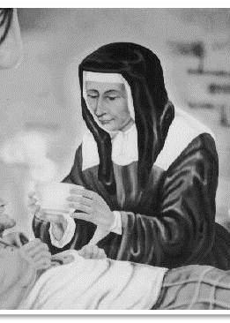
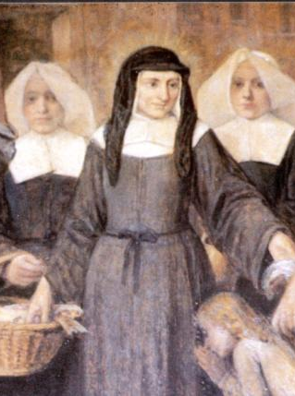
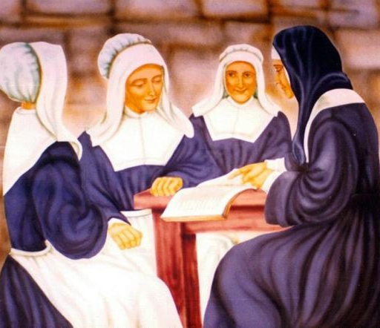
St Louise de Marillac
What aspects of Louise’s life resonate with you?
Prayer
O God,
You inspired St Louise with great love for the poor and abandoned. Grant us the grace to serve those whose lives touch ours with the same spirit of love and courage. May all who follow in Louise’s footsteps be sustained in their service. We ask this through Christ our Lord. Amen
Notes:
St Louise de Marillac was an orphan, a wife, a mother, a widow, a founder. She was a profoundly spiritual woman who is a good model for women of today.
What aspects of Louise’s life resonate with you?
Prayer
O God,
You inspired St Louise with great love for the poor and abandoned. Grant us the grace to serve those whose lives touch ours with the same spirit of love and courage. May all who follow in Louise’s footsteps be sustained in their service. We ask this through Christ our Lord. Amen

