Slide 1
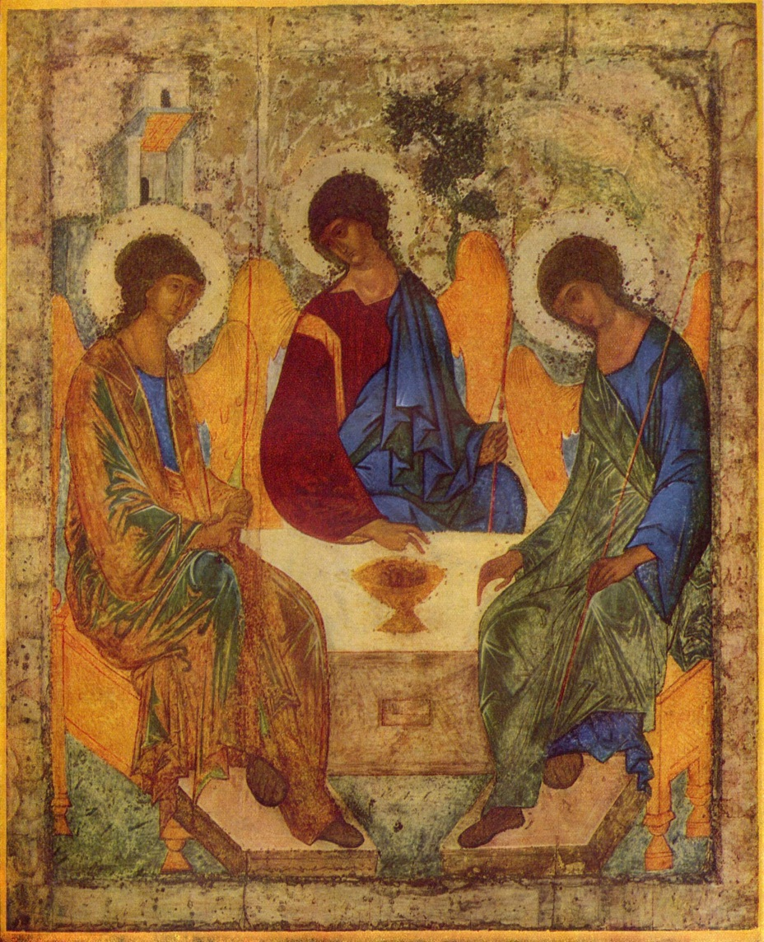
MISSION
INTEGRATION

Slide 2
WHAT IS MISSION?
Being sent to do something. It means undertaking our purpose, our reason for being.
The mission of the Church is to proclaim and witness to God’s love for us, as Jesus did.
The mission of the St Vincent de Paul Society is a particular way of proclaiming and witnessing, shaped by the charisma and spirituality of Frederic Ozanam.

Slide 3
MISSION IMPLIES MOVEMENT
Primarily a stretching, a breaking of boundaries so that God’s realm, love, maybe known, experienced as gift and be recognised as the essence of all life.
In order to branch out – a tree must have roots … a strong rootedness, a strong connection to the source of life, a strong sense of identity.
To have roots is not to be root bound, immobilised but to have new life.
Your spirit is found in outreach and inclusion, transforming encounters with others. To do it well, you need to reach out from a place of deep rootedness, a deep sense of who you are.

Slide 4
MISSION INTEGRATION
What is Mission Integration?
It is all of the processes, programmes and relationships that express a spirit that is deeply woven into the fibre of organisations, a spirit that is expressed in a deep commitment and sense of purpose, rooted in the values and traditions of the organisation, and evident in a special gift that is part of the culture.
It is what draws people to the organisation and keeps them there.
Mission is the responsibility of every person in the organisation.

Slide 5
THE MISSION OF THE SOCIETY
The Society is a lay Catholic organisation that aspires to live the gospel message by serving the poor with love, respect, justice, hope and joy and by working to shape a more just and compassionate society.

Slide 6
WHAT CAN WORK IN MISSION INTEGRATION
Sharing story
Creating the opportunity for people to provide links form the story of Frederic Ozanam with their own life experiences.
Ask them what words in the Mission Statement are important to them.
Uncovering what is within, naming it and allowing it to grow.
Sharing the responsibility for Mission.
However, Mission does need to be seen as one person’s responsibility in order to develop and maintain momentum

Slide 7
WHAT DOESN’T WORK
Telling people what it means without allowing them to engage
in the process / story / creating
the next phase of the story

Slide 8
THE MISSION OF THE SOCIETY
The Society is a lay Catholic organisation that aspires to live the gospel message by serving the poor with love, respect, justice, hope and joy and by working to shape a more just and compassionate society.

Slide 9
KEY WORDS TO EXPLORE
Service of the poor.
Justice
Love
Respect
Hope
Joy
Compassion
Working to shape society

Slide 10
SOME ELEMENTS OF MISSION INTEGRATION
Mentoring Roles.
Structured orientation / induction to the spirit of the SVDP Society and Frederic Ozanam and others.
Mission Review / Process for reflection on life / work experiences in light of our Vincentian Charism / Spirit – to be used in team meetings at all levels. Becomes a tool for sharing / discussing issues / behaviours….
Discernment and reflection demonstrated in decision making.
Creating opportunities for celebrating who we are in light of our heritage, our Vincentian Story.

Slide 11
MISSION INTEGRATION :
WHAT IS IMPORTANT TO YOU?
HOW DO YOU SEE THIS IMPACTING ON THIS GROUP AND OUR WORK:
RELATIONSHIPS
PLANNING
STRATEGIES
POLICIES
PROCESSES
PRESENTATIONS
RESPONSIBILITIES
OTHER …..

Slide 12
MISSION INTEGRATION :
WHERE TO NEXT?
THIS GROUP
  Two hour introduction to story / values /
  review process;
Ongoing work on values/behaviours/evidence reviews
TEAMS
  Two hour introduction to story / values /
  review process;
Ongoing work on values/behaviours/evidence reviews

