Slide 1
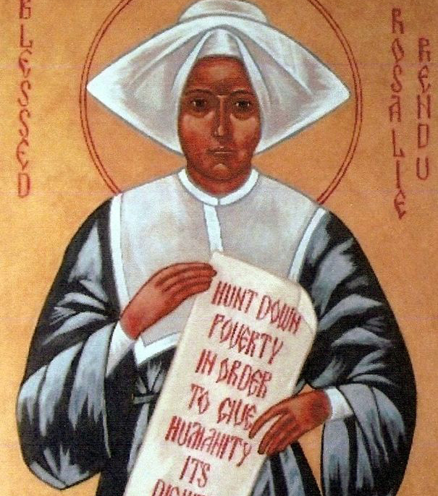
Rosalie Rendu
A Model for Today
Notes:
Slide 1
Blessed Rosalie Rendu as a Model for Today’s Vincentian
Rosalie Rendu was a simple woman of humble origins, with little formal education who spent most of her life serving the poor in one particular neighbourhood in Paris. In many ways she lived a simple and humble life and yet she is an excellent role model for Vincentians today.

Slide 2
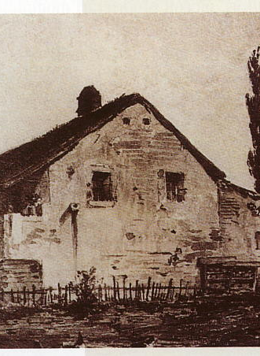
Family
Rosalie was born to a simple farming family
Her family hid priests during the revolution
Notes:
Slide 2
Family
Rosalie’s (Jeanne Marie as she was called then) beginnings in her family were formative for her. Her father was a farmer and although they were not rich, they did possess land. The family had enough means to provide assistance to poor people in the area. When the revolution broke out the family hid a number of priests in their household. The Bishop of Annency was one such person who found refuge with the family under the assumed name of Pierre. Rosalie one night saw him celebrating mass and realised who he was. She told her mother “Be careful or I will tell that Pierre is not really Pierre.” Her mother then told her of the situation. It was in this atmosphere of faith and willingness to take risks for others that Rosalie grew up.

Slide 3
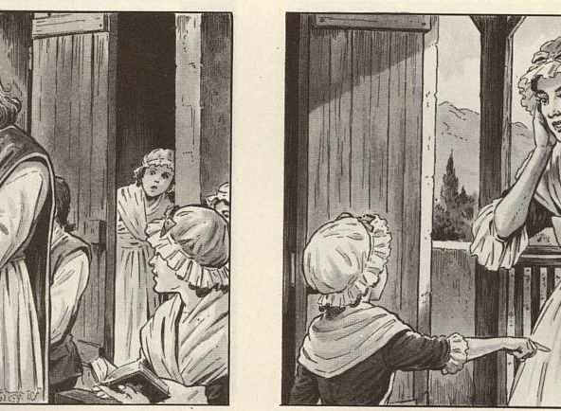
What did Rosalie learn from her mother that helped to make her the woman shewas?
• Solid simple faith
• Generous respectful outreach to those in need
• Sharing of self and what she had with others
Notes:
Slide 3
Rosalie’s father died when she was ten and therefore her mother was the most significant early influence on her. Leaving her mother when she entered the Daughters was one of the hardest things she had to do, especially knowing that they would probably never see each other again.
What did Rosalie learn from her mother that helped to make her the woman she was?
• Solid simple faith
• Generous respectful outreach to those in need
• Sharing of self and what they have with others

Slide 4
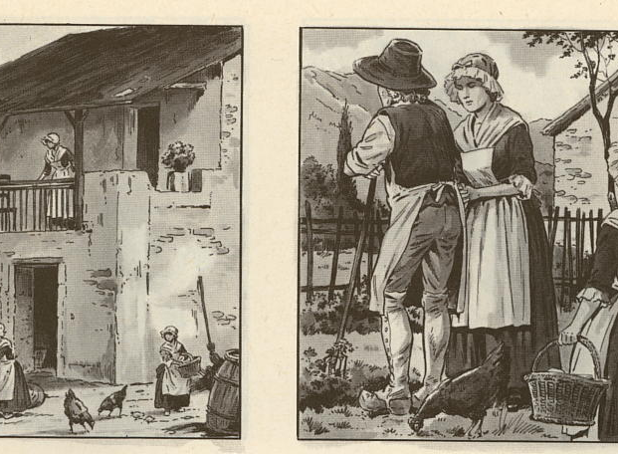
• Capacity to love family and friends and the people she served
• She imbibed her mother’s quiet courage in the face of danger
• Also imbibed her willingness to take risks. (Both displayed throughout her life)
Notes:
Slide 4
• Capacity to love family and friends (the poor as a D.C.)
• She imbibed her mother’s quiet courage in the face of danger
• Also imbibed her willingness to take risks. (Both displayed throughout her life)

Slide 5
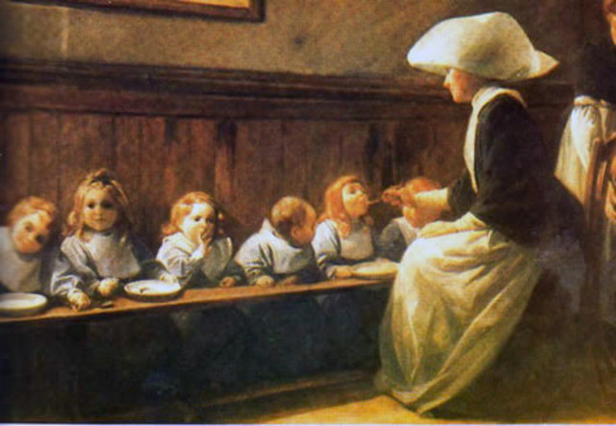
Rosalie’s early life taught her about handling life’s challenges and taking risks for what is right. What were some of your early life lessons?
Notes:
Slide 5
Rosalie’s early life taught her about handling life’s challenges and taking risks for what is right, what were some of your early life lessons?

Slide 6
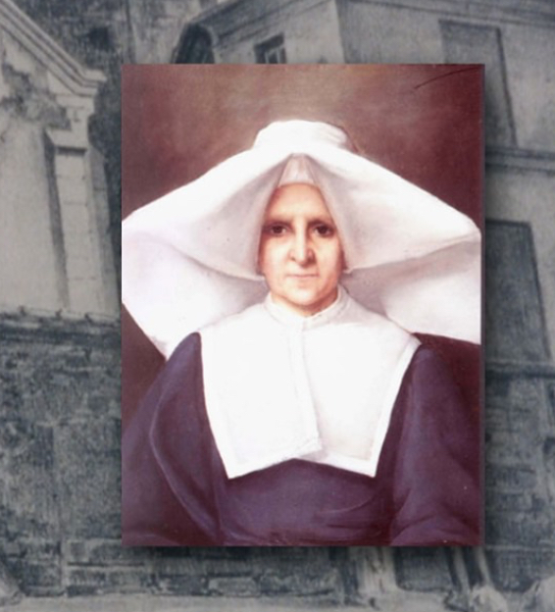
Vocation
From the age of reason,
Jeanne had thoughts of
consecrating herself to God.
None of the joys of this world
attracted her. She wanted no
part of its celebrations or
glitter. At the same time she
felt drawn by its groans and
misery.
Notes:
Slide 6
Vocation
Rosalie spent a couple of years in Gex in a boarding school run by the Ursulines. She was 13 when she went there and it is here that she came to know the Daughters of Charity. The Daughters ran a hospital and Rosalie witnessed their service of the poor here. Rosalie wanted to enter then but since she was so young here mother sent her to Carouge to a boarding school for six months. After these six months she began her postulancy with the Daughters in Gex.
Armand Melun, lifelong friend and spiritual adviser to Rosalie tells us that
From the age of reason, Jeanne had thoughts of consecrating herself to God. None of the joys of this world attracted her. She wanted no part of its celebrations or glitter. At the same time she felt drawn by its groans and misery.
So Rosalie began the journey of her vocation.
It is important to note her a little of the situation of the Daughters of Charity at this time. As you probably know St Vincent and St Louise founded the Daughters in 1633. They grew quickly from this time, however, were mostly only in France. Then the French revolution happened and the congregation was supressed and the sisters returned to their families. In 1800 Napoleon wanted the Sisters to return to the works on which the French society depended. The sisters began returning but their numbers had declined markedly
Now instead of 3,300 Sisters in 461 Houses there were 1, 598 Sisters in 260 Houses.
This was the community into which Rosalie entered, one that was regrouping from the trauma of this time

Slide 7
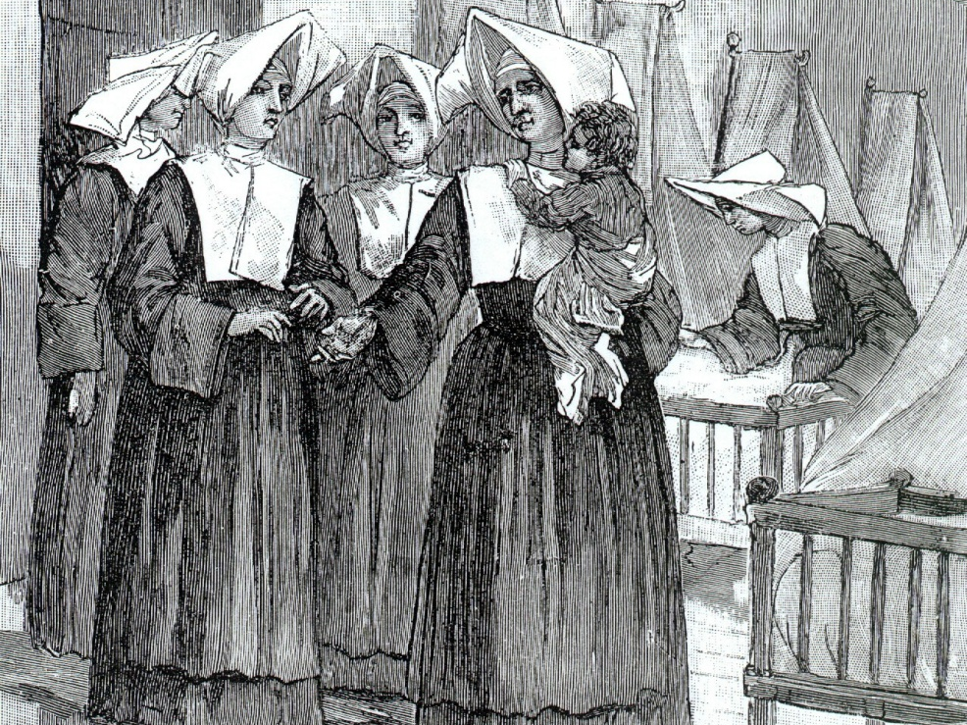
Now instead of 3,300 Sisters in 461 Houses there were 1, 598 Sisters in 260 Houses.

Slide 8
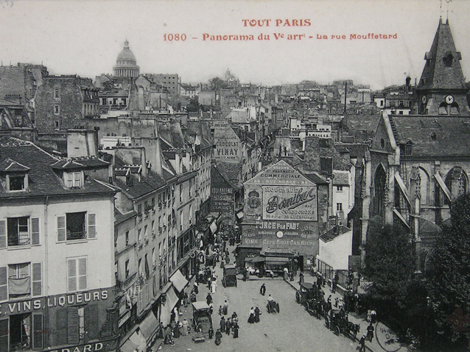
Mouffetard
Notes:
Slide 8
After postulancy Rosalie went to the Motherhouse of the Daughters for her seminary. Rosalie struggled in the Seminary and became somewhat depressed and quite ill. After six months she was sent to a local house of the community called Saint Martin, on the Rue Francs-Bourgeois-Saint Marcel, in the area of Paris in which she was to spend the remainder of her life. Once she was there Rosalie recovered her joy and exuberance. It seems that once she began her apostolic work as a religious education teacher all he anxieties left her and she found a “vast terrain for her zeal and her youthful fervour”.
Besides regaining her health and zealously giving herself to the service of those in need, the young seminary sister also won the hearts of her companions. She developed a deep relationship with her Sister Servant (local superior) Sr Tardy, who was very influential in her formation. She apparently told the Superioress General “I am very pleased with this little Rendu; give her the habit and leave her with us.”

Slide 9
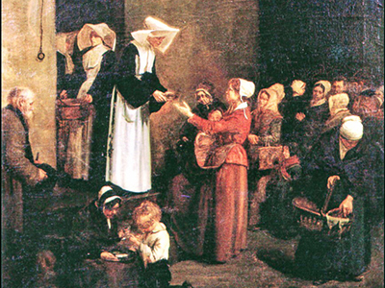
Rosalie found her seminary period difficult and yet she persevered in her vocation. What difficulties have you faced in your service and what keeps you going?
Notes:
Slide 9
Rosalie found her seminary period difficult and yet she persevered in her vocation. What difficulties have you faced as a Vincentian and what keeps you going?

Slide 10
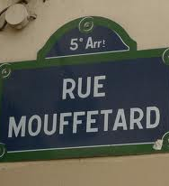
This area of Paris in which
Rosalie was living out her
vocation was described as a
place where the poor were
poorer, the filth more
unhealthy and disease more
deadly.
Families lived in small damp
rooms without air, light, heat
or bread.
Notes:
Slide 10
The Apostle of the Mouffetard District
So Rosalie had completed her initial formation and she was beginning her life’s work.
Sr Tardy, her Sister Servant, was apparently astonished by the advanced virtue of Rosalie who she never had to reproach at all.
The house in which Rosalie was living and ministering was one of the houses of charity which did not close during the revolution. They had continued to carry out their service to people in need during the dark days until one day they were summoned to the tribunal. However, the people that they had served came and spoke on their behalf and they were returned to their service. This is the atmosphere into which Rosalie came. This fearless devotion to people in need combined with the example she had from her family no doubt helped to bring out of Rosalie her heroic virtue.
This area of Paris in which Rosalie was living out her vocation was described as a place where the poor were poorer, the filth more unhealthy and disease more deadly. Families lived in small damp rooms without air, light, heat or bread. Rosalie saw this need and was energised and challenged by it. The people in this area were simple working people, day workers, laundresses, street cleaners, menders of clothing, heavy labourers, workers in tanning factories and rag pickers. These people worked in atrocious conditions for poor pay and suffered malnutrition and disease. The sisters of the house ran a pharmacy, a depository for clothing and household linens, and a free school for children who were poor.

Slide 11
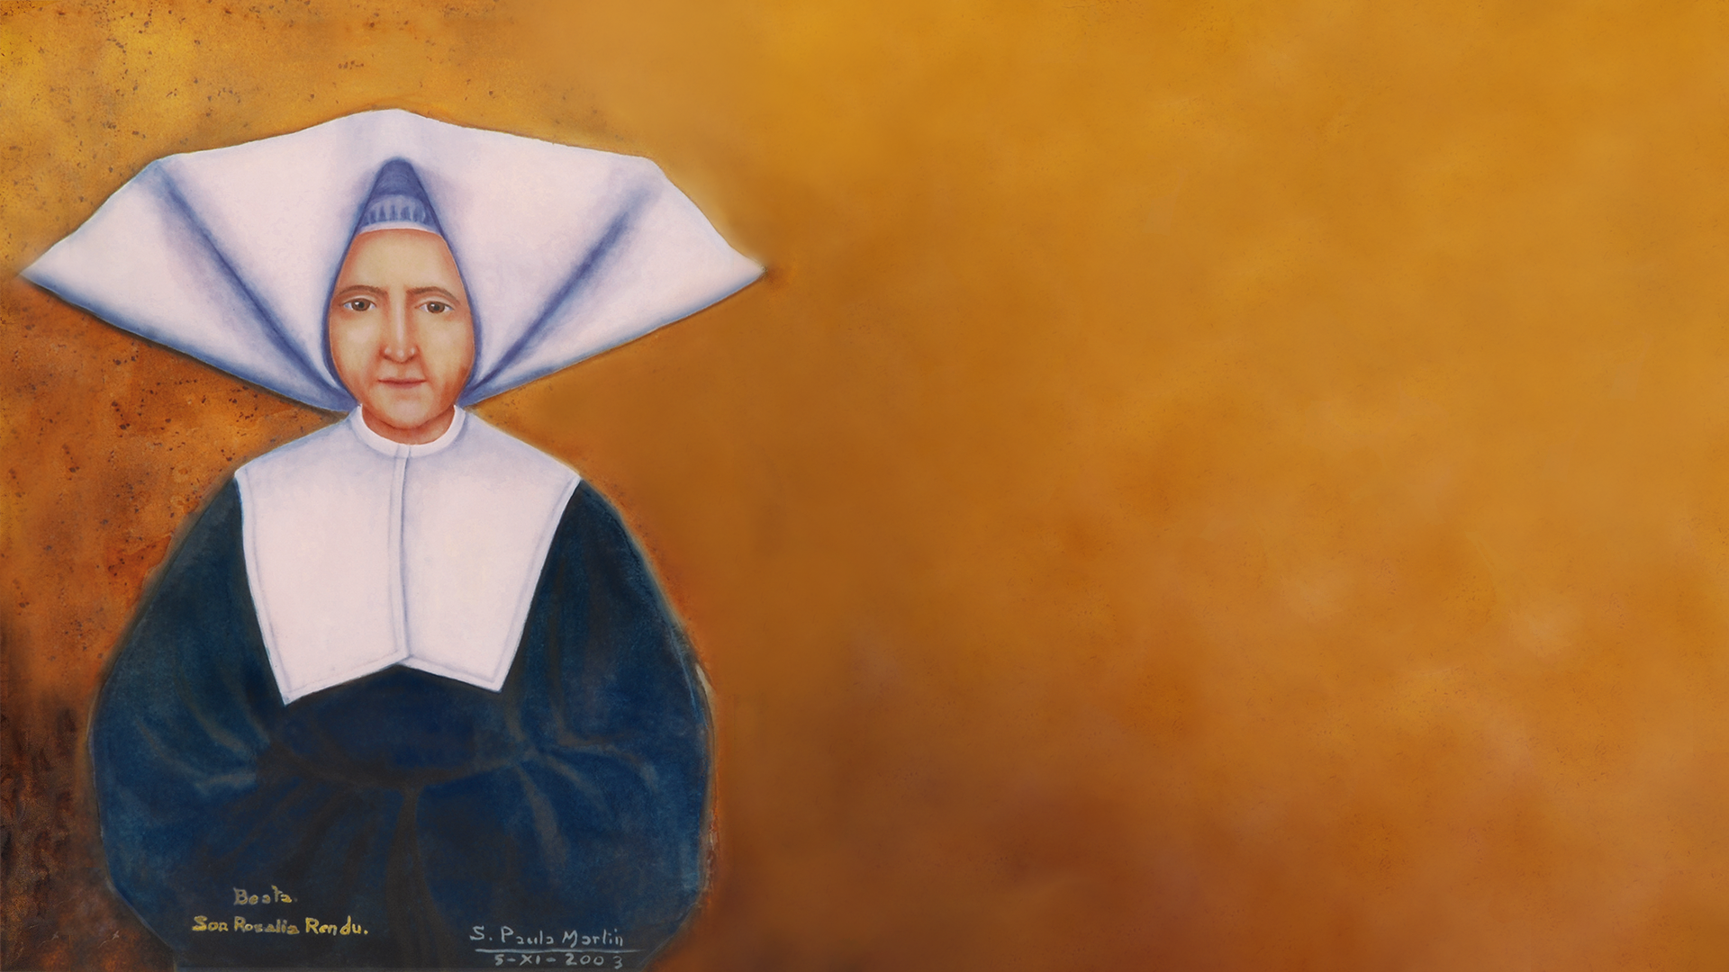
Cherish them.
Be patient.
You will see that they will
change.
Above all, sisters, do not
discourage them.
Later they will feel your
affection and want to please
you.
Notes:
Slide 11
Rosalie’s first ministries were teaching little girls and visiting the sick families. Rosalie said about her students
Cherish them. Be patient. You will see that they will change. Above all, sisters, do not discourage them. Later they will feel your affection and want to please you.
While the education that the girls received was basic it was designed to prepare them for the kind of life they would live. Quickly Rosalie realised that they also needed practical skills and she opened an ouvroir so that the girls could earn skills to help them earn a living.
The sisters went out to the poor in their homes and also provided some treatment at their house. The dispensary at the house gave out medicines and treatments. They also came for spiritual and material assistance. Rosalie also had a particular care for the elderly.
She also founded a day-care centre and pre-school where working mothers could have their children cared for. She also ran an orphanage and a home for the elderly.
Rosalie and her sisters cared for the sick and the dying in the recurrent cholera epidemics.

Slide 12
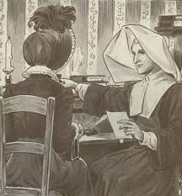
“Fear nothing, Sisters, you will never be without assistance so long as your two hands are like this.” She would then stretch one hand in the gesture of giving and extend the other to receive. She then added, “If one hand closes, it will be useless for the other to reach out…Give with measure…Manage well the goods of the poor and God will give to you in abundance
Notes:
Slide 12
Rosalie’s view of service the poor is summed up here
She also used to say, “Fear nothing, Sisters, you will never be without assistance so long as your two hands are like this.” She would then stretch one hand in the gesture of giving and extend the other to receive. She then added, “If one hand closes, it will be useless for the other to reach out…Give with measure…Manage well that goods of the poor and God will give to you in abundance.

Slide 13
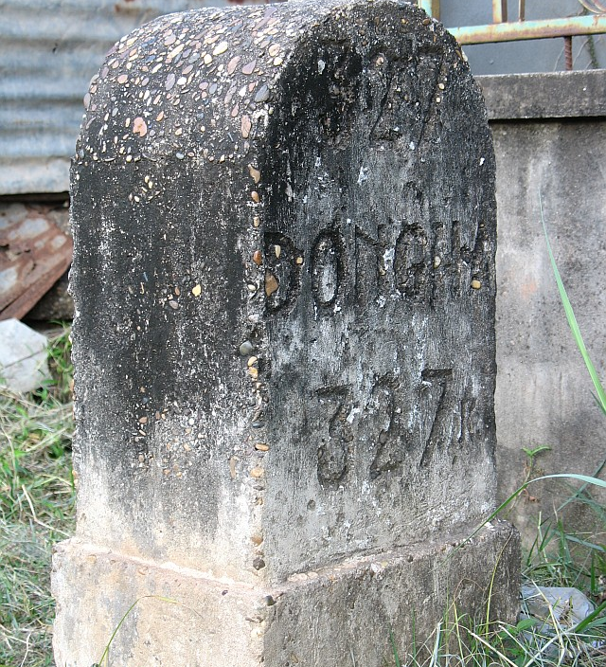
Sisters, … we are milestones.
All have the right to lay their
burdens upon us without our
having the right to complain.
Notes:
Slide 13
She would also say
Sisters, … we are milestones. All have the right to lay their burdens upon us without our having the right to complain.

Slide 14

Rosalie was a tireless worker
for the poor and she found
many new ways to help
them. What gives you energy
in your service of people in
need?
Notes:
Slide 14
Rosalie was a tireless worker for the poor and she found many new ways to help them. What gives you energy in your ministry?

Slide 15
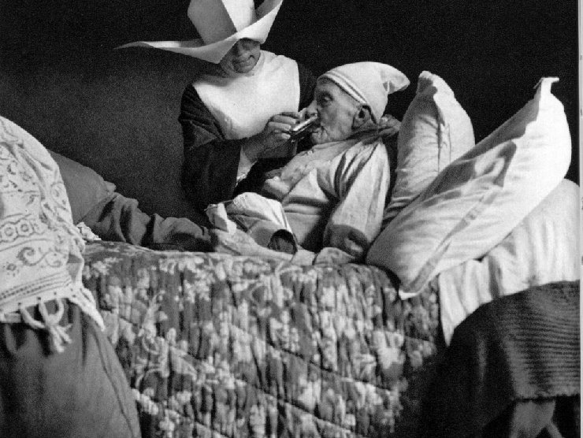
Superior and Formator
Notes:
Slide 15
Superior and Formator
In 1815 Rosalie became the Sister Servant of her community. Two years after that they moved to Rue l’Epee de Bois, where Rosalie would spend the rest of her life.
What was she like as a superior?
Her cousin describes her as being infinitely tender with her sisters. She would replace a sister in class if she seemed tired giving her a little break. She would become quite upset when a sister was leaving her house or even more so when one died.
Her house became the house to which younger sisters were sent in order to learn how to serve the poor and how to be a Daughter of Charity. 22 postulants spent time with her, she prepared 18 for their first vows and at the time of her death half of her community were under 4 years vocation. These facts alone are an indication that Rosalie was a good model and teacher for young women who were learning how to be Daughters of Charity.

Slide 16
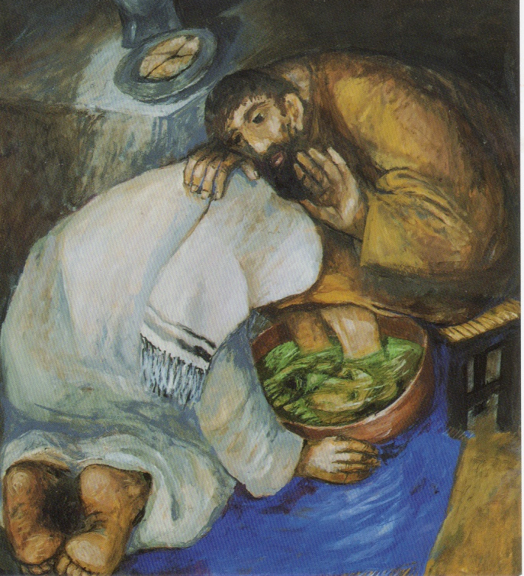
Rosalie showed great
leadership of others, how do
you show leadership, even if
you are not in a formal
leadership role?
Notes:
Slide 16
Rosalie showed great leadership of others, how do you show leadership, even if you are not in a formal leadership role?

Slide 17
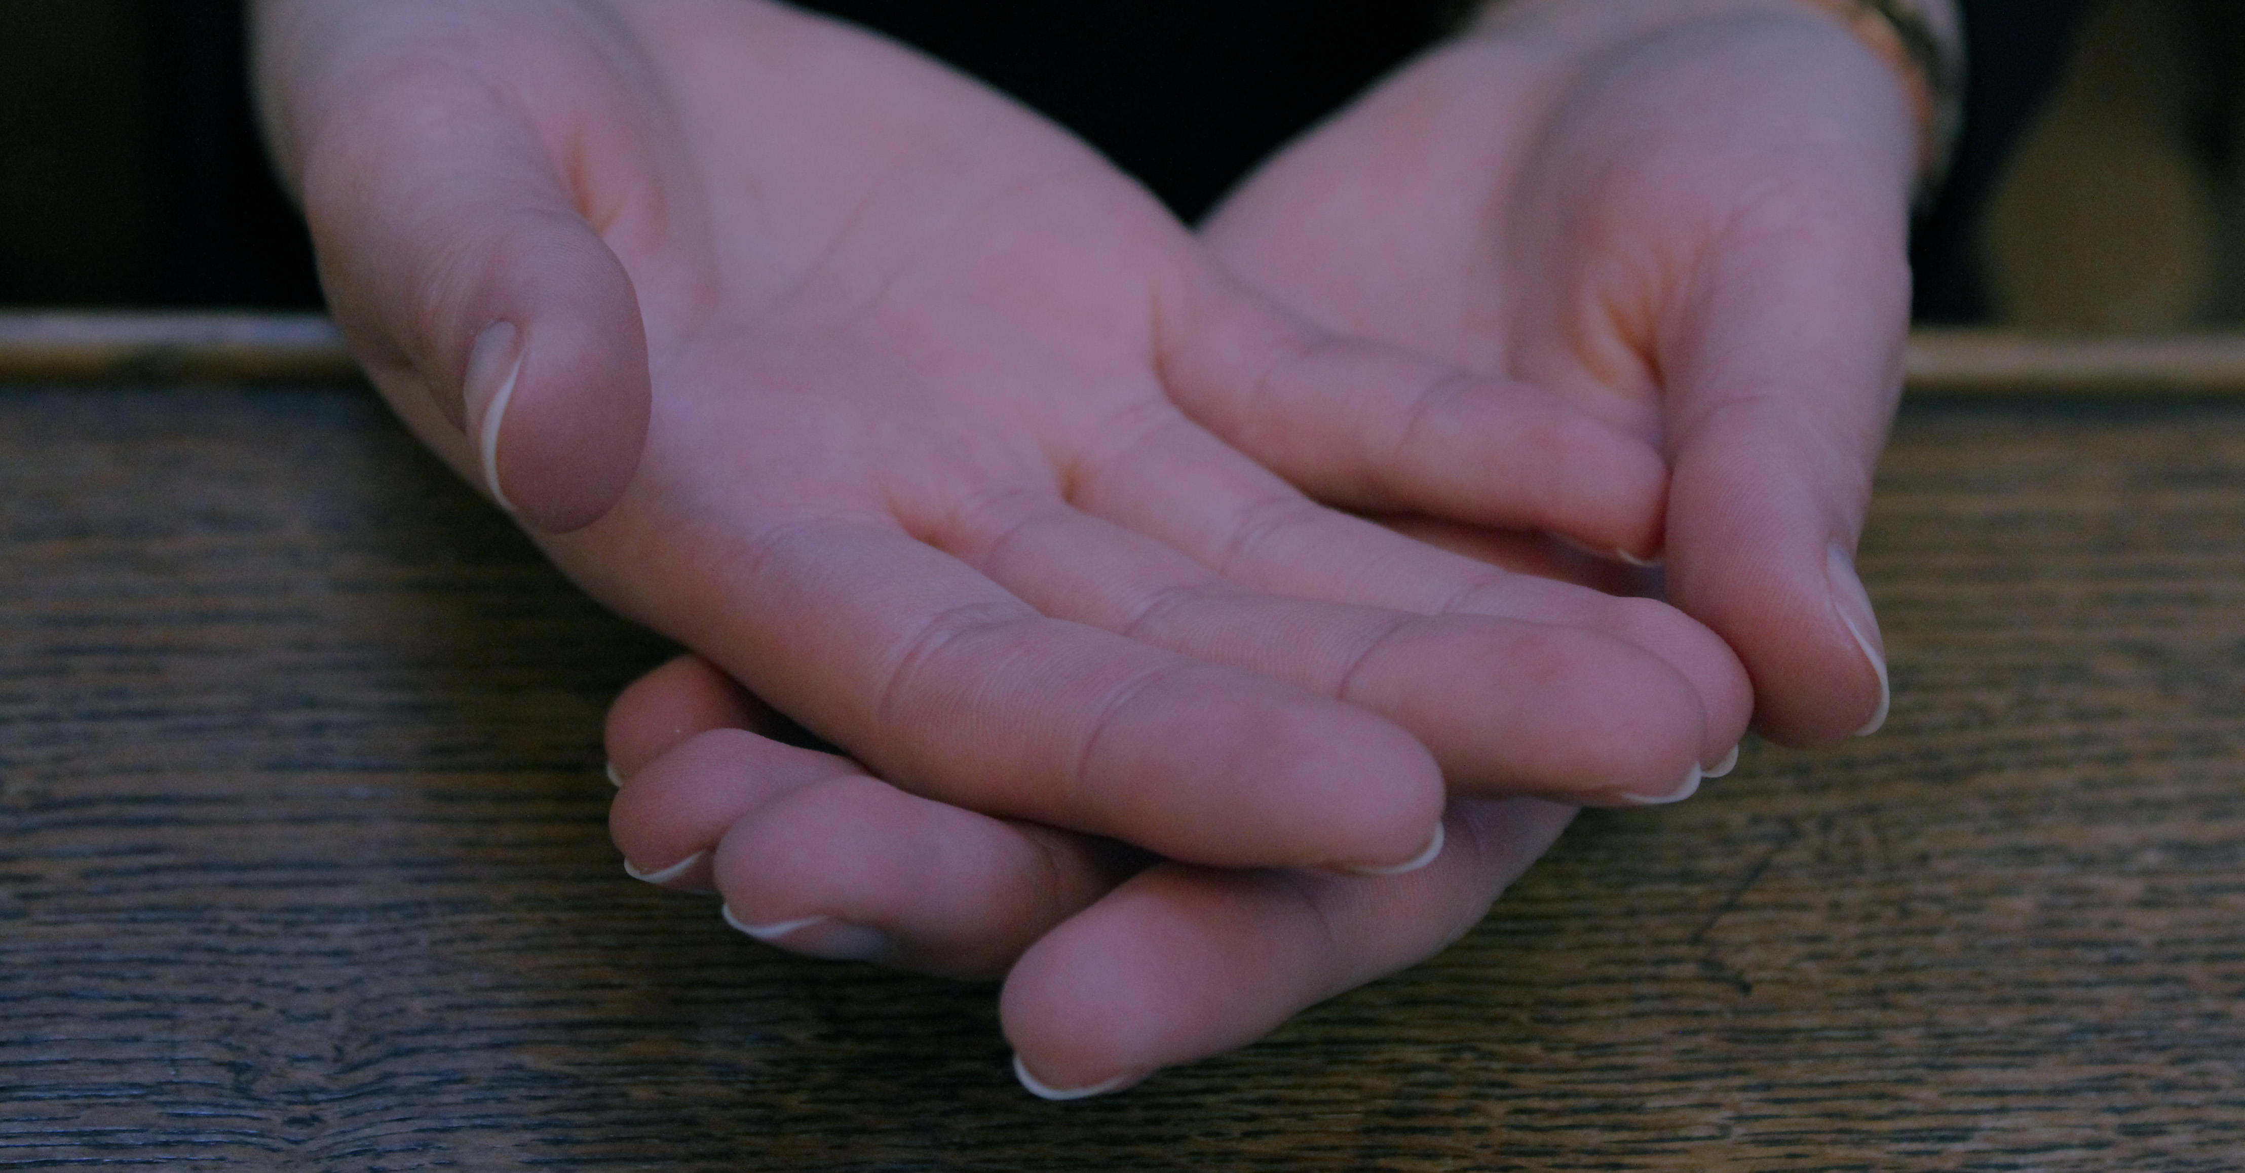
Woman of Prayer
“Let us support one another
on the way of the Cross and let
us walk in the footsteps of our
Divine Master. Following His
example, let us carry
[our Cross] with courage and
confidence in His infinite
Mercy”.
Notes:
Slide 17
Woman of Prayer
We have already seen that Rosalie was a sensitive soul. She found the separation from her family very difficult and missed them greatly. She was able to deal with this sacrifice because of her devotion to her vocation. She lived out the words on the seal of the Company “The charity of Jesus Christ Crucified urges us”. In a letter to her cousin Melanie she spoke of the importance of remaining united to Jesus Christ Crucified
“Let us support one another on the way of the Cross and let us walk in the footsteps of our Divine Master. Following His example, let us carry [our Cross] with courage and confidence in His infinite Mercy”. (Pg. 104)
We also know that she was inspired by the Vincentian ideal of seeing Christ in the faces of the people that she served.
Rosalie was at times criticised for neglecting her prayer. Certainly the volume of work that was carried out at the house on the Rue l’Epee du Bois would have left little time over. However, Rosalie’s companions said that she would take any spare moment, such as a ride in a carriage, to spend time in prayer. She herself said

Slide 18
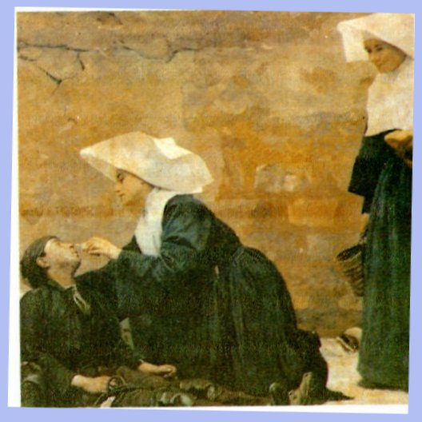
I never pray so well as I do in
the streets
Notes:
Slide 18
“I never pray so well as I do in the streets”. She also said that she was blest not to sleep well because she could then spend the time in prayer. I believe that the source of her prodigious energy for service and the love that she showed to all people was her deep prayer life.

Slide 19
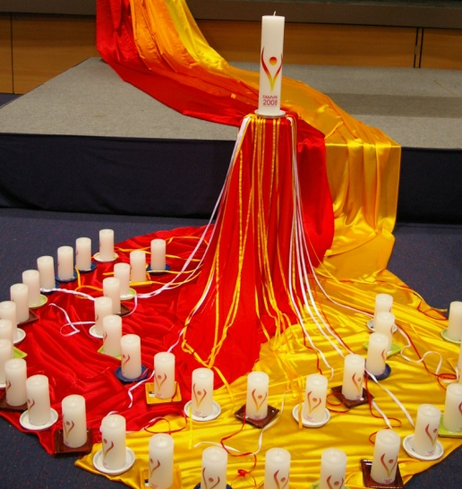
Rosalie was able to blend
prayer and service well, how
do you manage balance of
life?
What nourishes you for your
service?
Notes:
Slide 19
Rosalie was able to blend prayer and service well, how do you manage this balance? How does your prayer life nourish you for service?

Slide 20
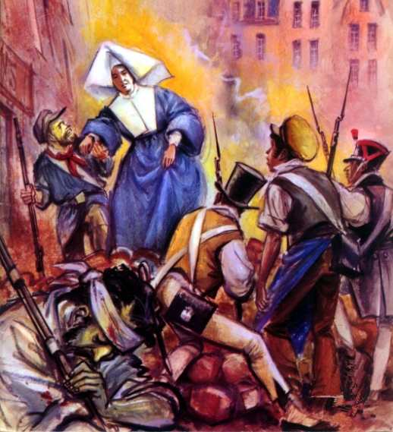
Woman of Courage
I am a Daughter of Charity. I
do not have a flag. I go to the
aid of the unfortunate
wherever I encounter them. I
promise you, if ever you,
yourself, are being pursued
and you ask me for help, it
would not be refused you.
Notes:
Slide 20
Woman of Courage
Perhaps the most famous stories of Rosalie are of her fearlessness during the revolutions. During the 1830 uprising the sister’s house became a field hospital for the treatment of the wounded. Rosalie frequently went out into the streets where the fighting was taking place. She went about pleading for an end to the hostilities. She also risked her own life to go and search for Monsieur Baccoffe who had gone missing during the fighting. She found him and saved his life. She also hid Archbishop de Quelen during the revolution when people were sacking his house.
In 1832 the following encounter with Prefect of Police occurred
Madame, I did not come seeking service but rather to render you one. I am the Prefect of Police…Do you realise, Sister, that you are seriously compromised? In contempt for the law you helped an officer of the former royal guard to escape. By his open revolt against the government, he had deserved the most serious punishment. I had already given the order to arrest you. I withdrew it upon the supplication of one of my officers. However, I have come and I want to hear from you how you dared to place yourself in a position of revolt against the law.
“Monsieur le Prefet,” replied Rosalie, “I am a Daughter of Charity. I do not have a flag. I go to the aid of the unfortunate wherever I encounter them. I promise you, if ever you, yourself, are being pursued and you ask me for help, it would not be refused you.
In 1848 an officer of the security police was being pursued by insurgents and he found refuge in the sister’s house. Rosalie placed herself between the officer and his pursuers saying “We don’t kill here”.

Slide 21

We are unlikely to be called
upon to perform such feats of
heroism but we are often
called upon to display moral
courage and to stand
up for what is right.
How well do you stand up
against injustice?
Notes:
Slide 21
We are unlikely to be called upon to perform such feats of heroism but we are often called upon to display moral courage and to stand up for what is right. How well do you stand up against injustice?

Slide 22
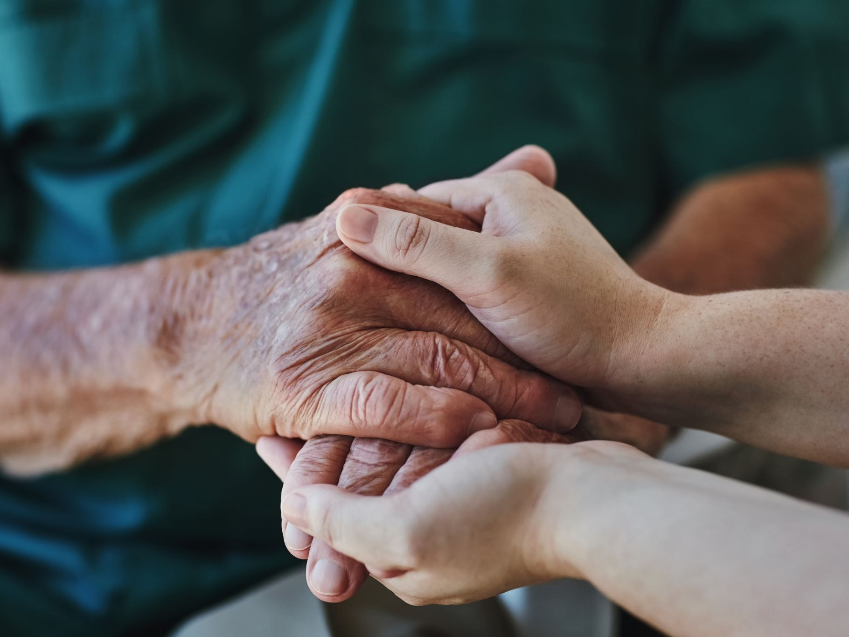
Rosalie’s Network of Charity
Recommended to them patience, which never considers the time spent listening to a
poor person as wasted, since the person already takes comfort in the good will that we
demonstrate by attending to the recitation of their sufferings; understanding, more
inclined to pity than to condemn faults…
Notes:
Slide 22
Rosalie’s Network of Charity
Rosalie had a great gift for teaching others to serve the poor. It was to Rosalie that the young men of the Society turned in order to learn how best to serve the poor. She referred families and supplied them with vouchers for food and clothing in order to supplement the meagre amount they had to give. However, her greatest gift to the fledgling Society was teaching them the manner of serving the poor, the Vincentian way of seeing Christ in the poor person. She also taught them to reflect together on their visits so that they could learn from each other and be more open to God’s presence in these encounters. Rosalie’s influence on the Society was extremely important in shaping the way that they served the poor. She
Recommended to them patience, which never considers the time spent listening to a poor person as wasted, since the person already takes comfort in the good will that we demonstrate by attending to the recitation of their sufferings; understanding, more inclined to pity than to condemn faults…

Slide 23

Hate the sin but love the poor persons [who
commit it]. If we has suffered as they have, if
we had spent our childhood deprived of all
Christian inspiration, we be far from their
equal.
Notes:
Slide 22
Rosalie’s Network of Charity
Rosalie had a great gift for teaching others to serve the poor. It was to Rosalie that the young men of the Society turned in order to learn how best to serve the poor. She referred families and supplied them with vouchers for food and clothing in order to supplement the meagre amount they had to give. However, her greatest gift to the fledgling Society was teaching them the manner of serving the poor, the Vincentian way of seeing Christ in the poor person. She also taught them to reflect together on their visits so that they could learn from each other and be more open to God’s presence in these encounters. Rosalie’s influence on the Society was extremely important in shaping the way that they served the poor. She
Recommended to them patience, which never considers the time spent listening to a poor person as wasted, since the person already takes comfort in the good will that we demonstrate by attending to the recitation of their sufferings; understanding, more inclined to pity than to condemn faults…

Slide 24

Be kind and love for love is your first
gift to the poor.
If you have nothing to give, give
yourself
Notes:
Slide 24
Rosalie also told them
Be kind and love for love is your first gift to the poor. If you have nothing to give, give yourself.

Slide 25
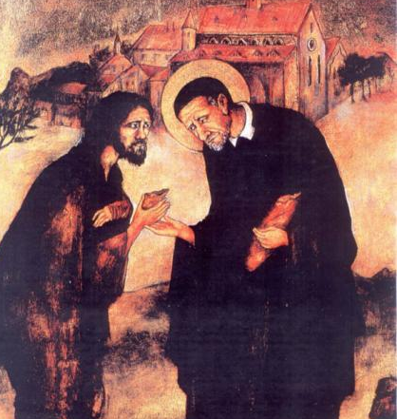
What does Rosalie’s advice mean to you? What helps you to see Christ, to see the good, in the people you serve?
Notes:
Slide 25
What does Rosalie’s advice mean to you? What helps you to see Christ in the people you serve?

Slide 26
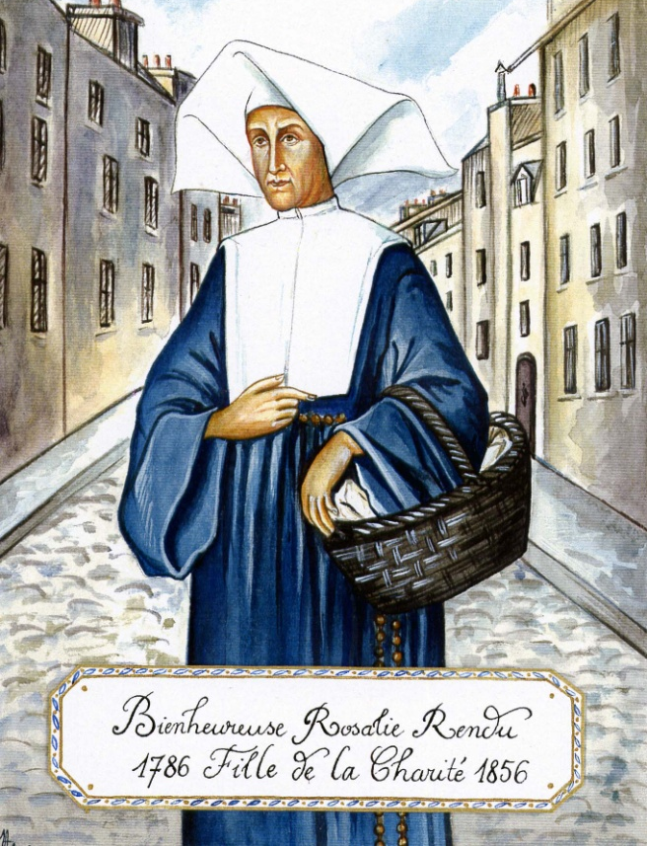
Final Years
I am a Daughter of Charity and only that.
Notes:
Slide 26
Final Years
Rosalie used to say “I am a Daughter of Charity and only that.” She lived out her vocation and did not seek any fame or recognition for herself. In 1852 she was award the Cross of the Legion of Honour, which she wanted to refuse but the Superior General made her accept. She was great at connecting people and drawing them into her network of charity. As her funeral procession went through the streets, all the people who had been helped by her came out to pay their respects. It has been said that her funeral was a testimony to her genius for uniting people. Armand Melun describes it thus “Factions vanished; hatreds dissipated; passions were stilled. There were only brothers and sisters and children who were accompanying their sisters and mother to her final resting place.” What kind of testament will you leave?

