Slide 1
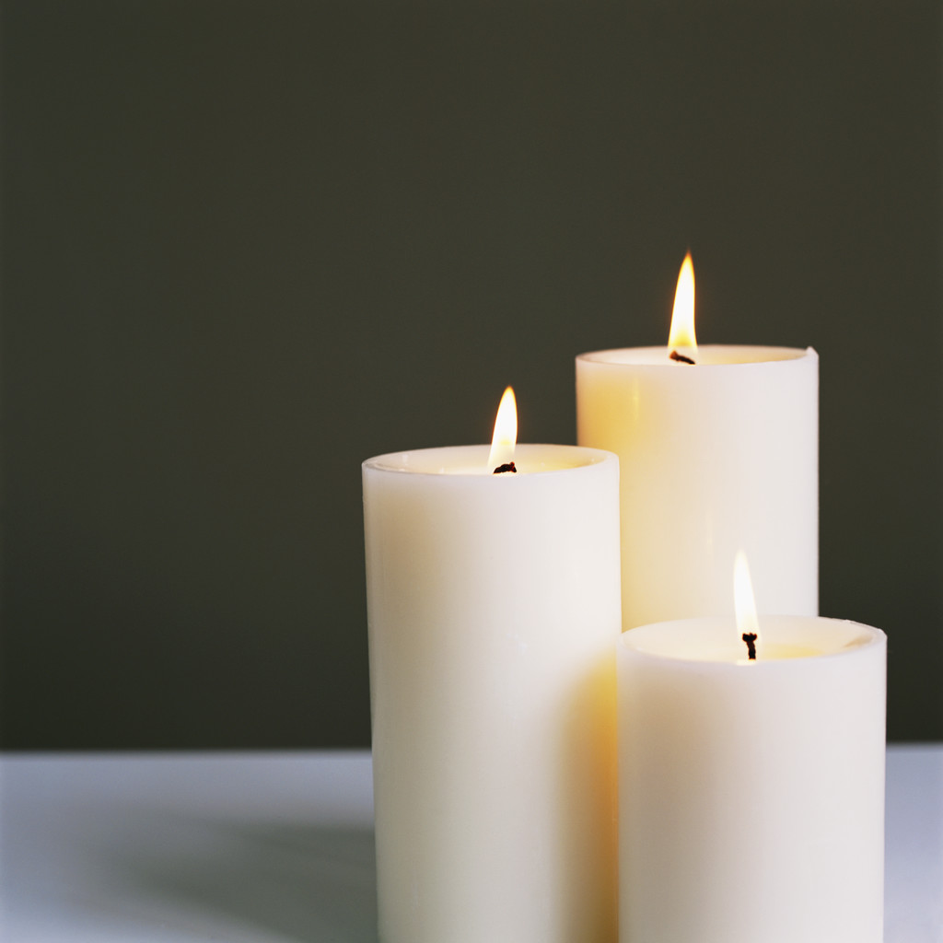
Let us reflect for a moment and recall that we are in the presence of God …
LISTEN!
Notice the sounds around you - small sounds, perhaps a bird, a distant voice.
Listen, be attentive!
Where is God in this space …
… in our thoughts
… in our words
… in the sounds around us
… in the silence
… in each other

Slide 2
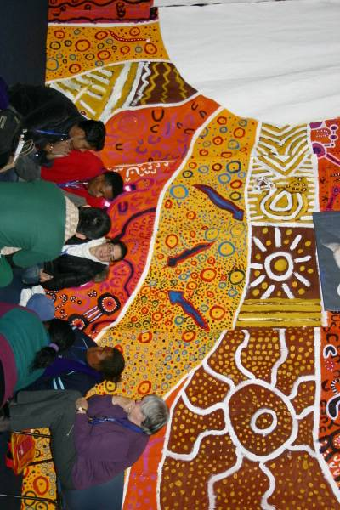
Acknowledgement of Country
Gathered here today, we acknowledge the traditional custodians of this land and pay our respects to the elders past, present and future for they hold the memories, the traditions, the culture and the hopes of Indigenous Australia. We must always remember that under the concrete and asphalt, this land is, was and always will be traditional Aboriginal land.
We pay respect to the first peoples on whose land we now are, acknowledging the loss of lands, cultures and treasures; knowing the consequences for people, communities and nations; and believing we can walk together to a better future. We gather today, taking this on.
We acknowledge this is, and always will be, Aboriginal land.

Slide 3

All: Come, Holy Spirit,
fill the hearts of Your faithful
and enkindle in them the fire of Your love.
Send forth Your Spirit
and they shall be created.
And you shall renew the face of the earth.
“If we are really called to carry the love of God far and wide, if we are to enflame the nations with this fire, if we have the vocation of setting the whole world on fire, if it is so, I say, if it is so, then how much I must myself burn with the divine fire!”
St Vincent de Paul
“Like a Great Fire – Vincent de Paul”
Editions du Signe, Italy, 1995,
We call the Holy Spirit upon us, the faithful to empower us to renew the face of the earth.
What does it feel like to have our hearts burn with the fire of love given by the Spirit for the work that we do?
What are we being ‘created’ to do?
All: O God, by the light of the Holy Spirit,
teach the hearts of the faithful
and grant that by the same Spirit
we may be truly wise
and ever enjoy His consolation.
Teach me as one of your faithful …
What do I need to learn?

Slide 4
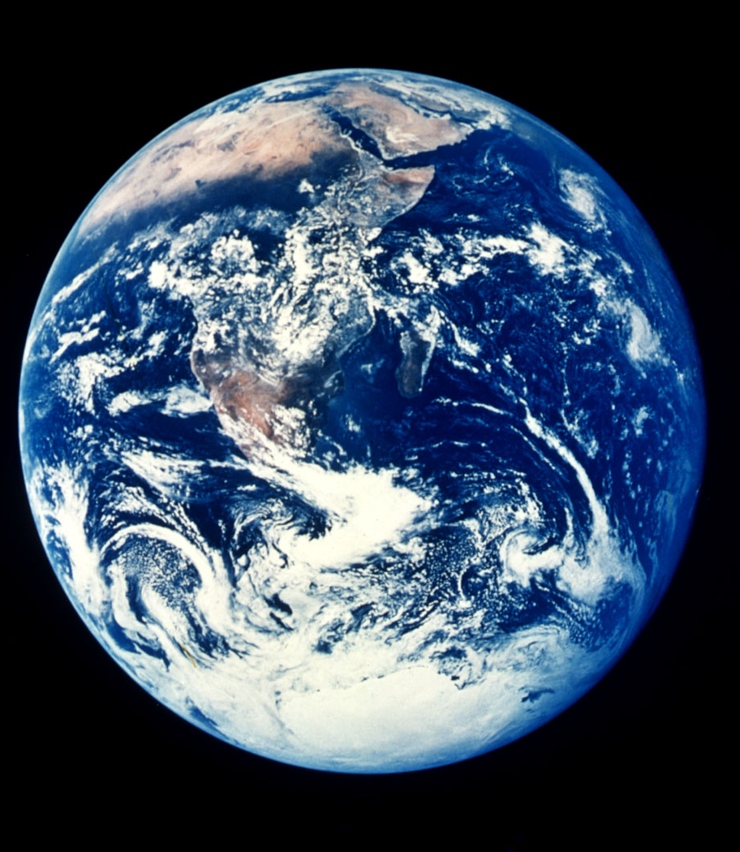




All: Compassionate God, we pray for our Church, especially our Pope, Bishops, Priests and Religious. May their leadership strengthen and nourish our Vincentian spirit. We pray for all members of the Vincentian Family throughout the world especially in those countries with which we are twinned. We pray that like St Vincent de Paul, we are open to the presence of Christ in the poor and are willing to share our spirit and resources.
As Vincentians we are part of a bigger family.
What unites all members of the Vincentian Family in their mission?
What unites us all as part of the wider church?
What unites us all as inhabitants of our world?

Slide 5
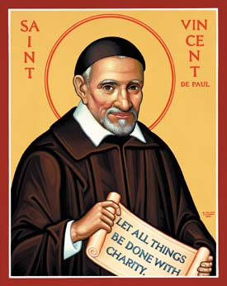
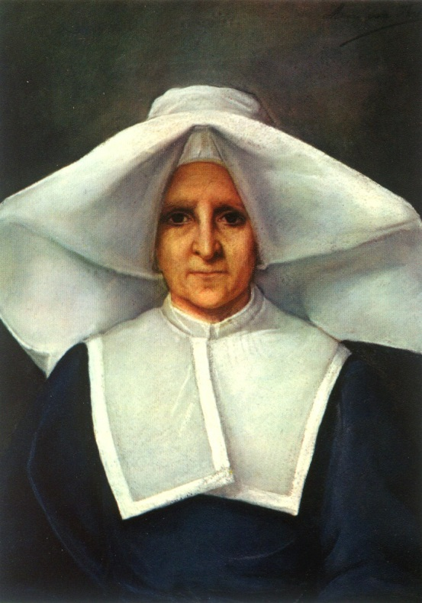
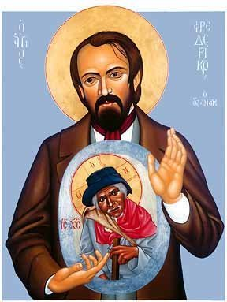
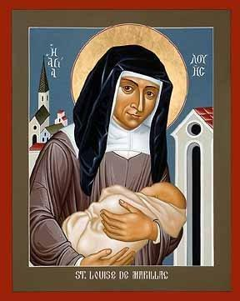
All:
Lord Jesus, we share in the faith and courage of our founders, especially Blessed Frederic Ozanam, Blessed Rosalie Rendu, Gerald ward and Charles O’Neill.

Slide 6
As Vincent de Paul and Louise de Marillac walked through the streets of Paris everywhere they looked they saw homeless people and beseeching beggars.
They saw hungry people.
They saw children and elderly men and women who were neglected.
They saw sick people without health care.
They saw refugees from warfare.
They saw people who were spiritually abandoned and without hope.
In these people they found brothers and sisters in Christ.
Rosalie Rendu, Frederic Ozanam, Emmanuel Bailly …. and so many others followed their spirit and served people in their many needs, in many places.
They incarnated the compassion of God.

Slide 7
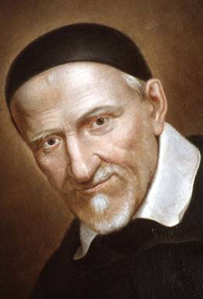
All:
May their spirit be renewed in the society of today. May we be open to the needs of those suffering poverty and injustice, remaining receptive to the grace of the Holy Spirit. We prayer that we build a sense of community wherever our members are gathered.

Slide 8
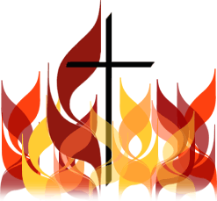
As we move on with our gathering let us …
“Be inspired by the example of
your Patrons!
Accept into your hearts and minds the sevenfold gift of the Holy Spirit!
Recognize and believe in the power of the Spirit in your lives!”
VIGIL WITH THE YOUNG PEOPLE
ADDRESS OF HIS HOLINESS BENEDICT XVI
Randwick Racecourse
Saturday, 19 July 2008

