Slide 1
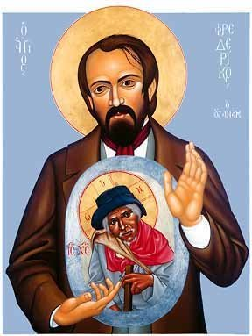
The Social Thought of
Frederic Ozanam

Slide 2

“deeply imbued with the great truths of Christianity, which contain for me consolation and hope, I find myself forced to express what my soul feels.”

Slide 3

“Young men, the moral regeneration of our ancient land of France will be our special work. You have felt the emptiness of material pleasures, you have felt the hunger for truth crying out within you; you have gone for light and comfort to the barren philosophy of modern apostles. You have not found food for your souls there. The religion of your forefathers appears before you today with full hands “

Slide 4
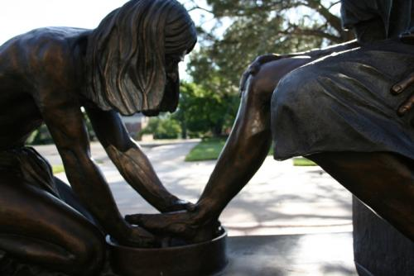
‘let us not relegate our beliefs to the domain of speculation and theory; let’s take them seriously, and let our life be the continual expression of them.”

Slide 5
I have found that Christianity had been for me, until now, a sphere of ideas, a sphere of worship, but not sufficiently a sphere of morality, of intentions, of actions.... I want to speak of faith! ... Religious ideas can have no value if they have not a practical and positive value. Religion serves less to think than to act; and if it teaches to live, it is in order to teach to die.... The value of Christianity is in this, and not in the attraction which its dogma may present to men of imagination and of mind

Slide 6
Should we remain inactive therefore in the midst of a suffering and groaning world? No, there is a preparatory path open to us: before taking action for the public good we can take action for the good of individuals; before regenerating France, we can solace poor persons. I would further wish that all young people might unite in head and heart in some charitable work and that there be formed through the whole country a vast association for the relief of the common people.

Slide 7

Philanthropy is a proud dame for whom good actions area kind of adorning and who loves to look at herself in the mirror. Charity is a tender mother who keeps her eyes fixed on the child she carries at the breast, who no longer thinks of herself, and who forgets her beauty for her love.”

Slide 8
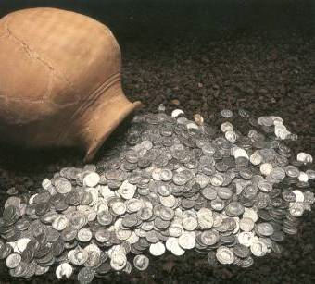
And the confrontation between these two self-interests, the poor who have the force of numbers and the rich that of silver, will be terrible if charity does not interpose, become a mediator, if Christians do not dominate with all the force of love.”

Slide 9
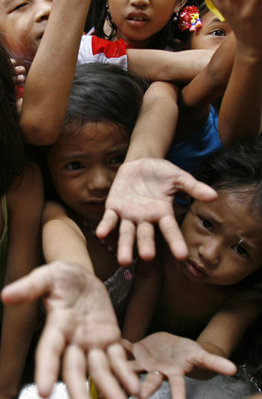
For if the question which today disturbs the world around us is neither an individual question nor a question of political forms, but a social question; if it is the struggle of those who have nothing with those who have too much

Slide 10
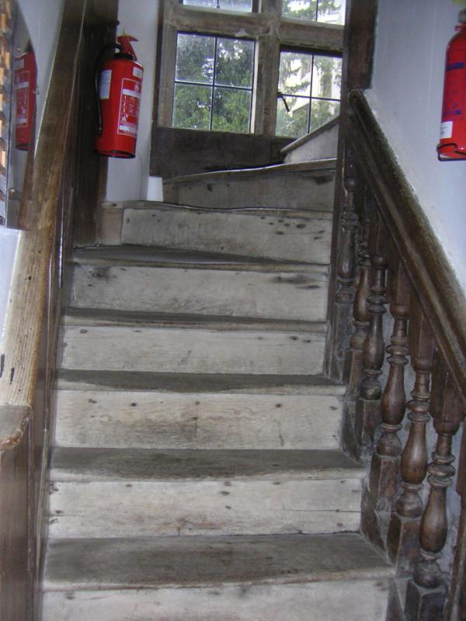
The knowledge of social well-being and of reform is to be learnt, not from books, nor from the public platform, but in climbing the stairs to the poor man’s garret, sitting by his bed-side, feeling the dame cold that pierces him, sharing the secret of his lonely heart and troubled mind. When the conditions of the poor have been examined … it is then and then only, that we know the elements of that formidable problem, that we begin to grasp it and may hope to solve it

Slide 11
“the public authorities of Paris have not discharged all their responsibility, when they have voted six million francs for the maintenance of unemployed workmen, which is the rate of three half-pence per head per day up to the month of the following April; and further that the time has not yet arrived to forget public starvation, simply because Winter and cholera are no longer there to remind us of them.”

Slide 12
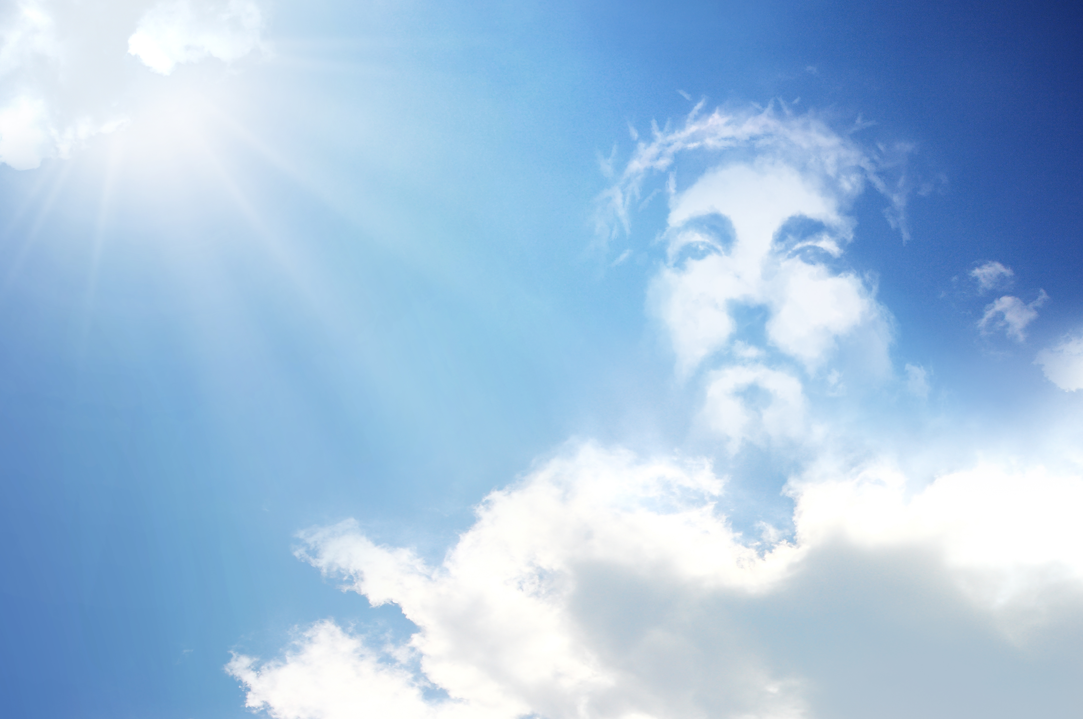
“We are not …socialists… in the sense that we do not want the overthrow of society, but we want a free, progressive, Christian reform of it …

Slide 13
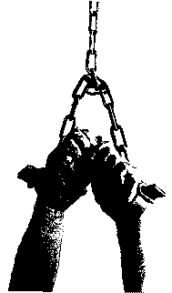
Exploitation occurs when the master considers his worker not as a partner nor even as an assistant, but as an instrument out of which he must extract as much service as possible at the smallest possible price. Yet the exploitation of a man by another man is slavery.

Slide 14
Both men and the poor we see with the eyes of the flesh; they are there and we can put our finger and hand in their wounds and the scars of the crown of thorns are visible on their foreheads; and at this point incredulity no longer has place and we should fall at their feet and say with the Apostle, Tu est Dominus et Deus meus. You are our masters, and we will be your servants. You are for us the sacred image of that God whom we do not see, and not knowing how to love Him otherwise shall we not love him in your persons?

Slide 15
The problem that divides men in our day is no longer a problem of political structure; it is a social problem; it has to do with what is preferred, the spirit of self-interest or the spirit of self-sacrifice, whether society will only be a great exploitation to the profit of the strongest or a consecration of each individual for the good of all and especially for the protection of the weak.

Slide 16
